Slide 1
Trace Replayer
Meeting: November 5, 2015

Slide 2
Agenda
Current Status of Dataseries System Call Replayer
Previous Replaying Issues
Current Replayer structure
Current Replaying Issues

Slide 3
Current Status

Slide 4
High-Level overview of our system call replayer
simple program
strace
strace trace file
preprocessor.o
our replayer
dataseries trace file
csv2ds.o
csv trace file, mapping file, and dataseries field table

Slide 5
pre-processor.o Work From Summer to Current
Added strace command to README which specifies how the trace file is generated. It captures read, write, close, and open system calls.
Added a simple program trace file.
Expanded the existing converter to convert strace trace file to csv trace file.
It captures all the open flags (ex. O_WRONLY, O_NOCTTY) and convert them to 0 or 1 in csv.
After conversion, csv includes following: time_called, return values, system call name, and syscall arguments.

Slide 6
strace to csv Example
strace:
1445365793.732528 open("sample-read-input.txt", O_RDONLY) = 3
csv:
1445365793.732528,3,open,"sample-read-input.txt",1,0,0,0,0,0,0,0,0,0,0,0,0,0,0,0,0,0

Slide 7
csv2ds Work From Summer to Current
Wrote the field mapping for basic system calls.
Created a script that runs pre-process and csv2ds programs to do the conversion.
Fixed a bug: changed the existing csv2ds program to do real parsing of csv instead of using split function.

Slide 8
Field Mapping Example
Common(time_called,return_value,errno);
open(given_pathname,flag_read_only,flag_write_only,flag_read_and_write,flag_append,flag_async,flag_create,flag_direct,flag_directory,flag_exclusive,flag_largefile,flag_no_access_time,flag_no_controlling_terminal,flag_no_follow,flag_no_blocking_mode,flag_no_delay,flag_synchronous,flag_truncate,flag_close_on_exec);

Slide 9
Previous Replaying Issues

Slide 10
Relayer Design Issues
DS Background Info:
an extent contains a collection of rows with the same fields and field-types
a DataSeries file is composed of an ordered sequence of records
A DataSeries record is analogous to a row in a conventional relational database.
A ExtentSeries is an iterator of same ExtentType records
Block Replayer Design:
It only has read and write operations.
Previous PhD implemented the converter to do following things:
Add 0 or 1 in a record to indicate this record is read or write.
Made the extent type to be read_write. So he treated all records to be same type
This approach makes sense because read and write have same number of arguments, and arguments have same type.
The replayer now can use TypeIndexModule to get an iterator that iterates all the extents of same type.

Slide 11
CSV to DS problem
Each system call has same number of arguments and type of arguments. Therefore, it makes much more sense to treat each system call as a unique extent type.
DS has ExtentSeries iterator that allows us to read all the records of same extent type.
Now, we are in trouble since we can only get records of one operation.
It turned that we can’t fix DataSeries to support this when I studied the DS file format.

Slide 12
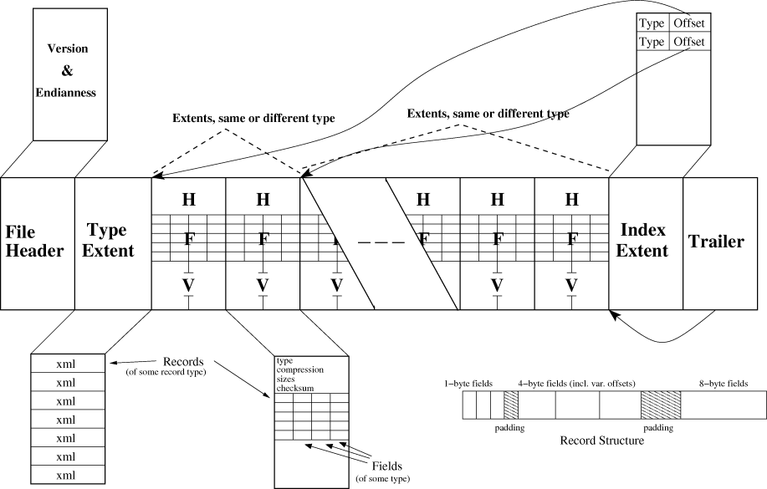
CSV to DS problem
DS groups records of same extent type (system call) into one chunk. Records of same extent type are right next to each other. Even we can read sequentially, records are not in the correct order. DS order ≠ csv order.

Slide 13
Two Solutions We Came Up With (#1)
1. Make all system calls to have same extent type. Fields in this extent type is the universal set of all system call arguments. Then the order of system call operations will be saved.
Advantages:
DS order = csv order.
Disadvantages:
A lot null values in the DS file and we have to append null values to CSV
Bigger DS and CSV file.
Hard to distinguish b/t a real NULL and a fake NULL

Slide 14
Two Solutions We Came Up With (#2)
2. Append an index to each row in a Extent. This tells us the order of an operation. One ExtentSeries for each system call. Replay them based on index.
Better is to replace time_called with index.
Advantages:
No need to change DS and converters.
Disadvantages:
Each system call must have time_called.

Slide 15
Our Replayer Implements the Second Solution
The our replayer still need to construct the order based on time_called from each ExtentSeries. This problem is very similar to merging K sorted lists into one sorted list. So I used a min-heap to solve this problem.
Each system call operation has a class right now. The class has fields of arguments and ExtentSeries. It also contains function that replays corresponding system call.
Adding new system calls to our replayer is simple. Just create its corresponding class.
Alternative: <ET=read,<one read syscall args>>,<ET=write,<one write syscall>>,<ET=read,<one read syscall args>>,...

Slide 16
Current Replayer Structure

Slide 17
Current Structure
Base class: SystemCallTraceReplayModule
Extend it to implement additional system calls and put replaying part inside processRow() function.
ex. OpenSystemCallTraceReplayModule
Once constructed an instance of a system call class, put in it a priority queue and system calls will be replayed.

Slide 18
Current Drawbacks
Replayer assumes that all files in trace exist.
E.g. Trace: read(fd, …..). What if the file being read was opened before the trace started?
What if a file is closed, and later a new file is opened, but fd is reused?
We may want to write some actual data based on user’s choice (for deduplication and compression).
Need support for operations like lseek(), etc.
What if size of file in trace is bigger than space available on device?

Slide 19
How Our Replayer Replays Write and Read
Read uses arguments from DS trace file to execute.
ex:
1445365793.732559, 56, 3, "Welcome to FSL.\nHope you make a lot of friends in here.\n", 4096
Read(3, our own buffer pointer, 4096)
Similar thing applies to write.
No check to see whether fd 3 is valid or the file exists.
No modification of write data.
Basically, current replayer assumes we have all the arguments.

Slide 20
System Call Replayer Work
Wrote a makefile.
Implemented a replayer that is able to replay basic 4 operations, read, write, open, and close.
It can take several input files, not just one.
Added several new options (modes) to the replayer program:
--version, -V: to display a version number
--verbose, -v: verbose mode.
--help, h: produce help message
--verify: verify data read by replayed read and trace read
--return: compare return values from replayed operations and captured by strace.

Slide 21
Current Replaying Issues

Slide 22
Potential Solutions: Missing files
Have a setup step which scans through all the system calls in-order and creates a list of files that are accessed but not created in the system call trace.
Should be able to specify where each file is stored, so maybe a file to location mapping is required.
Maybe allow user to specify a directory where we create all files?
What if accessed files in trace are across many directories? (maybe add support later?)
Warn and ignore these files.
Return error to user

Slide 23
Potential Solutions: Write Data
Allow user to specify type of workload (easier to do for deduplication than compression)
Using type, decide what data to generate.
Deduplication can use duplicate ratio and use random number generators to generate random data.
Need to explore what kind of data we need for compression workloads.
Default: write zeros

Slide 24
Questions
How do we generate random data? (Will the Filebench method work?)
/dev/urandom
How does repeated pattern for write data look like?
--pattern 0x0
--pattern 0xa7f8
use memset()
--pattern random
Strace actually allows us to captures error symbol and error string. What should we do with it? Ignore them? Include them in DS?
Ignore error string, but capture errno - compare errno in a mode.

Slide 25
Next Week Work
Add another mode that warn user if return values are different, instead of abort.
Add another mode to warn user if read data is different.
Expand Write to write zeros if no data was captured.
Add a mode to generate random data

Slide 26
Trace Replayer
November 12, 2015

Slide 27
Agenda
This Week Work
Summary
Next Week Work

Slide 28
Write pattern data
Allow user to specify --pattern or -p option
Get the value as a string and pass it write class. ex: 0x5
Replayer parses it hex value (int).
Replayer uses memset(buffer, int, size). ex: memset(buffer, 0x5, size)
Note: replayer allocates and destroies a new buffer every time a write is about to replay.
Default: write data in DS

Slide 29
Write random data
Achieved by using pattern option. User just have to specify --pattern random or -p random
Get the value as a string and pass it write class. ex: 0x5
Check if the value is “random”, if it is, then it is random option.
Open /dev/urandom
Read data from urandom into a buffer and use this buffer instead of data in DS.
Note: also does allocates and destroies a new buffer every time a write is about to replay. Also, it keeps urandom open until program exits

Slide 30
Write zeros data
User just have to specify --pattern 0x0 or -p 0x0
Same approach in the Write Pattern slide.
Replayer will write zeros if no pattern is given and no write data was captured.

Slide 31
Question
Instead of open2 and open3, can we make values null for open that has only two arguments?
Print warning messages in stderr or stdout?
Abort for all system calls or for specific system calls?
Print warning messages to a file? (add option for that?)

Slide 32
Summary
Allow user to write random, pattern, and zeros data.
Expanded Write to write zeros if no data was captured and no pattern option.

Slide 33
Next Week Work
Handle Open system call with three parameters: currently we only handle two parameters.

Slide 34
Trace Replayer
November 19, 2015

Slide 35
Agenda
Performance Results for different techniques

Slide 36
Performance Results
Cases:
Malloc and free every time for each write
Malloc and free once at every constructor and destructor
Assumptions:
i) block size = 4096 bytes
ii) Took 5 iterations for each cases and average results are shown
iii) For random case, there is a bug and we are working on it

Slide 37
Malloc and free every time - 1000 iterations (top), malloc/free once (bottom)
 | Real (s) | User (s) | Sys (s)
zeros | 0.140 | 0.058 | 0.032
pattern | 0.151 | 0.064 | 0.033
random
 | Real (s) | User (s) | Sys (s)
zeros | 0.158 | 0.107 | 0.049
pattern | 0.152 | 0.104 | 0.045
random

Slide 38
2. Malloc and free every time - 10,000 iterations (top), malloc/free once (bottom)
 | Real (s) | User (s) | Sys (s)
zeros | 1.367 | 0.506 | 0.309
pattern | 1.571 | 0.616 | 0.341
random
 | Real (s) | User (s) | Sys (s)
zeros | 1.605 | 0.714 | 0.343
pattern | 0.984 | 0.664 | 0.310
random

Slide 39
Trace Replayer
February 04, 2016

Slide 40
Agenda
Winter Work Status
Random Benchmarks
PRead Implementation Update
Strace2CSV Update

Slide 41
12/23/2015 Update
Work
Add a function that breaks mode argument into a SNIA format: mode_R_user, mode_W_user, mode_X_user, ...
Modify the trace conversion process so that all open system calls have mode_R_user, mode_W_user, mode_X_user and other fields.
Therefore, open with two arguments will have 0s for those fields.
open with three arguments will set appropriate mode field to 1s.
Test the feature with open strace that has three arguments.

Slide 42
12/23/2015 Update
Summary
Expand converter to handle open system call with three arguments. Now our replayer is able to convert open with three or two system call arguments.
Plan for next week
Expand replayer to replay open system call with three arguments.

Slide 43
12/31/2015 Update
Work
Add a function to OpenSystemCallModule that reconstructs mode argument from mode fields (ex. mode_R_user) in DS.
Modify replayer to always execute open system call with three arguments.
Note: mode will be ignored if O_CREAT or O_TMPFILE flags are not set.
Test the replayer to make sure that it does create a file if O_CREAT is given.

Slide 44
12/31/2015 Update
Summary
Now, our system is able to convert and replay open system calls with either two or three arguments. (It can replay creating a file now)
Plan for next week
Break the replayer down into a few components in a logical manner

Slide 45
1/7/2016 Update
Work
Break old replayer into modules manner.
Each module has its own header and source files.
Adding a new system call to our replayer requires implementing a module.
SystemCallTraceReplayModule is served as the basic system call replay module.
write, open, close, and read have their own module that extends SystemCallTraceReplayModule.

Slide 46
1/7/2016 Update - Work continued
Write instructions of how to using each module and functions. Functions are well documented.
Write instructions of how to implementing a specific system call in SystemCallTraceReplay module.
Fix Makefile to build those modules.
Test the new structure to make sure everything works same as the old one.
Moved old replayer into a directory.
Summary
Break replayer into modules. This breakdown makes replayer easy to expand, cleaner, easy to use, etc.

Slide 47
1/7/2016 Update - Plan for next week
Plan
Work on replaying lseek system call.

Slide 48
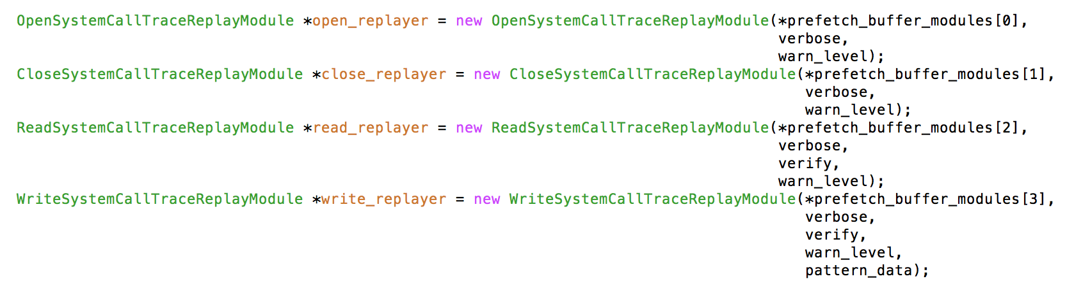
1/14/2015 Update
Work
Trying to do it in a loop fashion, but it’s complicated. Therefore, I didn’t make any changes.

Slide 49
1/14/2016 Update - Work continued
Change the usage of strace.sh script - switch input and output options.
Expand pre-processor to convert lseek strace to DataSeries and comments are added to explain the code.
Fix some verbose messages
Refactor main function - take out process options code and put it in a new function. The new function is documented.
Implement LSeekSystemCallTraceReplayModule (Comments and descriptions are included in the module to explain things).
Expand Makefile to build lseek module
Summary
Expand our system to replay and convert lseek, and clean the code.

Slide 50
1/14/2016 Update - Plan for next week
Move system call converter out of the block-converter.
Document the converter and refactor it if necessary.

Slide 51
01/20/2016 Update - Random Benchmarks
Different methods to generate random numbers: 1. Using standard PRNG - Mersenne Twister engine to generate 64-bit random numbers. The buffer is filled in blocks of 8 bytes with each time a newly generated random number.
2. Using rand()- In this approach, a 32-bit number is generated and then performed bit-manipulation to generate 64-bit number. The buffer is filled in blocks of 8 bytes with each time a newly generated random number.
3. Using rand()- In this approach, a 32-bit number is generated and then buffer is filled in blocks of 4 bytes.

Slide 52
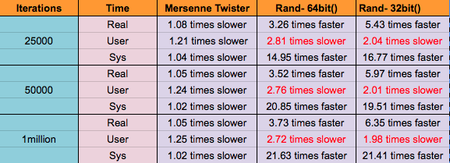
Random benchmarks results
With respect to /dev/urandom, the performance results are as follows:

Slide 53
Trace Replayer Random Pattern
The absolute time for filling a buffer with random data using rand() is faster.
Hence, we are using rand() as default method to fill buffer instead of /dev/urandom.

Slide 54
01/28/2016 Update - PRead System Call
PRead System Class is a class/module that has members and functions of replaying PRead System Call.
pread(fd, buffer, nbytes, offset);
It is extended from ReadSystemCallTraceReplayerModule class
class PReadSystemCallTraceReplayModule : public ReadSystemCallTraceReplayModule {
private:
/* PRead System Call Trace Fields in Dataseries file */
Int64Field offset_;

Slide 55
PRead System Call Module Implementation
Implemented PRead System Call as a subclass of Read System Call.
Modified Makefile to build PReadSystemCallReplayer Module.
Expand SystemCallReplayer main class to replay pread module.
Updated README for capturing strace for pread system call trace.
For converter part, expanded pread in strace.spec file.

Slide 56
Questions:
When the main syscall being replayed fails, you only perror() and we ignore the error. Is that correct? Should we have a mode that does not ignore errors, but rather aborts the replay?
To verify if pread() returned the same status as in the trace, you use memcmp. Why can’t we just compare directly — “if ((int)val == ret)”?
Verbose mode documentation.
How to test pread module? each system call has one program that generates that particular system calls or one large program that has all kinds of system calls.

Slide 57
Strace2CSV
Intro
strace to CSV conversion code is in pre-processor.
pre-processor has codes that convert block, strace, nfs, etc.
It is reaching 700+ lines of code.
Functions are not documented. Therefore, it requires people to read the code to understand the function.
Therefore, we need to move our strace2csv converter code out of this program. This makes things easy to manage, extend, understand, etc.

Slide 58
Strace2CSV Work
Work
Create a directory that contains strace converter.
pre-processor.cpp is divided into strace2csv.cpp and strace2csv-util.cpp
Main function is in strace2csv.cpp.
strace2csv.cpp is documented and coding style is fixed.
All utility functions are written in strace2csv-util.cpp file.
All functions and codes are well documented.
Some functions are refactored to make code better.
Minor fixes while refactoring the code (error message, remove duplicate code, etc)
Going to email the patch.

Slide 59
Strace2CSV - Space After Comma Issue
Issue Intro
strace generates traces like this - read(3, “hello”, 6) = 3
Originally, our pre-processer (now it is strace2csv) takes out parenthesis and simply print arguments to the output file.
Since our CSV library doesn’t ignore spaces after commas, this will cause some troubles (fields will be ‘3| hello| 6’ instead of ‘3|hello|6).
Therefore, we have to handle this problem.

Slide 60
Strace2CSV - Space After Comma Attempts
Attempts
Original solution: remove starting and ending spaces for each field - Fail if read(3, “ hello”,7)
Find a CSV library that ignores spaces between fields - Tried, but most libraries require us to download the source code from github and directly parse a CSV file instead of a string. It requires us to test every library to make sure it does ignore spaces. Not really good solution.
Remove spaces after comma manually in pre-processor (strace2csv) - Choose this

Slide 61
Strace2CSV - Space After Comma Solution
Solution - Remove spaces after commas
Add a function to strace2csv program that removes spaces after each comma. It takes care of edge cases - comma inside double quotes, comma inside of double quotes within double quotes, multiple spaces instead of single space, etc.
Test the function with a few cases and a strace file.
Call the function after taking out parenthesis.
Now, the problem is solved.

Slide 62
2/4/2016 Update - Plan for next week
Plan
Continue the same refactoring process for csv2ds.
Work on new system call - stat(), truncate()

Slide 63
Trace Replayer
February 15, 2016

Slide 64
Agenda
Last Week Todos
Truncate System Call

Slide 65
Last Week Todos
Work
Decide not to remove header files. Best practice to split class into a header and an implementation files in C++. However, we can combine pread and read into one source file.
Use existing modes to check replayed result instead of adding a new one.
Allow users to put comments in spec string.
open("/foo/bar", O_RDONLY) = -1 ENOENT (No such file or directory)
We can only capture errno symbol, but not errno.

Slide 66
Last Week Todos
Errno Solutions
We can convert replayed errno num to errno symbol, but this will slow down the replaying.
We can convert errno symbol to errno num and store it in DS. - Choose this
Errno symbol to errno num design
Build a hash table that does the lookup.
Add if statements to find the num.
Find a way to convert string to Macro? Google it, but seems not possible.
Do we need errno string?

Slide 67
Truncate System Call
Add spec string for truncate.
Implement truncate module.
Expand replayer to replay truncate.
Modify Makefile to build the new module.
Add a mini program to generate truncate system call traces for testing purpose.
Questions
Should we add a script that runs the test?

Slide 68
Plan for next week
Capture errno num in DS, possibly also errno string?
Expand replayer to support unlink?

Slide 69
Trace Replayer
February 22, 2016

Slide 70
Agenda
PRead System Call Update
Stat System Call Implementation
Test programs
Questions
Last week todo
Unlink System Call
Plan for next week

Slide 71
PRead System Call Update
Removed header file for PRead System Call.
Defined class for PRead System Call in Read System Call header file
Separate source file for PRead System Call.

Slide 72
Stat System Call - I
Replayer Part ->
Added new Stat System Call as subclass of SystemCallTraceReplayModule class
StatSystemCallTraceReplayModule::StatSystemCallTraceReplayModule(DataSeriesModule &source, bool verbose_flag, int warn_level_flag):
SystemCallTraceReplayModule(source, verbose_flag, warn_level_flag),
given_pathname(series, "given_pathname") {
sys_call_ = "stat";
}
Expanded replayer to replay stat system call.
Modified Makefile to build new module.
Updated README on how to take strace for stat system call.

Slide 73
Stat System Call - II
Converter Part ->
Added spec string for stat system call
stat(given_pathname);
Expanded syscall-converter and added new function process_stat_args() to convert strace stat system call to DataSeries.
bool process_stat_args(std::string &sys_call_csv_args);

Slide 74
Test Programs
Added test program for pread and stat system call.
Tested for success and failure conditions
In case of failure conditions -
If actual system call fails, our replayer returns the same output showing failure of system call
However, replayer is executed successfully.

Slide 75
Questions
strace for stat system call captures
1456109894.405792 stat("InputFileName.txt", {st_mode=S_IFREG|0664, st_size=1532, ...}) = 0
Second argument of strace represents the struct stat.
Currently, in our replayer new stat structure is passed.
Should we capture the arguments of struct stat and pass this structure to our replayer ??

Slide 76
Last Week Todos
Work
Create a routine that does simple lookup for errno
Have some difficulties of storing errno in Dataseries
The spec mapping maps values to fields in DS
spec mapping: Common(time_called,errno_number,return_value);
Errno may be not be existed

Slide 77
Unlink System Call
Converter
Add spec string for unlink.
Replayer
Implement unlink module.
Expand replayer to replay unlink.
Modify Makefile to build the new module.
Add a mini program to generate unlink system call traces for testing purpose.

Slide 78
Plan for next week
new system calls? - symlink and chdir
Store errno

Slide 79
Trace Replayer
February 29, 2016

Slide 80
Agenda
No null-character string bug
Store errno in DS
Chdir and Symlink System Call
LStat System Call Update
Mkdir System Call Implementation
Test programs
Questions

Slide 81
No null-character string bug
Originally, to get string field from DataSeries, we used DS API .val() function in replayer.
We were getting correct string before.
The bug was triggered when I wrote a test program to open a file that has four-char long name - “test”.
Replayer reported error - “test#: No such file”
Bug is either in converter or replayer.
Use print statements to print the file name value in strace2csv and csv2ds, and values are correct.
It was incorrect in replayer.

Slide 82
No null-character string bug
Dig more into converter code.
csv2ds used FieldSpace.cpp to set field values in DS.
Essentially, FieldSpace.cpp used following function:
Using .val() for getting double and int are good.
But we have to use stringval() to get C++ string.
Then use .c_str() to get char * string.
Also need to create another const char * for buffers that take const char*
The problem was fixed for all modules that use .val() to get string value.

Slide 83
Store errno in DS
Sometimes we have errno in strace, and sometimes we don’t
This depends on the program that makes the system call.
Spec string does the field mapping.
Having an errno field in spec string and no errno in strace causes the converter to report error(the number of fields in spec string doesn't match the number of fields in strace). This could even result wrong field mapping.
Ex: spec string: Common(time_called,errno_num,return_value);
trace: 13333.3,0
Note: the trace doesn't have an errno_num, but our converter expects an errno. Converter maps time_called -> 13333.3 and errno_num -> 0. This is not what we wanted.

Slide 84
Store errno in DS - Solution
DataSeries allows null field.
Somehow we need to let converter know that errno_num should be null if it doesn't exist.
Change the design converter, but it would require a lot of work.
Keep current design, and add an invalid errno (0) in DS if no errno is in trace. - Choose this and implemented this.
Now, our converter stores errno in DS, but errno is not currently used in replayer.

Slide 85
Chdir and Symlink System Call
Converter
Add spec string for chdir and symlink.
Replayer
Implement symlink and chdir module.
Expand replayer to replay chdir and symlink.
Modify Makefile to build these two modules.
Add two mini program to generate symlink and chdir system call traces for testing purpose.

Slide 86
LStat System Call
Replayer Part ->
Added new LStat System Call as subclass of StatSystemCallTraceReplayModule class
LStatSystemCallTraceReplayModule::StatSystemCallTraceReplayModule(DataSeriesModule &source, bool verbose_flag, int warn_level_flag):
StatSystemCallTraceReplayModule(source, verbose_flag, warn_level_flag) {
sys_call_ = "lstat";
}
Expanded replayer to replay lstat system call.
Source file for lstat is same as stat system call.
Updated README on how to take strace for lstat system call.
Converter Part ->
Added spec string for lstat system call

Slide 87
Mkdir System Call Implementation - |
Replayer Part ->
Added new Mkdir System Call as subclass of SystemCallTraceReplayModule class
MkdirSystemCallTraceReplayModule::StatSystemCallTraceReplayModule(DataSeriesModule &source, bool verbose_flag, int warn_level_flag):
SystemCallTraceReplayModule(source, verbose_flag, warn_level_flag),
given_pathname(series, "given_pathname") ,
mode_R_user(series, "mode_R_user"), …… ,
mode_X_others(series, "mode_X_others"){
sys_call_ = "stat";
}
Expanded replayer to replay mkdir system call.
Modified Makefile to build new module.
Updated README on how to take strace for mkdir system call.

Slide 88
Mkdir System Call - II
Converter Part ->
Added spec string for mkdir system call
mkdir(given_pathname,mode_R_user,mode_W_user,mode_X_user,mode_R_group,mode_W_group,mode_X_group,mode_R_others,mode_W_others,mode_X_others);
Expanded syscall-converter and added new function process_mkdir_args() to convert strace stat system call to DataSeries.
bool process_mkdir_args(std::string &sys_call_csv_args);
Utilized process_open_mode() to extract individual mode and storing them in a vector.

Slide 89
Questions
We have many system calls that takes ‘mode’ as an argument. For ex: open, mkdir, create, etc. For all these system calls,
In replayer part, we have to find what modes are currently set in replaying current system call that Extent Series is pointing.
In convert part, we have to process modes individually to store in CSV format.
For example: 777 is stored as 1,1,1,1,1,1,1,1,1
Should we make a common function that should be inherited by system call class that requires mode as argument?

Slide 90
Questions
Tried to use function pointer to get rid of some modules, but failed.
Do we really need to eliminate modules?
Current modes: default, warn, abort: should we use existing modes to use errno? or another mode?

Slide 91
Plan for next week.
Implement access, rmdir, create, and link.
Modify existing modules to use errno.
add all tests/regressions in to “tests” folder
fix csv2ds FieldSpace.cpp, new “set” function to store a null-terminated string in during conversion, to simplify replayer code (and void the NULL bug)
add code to verify stat() buf contents, only key fields.

Slide 92
Trace Replayer
March 7, 2016

Slide 93
Agenda
Replayer Mode
Access system call
Test script
Last record in strace

Slide 94
Replayer mode
Added four functions in the base replayer to check modes: verbose_mode(), default_mode(), warn_mode(), and abort_mode()
Replaced if statements with those functions.
In processRow(), we check if user is in verbose mode and print out its fields.
Since this printing fields is in every module, I removed those printing messages in all modules.

Slide 95
Replayer mode - Continued
Added print_sys_call_fields() that calls functions print_common_fields and print_specific_fields
Added a common function (print_common_fields) in the base module to print common fields
Added an abstract function (print_specific_fields() )to let the child module (ex. Open, read) to print out its own specific fields
Implement print_specific_fields() for existing modules (ex. Read, write, …).
All of these make code cleaner and easier to read.

Slide 96
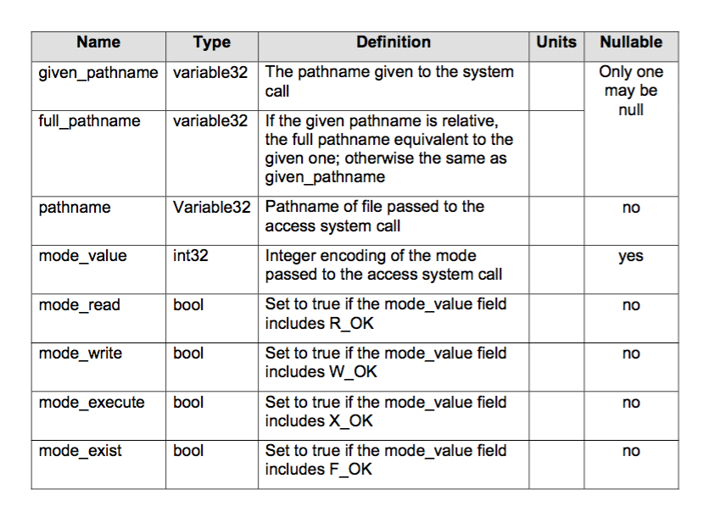
Mistake in SNIA document for Access sys call
given_pathname is already there.
No need for pathname field. pathname is redundant.
So our DS will not follow this for access only.

Slide 97
Support replaying access
Add spec string for access.
Implement access module.
Expand replayer to replay access.
Modify Makefile to build the new module.
Open script is in progress, once that is done. We can simply follow that script.

Slide 98
Test script for open
The script does following things:
Enter test directory and execute make to make sure test program is up-to-date
Create a tmp file (test program will open this tmp file) and run strace with test program.
Now we have open strace trace file.
Enter sys call converter directory and runs strace2ds.sh script to do the conversion
Now DS file is ready for replaying.
Enter sys call replayer directory and runs replayer with the given DS.
Problems:
How do we actually check test passes or fails?
Should we always make before executing a program in the script?
How do we remove irrelevant records in strace? - detail in next slide.

Slide 99
How do we remove irrelevant records in strace?
When we capture open sys call in strace, there are some irrelevant records.
Those records are generated by dynamic loader since some libraries are dynamically loaded into the test program.
Currently, we manually remove those records and then run converter.
How do we actually remove in the script?

Slide 100
Remove irrelevant records in strace - Solutions
We don’t consider those as irrelevant, just replay them.
Generate strace from the test program and manually remove those records. Save them in a directory.
Static, not flexible.
Remove X number of records in the script before doing any conversion.
Static, different OS may gives us different number of irrelevant records.

Slide 101
Remove irrelevant records - Discussion
Find out why this extra open() entry is added
Where is the extra open() entry? Opening tmp file is what our test program does.
Check also exit(3)
Why do we need to check
a program/script to generate an strace file and capture it in raw form. Call this, say. FILE.raw (find a better name please). We don’t run this script all the time; only when needed. - I don’t understand.

Slide 102
Last record in strace
Strace always generate “time_called +++ exited with 111 +++” at the end of strace trace file even if we only capture open sys call.
This caused some trouble in strace2csv conversion.
Before, we have to manually remove the last record before doing the conversion.
Without removing it, last valid sys call will be printed out twice in CSV file.
Therefore, there are two things we need to fix in strace2csv.

Slide 103
Last record in strace - solution
Since valid sys call follows this format: open("/foo/bar", O_RDONLY) = -1 ENOENT (No such file or directory)
Let strace2csv tries to parse the last record.
Since “ = ” can’t be found in “+++ exited with num +++”, strace2csv will report error.
Before reporting error, we add an if statement to see if “+++ exited with ” can be found in the record.
If it can be found, set out_row to be “”. Then strace2csv will write nothing to CSV.

Slide 104
Trace Replayer
March 17, 2016

Slide 105
Agenda
Last record in strace - better solution
Checking errno feature
after_sys_call function
Verify stat system call
Parsing struct stat

Slide 106
Last record in strace - better solution
As we discussed in the email, the old solution is ugly.
Instead of using check to see if the record contains “+++ exited with ” substring, we used regular expression to check to see if it is really the last record that we want to remove.
The expression: “.*+++ exited with .* +++$”
“.*” at the beginning is used to match time_called.

Slide 107
Checking Errno Feature
Added errno_number_ field to the base module since all modules have it.
Currently, our replayer always execute compare_retval() after replaying a sys call in processRow().
Since we need to compare errno when both replayed and actual return value are -1, instead of adding a new function to compare errno, I changed function compare_retval() to be compare_retval_and_errno().
Removed checking replayed return value in processRow() [if (ret == -1)]

Slide 108
after_sys_call() function
compare_errno_and_retval() and printing verbose messages are called in all modules’ processRow() function.
This is cumbersome if we modify something (ex. Name of the function) and shared among modules.
Since these two things are done after replaying a sys call, I added after_sys_call() function after calling processRow() in execute().

Slide 109
Verify stat system call
REPLAYER PART:
Strace capture for stat system call
1456755199.727021 stat("InputFileName", {st_mode=S_IFREG|0664, st_size=1794, ...}) = 0
In strace, only two fields of strace are captured - st_mode and st_size.
Added ‘verify’ mode to match the replayed and captured return values.
Added code to verify struct buf contents for two fields - st_mode and st_size.

Slide 110
Parsing struct stat -I
CONVERTER CODE
Added process_stat_args() function.
It process arguments from strace to CSV format for stat system call.
Example: stat(given_pathname, stat_result_mode, stat_result_size) to "README",33432,1794
Added get_stat_fields() function.
This function extracts the values of different fields of struct stat buffer and combine them into a vector.
Example: {st_mode=S_IFREG|0664, st_size=1794, ...}
Extracts st_mode as 33432 and st_size as 1794.

Slide 111
Parsing struct stat -II
Added process_stat_mode() function
This function split the file_type and file_mode bits.
Example : st_mode=S_IFREG|0664
File_type = S_IFREG, File_Mode = 0664
Returns the bitwise OR value of file_type and file_mode.

Slide 112
Questions
Should we have setters and getters for fields in the module? Or we access them directly?
Often times, I came acrossed performance vs. cleaner code. Calling a function may slow down replayer, but makes code easier to read. Which factor should we favor?
How to extract st_mode value?
Example: 0100000 | 0664 = 33204 and 0100000 | 664 = 33432.
Converting ‘0664’ as string to integer returns 664.
So we are getting wrong results.
Should i write a new function to handle this?

Slide 113
Trace Replayer
March 28, 2016

Slide 114
Agenda
Testing
New system calls
Stat system call
Mkdir system call

Slide 115
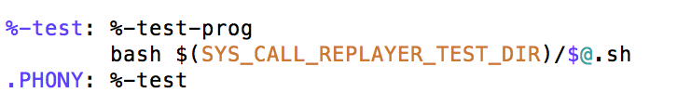
Testing
Put test programs in test directory.
Currently, only read, write, open, close, access, link, rmdir, and creat in it.
Create a Makefile to make those programs.
Add rules in the Makefile to execute test scripts
Add a rule in replayer Makefile to call the test rule in test directory Makefile
test: $(TARGETS)
$(MAKE) -C $(SYS_CALL_REPLAYER_TEST_DIR) test
.PHONY: test

Slide 116
Testing - Continued
The test script for general sys call is done.
Adding a test script for a sys call is very simple. - copy test script and modify a few variables in the script.
Maybe view the script code to see if it needs to be modified?
Questions:
Script content is most likely going to be same. Is it possible to share the content?

Slide 117
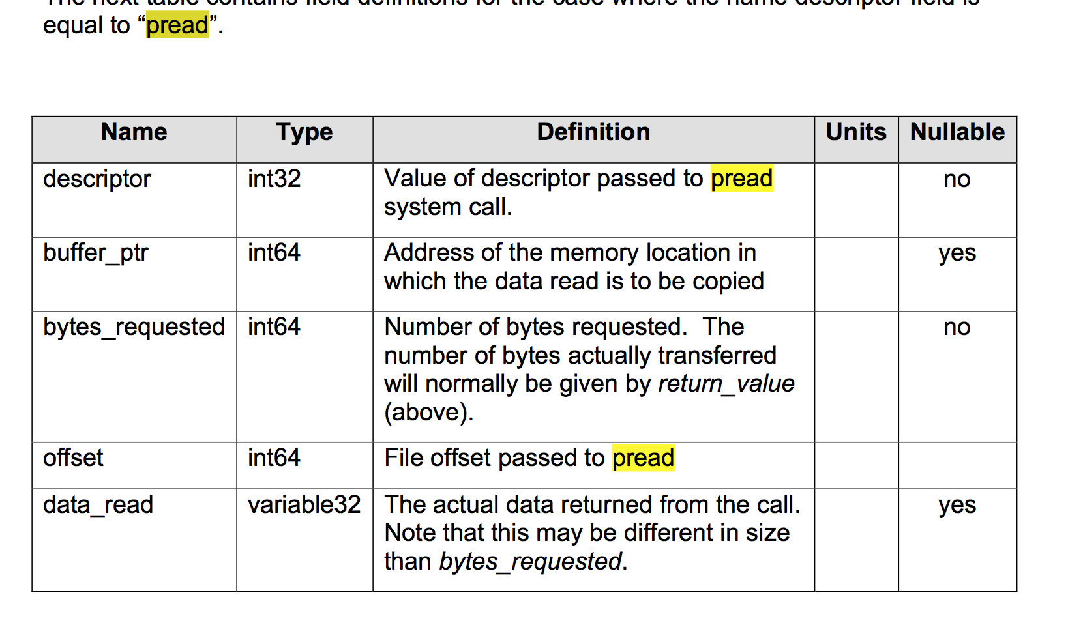
SNIA doc - pread and pwrite
Nullable for offset is unknown
Should we assume NOT nullable?

Slide 118
Link, and Rmdir System Calls
Converter
Add spec string for link and rmdir.
Replayer
Implement link and rmdir module.
Expand replayer to replay link and rmdir.
Modify Makefile to build these two modules.
Add two mini program to generate link and rmdir system call traces for testing purpose.

Slide 119
Stat System Call - I
REPLAYER PART:
Modified stat system to add more fields to capture different fields of struct stat buffer.
Modified ‘verify’ mode to match the replayed and captured return values.
Our replayer matches only the key fields of struct stat
st_ino, st_mode, st_nlink, st_uid, st_gid, st_siz, st_blksize, st_blocks
Updated stat system call to add print_specific_fileds() function.

Slide 120
Stat System Call - ||
CONVERTER PART:
Modified get_stat_fields() function:
The function is modified to extracts the values of different fields of struct stat buffer and combine them into a vector.
Example: {st_ino=145210, st_mode=S_IFREG|0664, st_nlink=1, st_uid=1000, st_gid=1000, st_blksize=4096, st_b locks=8, st_size=1367} is converted to "README",145210,33204,1,1000,1000,4096,8,1367

Slide 121
Mkdir System Call
REPLAYER CODE:
Removed the code for process_mode() function since we are using the mode_value field directly.
Use: mkdir(given_pathname,mode_value);
Instead of: mkdir(given_pathname,mode_R_user,mode_W_user,mode_X_user,mode_R_group,mode_W_group,mode_X_group,mode_R_others,mode_W_others,mode_X_others)
Modified code to add print_specific_fields() function.
CONVERTER CODE:
Removed process_mkdir_args() function as there is no need to process mode value explicitly.

Slide 122
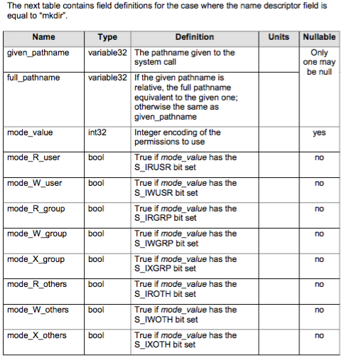
Mkdir in SNIA Document
There is missing ‘mode_X_user’ field in SNIA document for mkdir system call.
Is it intentional or do we need to correct this?
If it is correct, how to handle if S_IXUSR bit is set?

Slide 123
Plan for next week.
Shubhi: implement system calls readv and writev
Check all system calls to make sure use value directly, instead of composing the value (ex. Mode_value, flag, etc)
Verify commands in testing script - cd, strace, etc
Generalize testing script
Test the replayer in trex machine

Slide 124
Trace Replayer
April 4, 2016

Slide 125
Agenda
Last week discussions
Check existing modules to use values directly
Testing - script
Testing - Makefile
Stat system call updates
Mkdir system call updates
Add sticky mode values
Readv and writev system call

Slide 126
Checking existing modules to use values directly.
Checked current existing system calls to make sure that modules use value directly, rather than composing the value from individual fields. (ex. mode_value, flag, etc).
In open module, it has mode and flag fields, but no individual field. This is okay since we don’t need those fields for our module.
If someone wants to extract individual field, they will have to modify the module.

Slide 127
Built sys call replayer on trex machine
After installing boost and aio libraries, the replayer was built without any error.
DataSeries was also installed without any problem.
Instructions of how to build our replayer is included in the email.

Slide 128
Testing - Script
Added if statements to make sure commands are executed successfully
Changed variables in testing script to take first argument as the name of system call instead of providing static values
Some test programs take two files as its arguments (unlink, link, etc), but some take one file (open, close, etc).
Therefore, to make the test script work for both cases, test script creates two temporary files now, instead of one. Note: all test programs receive two files, but one-file program only uses the first file. (Maybe a better way to fix this?)
Made testing script to take second argument as the mode value of replaying

Slide 129
Testing - Makefile
Added two rules in Makefile for testing replayer in two modes: test-default and test-abort
Warn mode is ignored because we can’t predict the warning messages.
Some test programs take two files as its arguments (unlink, link, etc), but some take one file (open, close, etc).
Current:
test-default: test-messages $(TARGETS)
bash $(SYS_CALL_REPLAYER_TEST_DIR)/system-call-test.sh open
Maybe?:
%-test: %-test-prog
bash $(SYS_CALL_REPLAYER_TEST_DIR)/system-call-test.sh %

Slide 130
Stat System Call Update - I
CONVERTER PART:
Capture all fields of struct stat.
Modified converter to code capture all fields of struct stat buffer.
Added split_stat_args() function in the converter to split the stat arguments.
System call arguments in strace are in format:
"Filename",{st_dev=makedev(252,0),st_ino=145210,st_mode=S_IFREG|0664,st_nlink=1,...}
It returns a vector having tokenized sys call arguments.
"Filename"
st_dev=makedev(252,0) and so on
Last three fields of stat buffer are st_atime, st_mtime and st_ctime.
These are in the format: 2016/03/21-10:38:04
DataSeries store time in Tfracs.
Question: How to deal with time specific fields?

Slide 131
Stat System Call Update - II
REPLAYER PART:
Added print_mode_value() function
This function is called only in verbose and verify mode
It takes the st_mode value as an argument and prints the mode in more readable format.
Example:
0664: -rw-rw-r--

Slide 132
Mkdir System Call Update
CONVERTER PART:
Added process_mkdir_args() function to process individual mode bits explicitly.
Use format : mkdir(given_pathname,mode_R_user,mode_W_user,mode_X_user,mode_R_group,mode_W_group,mode_X_group,mode_R_others,mode_W_others,mode_X_others)
As individual mode bits are set as nullable = ‘no’ in SNIA document.

Slide 133
Add sticky mode values
Replayer:
Since replayer uses mode_value directly, it already uses sticky bits if the trace records do have sticky bits in the mode value. Also, our replayer doesn’t use individual mode value. Therefore, no modification is needed for replayer part.
Converter:
Modified table (it specifies the structure of DataSeries file) to hold set-user-id, sticky bit, and set-group-id.
Only open and creat are modified. We need to modify all system calls that have mode value argument.

Slide 134
Add sticky mode values - Continued
Converter:
open mode_S_user 0 bool
open mode_S_group 0 bool
open mode_S_sticky 0 bool
Fixed open and creat spec strings to map those bits.
mode_S_user,mode_S_group,mode_S_sticky
Fixing other system calls are required, ex. stat

Slide 135
Readv and Writev System Call - I
Replayer Part ->
Added new Readv System Call and Writev System Call as subclass of SystemCallTraceReplayModule class
Expanded replayer to replay readv system call.
Updated README on how to take strace for readv system call.
Expanded Makefile to build new modules.

Slide 136
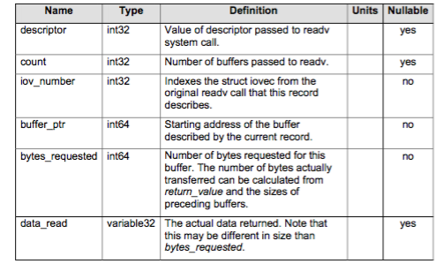
Readv and Writev System Call - II
Questions:
Strace for readv system call:
1459772343.142351 readv(3, [{"This", 4},
{"is our", 6}, {"system call", 11}, {"trace replayer", 14}], 4) = 45
Readv system call has format:
ssize_t readv(int fd, const struct iovec *iov,
int iovcnt);
In SNIA document
Buffer_ptr field is set as nullable = ‘no’
How to capture the address of the buffer?
Similar issue faced for writev system call.

Slide 137
Plans for next week
Shubhi: Implement system calls readlink and utimes
Make sure SNIA document has composed values and those fields are consistent.
Add not extracting values in README
How to test system calls that have multiple values - mode
Add warn mode for Makefile
Pass open-test to the script and the script will truncate the string: echo $1 | cut -d- -f2
What is Tfrac? Is it in seconds or not? /* DataSeries expects the time in Tfracs. One tfrac is 1/(2^32) of a second */

Slide 138
Plans for next week
Find options in strace to capture time in BIG NUMBER
Verify pointer in readv and writev
Check to see if sticky bits make differences in open sys call

Slide 139
Trace Replayer
April 11, 2016

Slide 140
Agenda
Last week discussions
Check SNIA document to make sure direct values are included
Explain Tfrac in SNIA doc - another doc already explains it.
README - notes on integer encoding
Permission bits - sticky bits
Testing - script
Testing - Makefile
convert_timeStamp_to_epoch()
Readlink System Call
Utime System Call
Readv and Writev system call

Slide 141
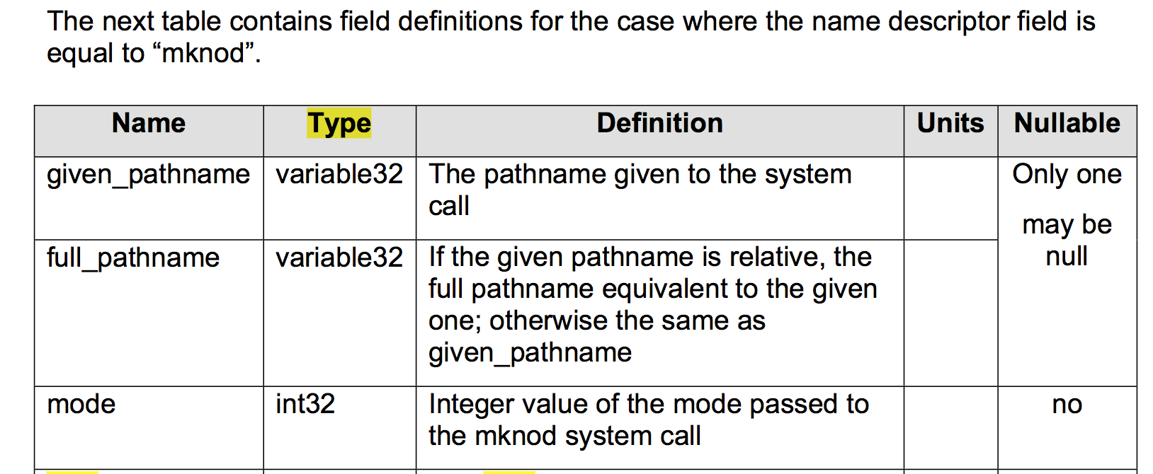
Checking direct values in SNIA document
Check all system calls in SNIA documents contain both individual bit and direct value fields.
Mode should be mode_value. Red-line changed that field.

Slide 142
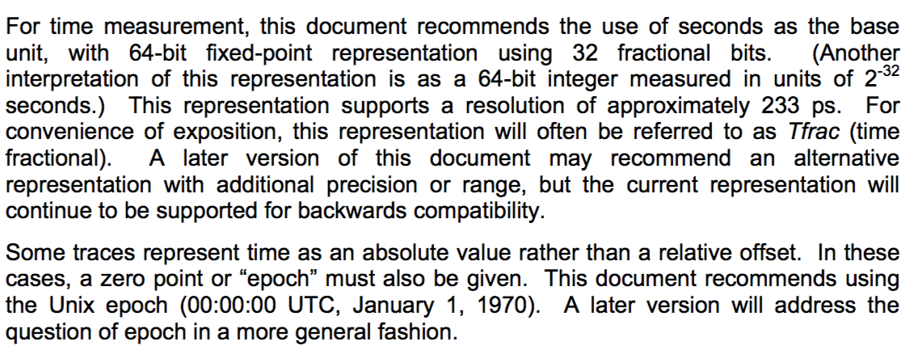
Adding Tfrac to SNIA document
Double check SNIA document to see if it explains that Tfrac is.
PosixSystemCallSemantics didn’t mention it at all.
It turns out “I/O Trace Common Semantics”, a seperate doc, explains the unit.
Therefore, no need to modify SNIA document.

Slide 143
Adding notes on using direct values in README
Wrote a paragraph to explain followings:
Why we store integer encoding even though we already have individual bits
Why we choose to use integer encoding rather than composing values at runtime.
Modification to modules is required to extract individual bits
Sent it to you to review.

Slide 144
Permission bits - sticky bits
Write a small program to create a file “foo” with “S_ISVTX|S_IRWXU”
We get "-rwx-----T 1 ubuntu ubuntu 0 Apr 9 14:59 foo"
Strace captures sticky bits in open.
Open man page doesn’t mention anything about sticky bit and SNIA document doesn’t have a sticky bit field for open.
Mkdir and creat system calls do the same thing.
Decision: store sticky bits for all system calls that use mode values.
Going to modify SNIA document and converter to do this.
No modification is required for replayer.
Need to pay attention to implementing system calls that have mode values in the future.

Slide 145
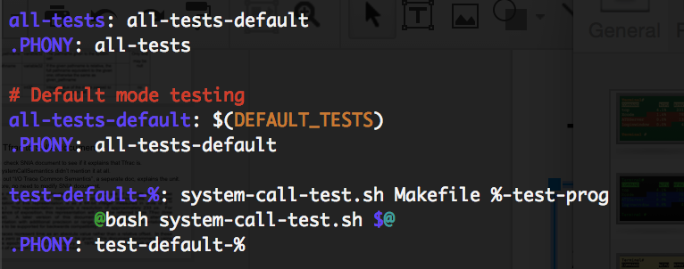
Testing - Makefile
Completely rebuild Makefile.
It has rules for testing replayer in default, warn, and abort modes.
Not sure if we should have test-open rule or require users to type test-default-open every time.
Ex:

Slide 146
Testing - Script
Modified open mini test program to create, open, and close a file.
Modified script to extract mode and system call name values from second argument, and executes testing accordingly.
One issue:
Script will fail for system calls that depend on other system calls.
Ex:
When we wants to test close system call, the script captures close system calls.
Replaying this will fail due to a file that is not being opened yet.
How can we fix the issue?

Slide 147
Testing Script - solution
script executes “strace -ttt -v -e trace=$SYS_CALLS -s $STRACE_STRSIZE -o $TEST_STRACE $TEST_PROG”
$SYS_CALLS need to be a set -> {open, close}
SYS_CALLS=`echo $1 | cut -d '-' -f 3`
Therefore, makefile need to pass test-default-open,close rather than test-default-open.

Slide 148
convert_timeStamp_to_epoch()
Dataseries expects the time value in Tfracs.
Tfracs is the timestamp relative to Unix epoch
It is stored as Int64Field value.
Added a new function in converter which takes the timestamp captured in strace and convert it to an epoch timestamp.
Example:
Strace timestamp: 2016/04/04-08:05:20
Epoch timestamp : 1459771520

Slide 149
Readlink System Call
Replayer Part ->
Added new Readlink System Call as subclass of SystemCallTraceReplayModule class
Expanded replayer to replay readlink system call.
Modified Makefile to build new module.
Updated README on how to take strace for stat system call.
Added a test program to test readlink system call.

Slide 150
Utime System Call - I
Replayer Part ->
Added new Utime System Call as subclass of SystemCallTraceReplayModule class
Expanded replayer to replay utime system call.
Modified Makefile to build new module.
Updated README on how to take strace for utime system call.
Added a test program to test utime system call.

Slide 151
Utime System Call - II
Converter Part ->
Added process_utime_args() function to convert strace to CSV format.
Uses convert_timeStamp_to_epoch() to get access time and modify time
Example: strace for utime system call: 1460380681.098587 utime("test.txt", [2016/04/04-08:05:20, 2016/03/16-23:54:28]) = 0
It is converted to utime,1460380681.098587,0,0,"test.txt",1459771520,1458186868

Slide 152
Readv and writev system call
Strace for readv system call:
1459772343.142351 readv(3, [{"This", 4}, {"is our", 6}, {"system call", 11}, {"trace replayer", 14}], 4) = 45
Readv system call has format:
ssize_t readv(int fd, const struct iovec *iov,int iovcnt);
How to convert it in CSV:
2 ways
1. record readv(fd, total-bytes, data, count) where "data" is a concatenation of all the data transferred.
First record readv(fd, total-bytes, count). Then record "count" records of readv-iov(fd, sequence, iov_len, data)
readv(3, 35, 4)
readv-iov(fd, 0, 4, "This")
readv-iov(fd, 1, is our, "6")
readv-iov(fd, 2, system call, "11")
readv-iov(fd, 3, trace replayer, "14")

Slide 153
Readv and writev system call II
Which way should we consider to convert?
First way is easy.
For another alternative, how to add rows in DataSeries as the number of readv-iov vector will vary for different instances of readv system call.
How to specify format in specstrings??

Slide 154
Plans for next week
Leixiang:
Modify SNIA document and converter to store sticky bits.
Implement chmod
Add tfrac reference to Type-independent information
Add another variable in script to indicates what system calls to capture
Shubhi: Implement system calls utimes, readv, writev
Implement system calls that take file names first.

Slide 155
Trace Replayer
April 18, 2016

Slide 156
Agenda
Last week discussions
Three permission bits and add Tfrac reference
Dependent system call - close
Rewrote README - notes on integer encoding
Readv and writev replaying method
convert_timeStamp_to_epoch()
Chmod system call
Readv system call
Utimes system call
Parsing of stat system call strace

Slide 157
Three permission bits and add Tfrac reference
Added set-user-id, set-group-id, and sticky bit fields to the system calls that have mode_value in SNIA document.
Redline these changes and pushed them to the git rep.
Added these three bits in spec string, so that our converter does the right field mapping.
Modified the table(the structure of DataSeries output file) to store these three bits.
Extended process_mode() function in strace2csv to generate these three bits.
Add Tfrac reference to Type-independent information.
Changed mode_value’s nullable field to be NO for mknod sys call.

Slide 158
Dependent system calls - close
Some system calls depend on other system calls, such as close. Therefore, need to teach testing script to capture independent and dependent system calls.
Added variable SYS_CALL_NAME to hold the system call that user wants to test
Added variable SYS_CALLS to tell the script what system calls to capture in strace.
Added a switch statement to modify SYS_CALLS variable.
Supporting more dependent system calls is simple, just add a case in switch statement.

Slide 159
Dependent system calls - close - continued
Since close and open test programs are same, cloned open test program for close sys call.
Finally, modified testing Makefile to test close system call.
Added a case in switch statement to tell the testing script to capture both open and close system calls.

Slide 160
README - notes on integer encoding
Notes on integer encoding were rewritten in README.
They will be pushed to the git once you approve it.

Slide 161
Chmod System Calls
Converter and Replayer
Added spec string for chmod
Added process_chmod_args() function to process chmod arguments
Implemented chmod module.
Expanded replayer to replay chmod.
Modified Makefile to build chmod module.
Testing
Added a mini program to generate chmod system call traces.
Added a rule in testing Makefile to invoke chmod testing

Slide 162
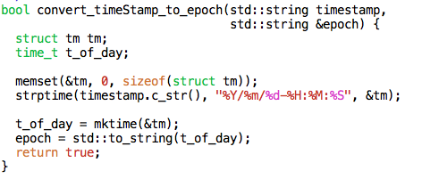
Convert TimeStamp to Epoch
Modified convert_timeStamp_to_epoch() function.
Now we are using strptime() function to fill the struct tm object.
mktime() is used to convert struct tm object to local time

Slide 163
Readv system call
CONVERTER PART
As per SNIA document, we have following specification for readv
readv(descriptor, count, ion-number, bytes_requested, data_read);
As per Prof Geoff’s suggestion, we should have 2 extent type
readv(fd, total-bytes, count)
readv-iov(fd, sequence, iov_len, data)
Are we supposed to change the SNIA document?
We have common field for each extent
Common(time_called,errno_number,return_value);
What will be the errno_number and return_value for ‘readv-iov’ extents?

Slide 164
Utimes System Call - I
Replayer Part ->
Added new Utimes System Call as subclass of UtimeSystemCallTraceReplayModule class
Expanded replayer to replay utimes system call.
Modified Makefile to build new module.
Updated README on how to take strace for utimes system call.
Added a test program to test utimes system call.

Slide 165
Utimes System Call - II
Converter Part ->
Used process_utime_args() function to convert strace to CSV format.
Same as Utime System Call
Added spec string for utimes system call.

Slide 166
Parsing of stat system call strace
Strace format for stat system call:
1460839568.377194 stat("test_dir", {st_dev=makedev(252, 0), st_ino=144955, st_mode=S_IFDIR|0775, st_nlink=3, st_uid=1000, st_gid=1000, st_blksize=4096, st _blocks=8, st_size=4096, st_atime=2016/04/16-12:54:23, st_mtime=2016/04/16-12:53:52, st_ctime=2016/04/16-12:53:52}) = 0
If filename contains ‘,’ or ‘{’ or ‘}’, our parsing will fail.
How to deal with this condition?

Slide 167
Plans for next week
Leixiang:
What happens in strace and say read(2) when you get non-alphanumeric bytes, try to ensure we can parse that and store it correctly in trace. Need DS to support a variable length buffer of ANY bytes (including zeros). Same for readv() etc.
Test tracing syscalls that read/write binary bytes (say from an executable)
Add UniqueID field
Add a default case in switch statement of testing script
Shubhi:
Test what happens when capturing syscalls with special chars and binary chars
Evaluate the complexity of strace

Slide 168
Trace Replayer
April 25, 2016

Slide 169
Agenda
Last week discussions
Add UniqueID field
Add a test case for write
Explore strace capturing reading an object file.
Explore strace capturing reading an executable file
Converter issues
Test Stat system call with filename having special characters
Utime system call updates
Readv system call

Slide 170
Add UniqueID field - Converter part
Changed time_called field in the table to be nullable (It’s nullable in SNIA doc, but we changed it due to previous design, not changed it back).
Added unique_id field in spec string Common
Changed row_number variable in strace2csv to be global variable (moving outside of main function)
Modified strace2csv-util.cpp to append row_number variable after return value.
Question:
Use unique_id or UniqueID? Field names in SNIA document start with lowercase, but UniqueID is different.

Slide 171
Add UniqueID field - Replayer part
Added unique_id_ field in base replaying module.
Modified print_common_fields() to print unique id.
Modified replayer to use unique_id as the key to sort modules, NOT time_called.

Slide 172
Add a test case for write
First, added a default case in testing script switch statement. The default case only captures one system call.
Wrote a test program for write system call
Added a switch case for write - capture open,write, and close
Added Makefile rules for testing write in three modes.

Slide 173
Explore strace capturing reading an object file
Used following command line to see what happens in strace when we get unreadable characters.
strace -ttt -s 409600 -o object-read.strace cat open-test-prog
We get unreadable characters: \\177ELF\2\1\1\0\0\0\0\0\0\0\0\0\2\0>\0\1\0\0\0006\10@\0\0\0\0\0@\0\0\0\0\0\0\0\20=\0\0\0\0\0\0\0\0\0\0@\0008\0\t\0@…
Our converter failed to parse this because unknown escape sequence
terminate called after throwing an instance of 'boost::escaped_list_error'
what(): unknown escape sequence
./strace2ds.sh: line 86: 26077 Aborted (core dumped) ./$DS_CONVERTER -q $OUTPUTFILE $TABLEFILE $SPECSTRINGFILE $XML_DIR $TEMPFILE

Slide 174
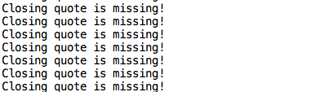
Explore strace capturing reading an executable file
Used .exe to test read and write functions.
Our converter is unable to convert all the rows.
Throws error
Remove_spaces_after_comma() fails to check all combinations of open and close brackets.

Slide 175
Converter issues
Can’t rely on CSV anymore, since backslash ‘\’ is used to escape double-quote.
Can’t parse buffers that contain any bytes, meaning we can only parse readable characters
Since converter fails to convert reading object file, can’t test syscalls that read/write binary bytes.

Slide 176
Strace complexity
More than 100+ source files
Didn’t find a file that talks about strace design
No function documentation
Modification is doable, but may require a student to take weeks to read and understand the code

Slide 177
Test stat with special character in filename
Tested stat system call with special character in filename.
It is giving correct results for all the characters except ‘,’ ‘{‘ and ‘}’
It is because our code finds first comma(‘,’) to separate filename
And it takes all the string between open(‘{’) and close(‘}’) curly braces to parse the stat struct buffer.

Slide 178
Utime System Call Updates
Tested for condition on passing NULL values to struct utimbuf.
Strace fills the struct timebuf with current time of the system.
This solves our problem.
However, on replaying we can only set the time value which are fetched from dataseries.

Slide 179
Readv system call
CONVERTER PART:
Implemented process_readv_args() to process parse struct iovec.
bool process_readv_args(std::string &sys_call_csv_args)
Our converter is designed in a way such that we read one row from strace file and write one row in CSV file.
Currently working on the part to write multiple rows on the CSV for one readv system call row.

Slide 180
Plans for next week
Leixiang:
Look for another Linux tracer that will dump binary.
Test if strace can be compiled on Linux.
Shubhi:
Complete readv system call- replayer and converter part
If no other Linux tracer can Is it possible to link strace with DataSeries? Just to prove that it can be done.

Slide 181
Trace Replayer
May 2, 2016

Slide 182
Agenda
Last week discussions
Look for another tracer
Customize strace
Next week

Slide 183
Look for another tracer
Dtrace
Tracing framework for troubleshooting kernel and application problems, not used for tracking system calls
ktrace
Similar to strace, but no binary format option.
Ftrace
Trace functions used by an application
Sysdig
The definitive system and process troubleshooting tool
Can be used like strace, but does do what we want it to do.
Output format: *%evt.num %evt.time %evt.cpu %proc.name (%thread.tid) %evt.dir %evt.type %evt.info

Slide 184
Look for another tracer - Summary
Most tracers that trace system calls behave like strace.
Basically, all tracer print system call traces in human-readable format.
Even if the tracer has an option to print buffer data in hex or binary format, we still need to parse output and convert it to DS.
Conclusion: have to customize strace to generate DataSeries directly if we want to avoid parsing.

Slide 185
Customize strace
Tried to build strace on Ubuntu - success
Digged more into strace code.
Tried to modify system call output format - success.
Modification is not hard as it seems.
Since DataSeries is written in C++ and strace is written in C, we need to figure out how to compile strace with DS API.
Tried to configure strace Makefile to build strace with g++ - Failed
In C++, programmer has to cast the return of malloc(), but C allows you to skip the cast step. Therefore, can’t compile strace with g++

Slide 186
Customize strace - Continued
GCC can also compile C++ program, so I also created a C++ program that does malloc without cast.
GCC also can’t compile the small program - error: invalid conversion from ‘void*’ to ‘char*’
Basically, C++ is NOT a superset of C. There are places that they are different.
Strace need DataSeries API in order to produce DS output file
Need to compile strace using C++ compiler.
Two options:
Modify strace, so that it can be compiled using C++ compiler. Will need a lot of code modifying. No idea what other problems might come up.
Use alternative format, rather than DS. This is not a very good option since replayer replies on DS.

Slide 187
Plans for next week
Leixiang:
Do a test: write a test C program to link it to C++ library
Google for how to link C programs with C++ libraries
If that works, then try to modify strace code for one simple fxn
Look to see if DataSeries website says link C program with DataSeries
Shubhi:

Slide 188
Trace Replayer
May 10, 2016

Slide 189
Agenda
Last week discussions
Check DS website to find C linking
How to link a C++ program into a C program
Modify strace to generate DS directly

Slide 190
DataSeries
“ DataSeries includes the C++ interface to quickly read and analyze DataSeries files”
Didn’t find any linking DS with C program on DataSeries website

Slide 191
Two ways to mix C++ and C code
Make C++ functions callable by C. Decided to go with this one
Another to handle this is compiling using a C++ compiler. This needs us to update strace C-style code in certain ways since C++ compiler is more careful/picky.
C++ official website reference: https://isocpp.org/wiki/faq/mixing-c-and-cpp#call-cpp

Slide 192
Linking a C++ program into a C program
Declare C++ function extern “C”
The extern “C” line tells the C++ compiler to use C calling conventions and name mangling
Write a C wrapper around C++ classes
The header of C wrapper should be readable by C and C++ compilers
C wrapper source code has to be C++ code since wrapper code is calling C++ function. This means that it has to be compiled with C++ compiler.
Once wrapper is done, C program will use wrapper to call desired C++ functions. C program can be compiled by using C compiler
Note: just compile source files into objects, no linking is done in here.
Linking everything has to be done by C++ compiler, C compiler won’t work.

Slide 193
Modify csv2ds to be callable by C program
We can either create a wrapper around DS code or around our existing C++ csv2ds converter.
Creating a wrapper around DS code require more work since we only use a small subset of DS features.
I chose csv2ds converter since it is easier to test whether it is feasible to modify strace to generate DS.
Note: good design was NOT considered when I modified code.
Modified csv2ds main function to be a setup() function.
Such as setting DS to read DS table format, XML files, output filenames.
Wrote a writeClose() function which takes fd as its parameter. This function writes a single close record to DS - very simple

Slide 194
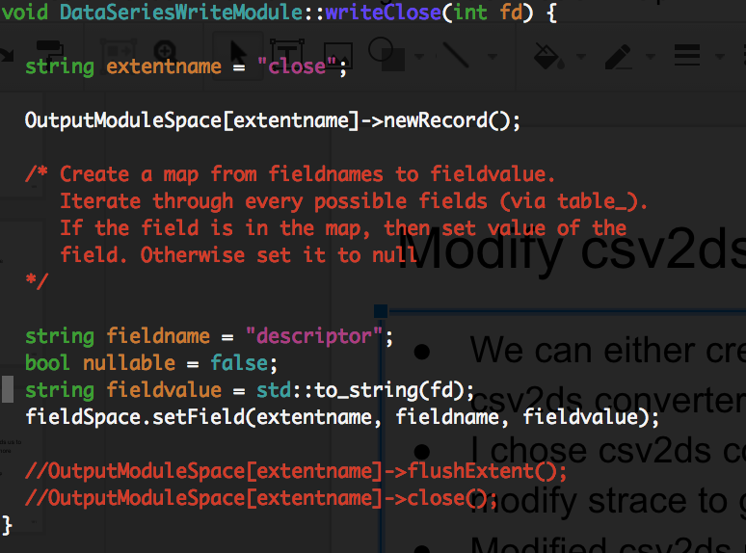
Modify csv2ds to be callable by C program - Code

Slide 195
csv2ds wrapper
Wrote wrapper header file
All functions declarations in wrapper code use C-style. Also, put ‘extern “C”’ around those functions.
Implemented wrapper to use csv2ds functions
Wrapper function will do all the conversion from C types to C++ types.
EX: if a csv2ds function takes a C++ string, wrapper function will create a string from char * and then call csv2ds function.

Slide 196
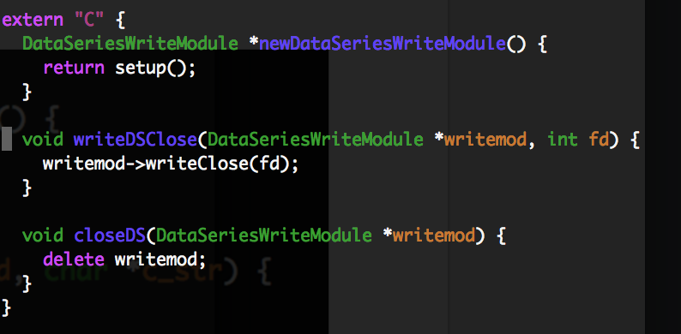
csv2ds wrapper - Code

Slide 197
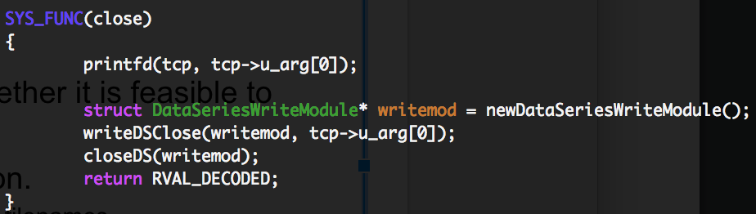
Strace modification
Found that desc.c (one of strace source file) contains code to print close file descriptor argument.
Put generating DS code in there without modifying any strace original behavior.

Slide 198
Last step: strace Makefile modification
Appended wrapper-csv2ds, csv2ds, and FieldSpace object to strace objects.
Modified Makefile to use g++ when it links all strace objects into an executable program.
Note: makefile is generated by automake. Therefore, modification to Makefile is bad.

Slide 199
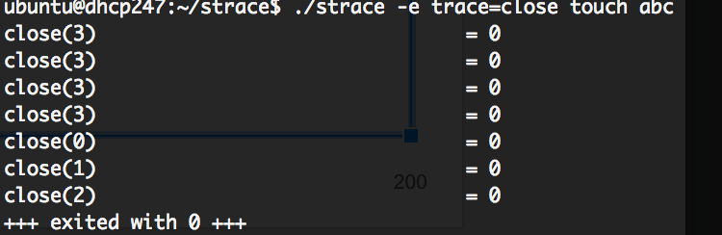
Test strace
Used modified strace to capture close sys calls: “./strace -e trace=close touch abc”
./strace -e trace=close touch abc
Foo.ds was generated.

Slide 200
Test strace - continued
To make sure the last close record is written to DS, used our replayer to replay foo.ds.
Executed replayer with verbose mode to print fields: “./system-call-replayer foo.ds -v”
FD is indeed what we want. Other fields are 0 because we didn’t set them when we generate DS.

Slide 201
Future strace TODO list
Need to decide whether create wrapper around DS or around csv2ds.
Modify strace automake to use g++ in appropriate place.
Need to design a good way to modify strace.

Slide 202
Trace Replayer
May 18, 2016

Slide 203
Agenda
Wrapper strace2ds

Slide 204
Strace modification
In addition to DS output file name, strace needs to table file name and xml dir.
XML dir contains XML files that are needed by DS API to describe the structure of DS.
Table file is needed by our program to tell what fields are going to be in DS.
Spec performs the mapping in the csv2ds model.
Spec file is something I am unsure about.

Slide 205
Converter modification
Rewrote converter code to actually help strace to generate DS.
Created a new directory for wrapper-strace2ds and modified codes in there.
Created a wrapper header file for strace2ds.cpp: strace2ds.h
Strace2ds.h will contain all the wrapper functions that strace need to create DS.

Slide 206
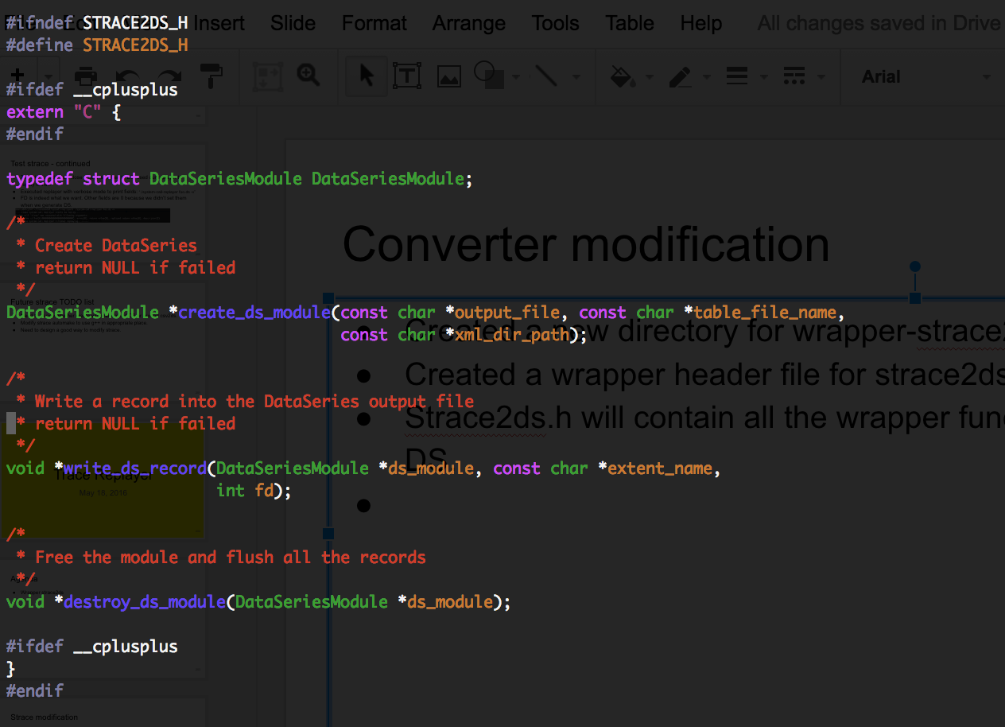
Converter modification

Slide 207
Converter Question
We have all the fields values in strace, but there is no field name associated with each field value.
In write_record function, how do we tell strace2csv which fields are for what?
How do we generate this field name? Do it like spec string in csv2ds model?
If code generates field names, where do we generate? In strace? In strace2ds?
Some ideas I have:
Strace creates a fieldname-fieldvalue mapping and pass sys arguments and mapping to csv2ds.
Strace just needs to pass sys arguments to csv2ds. Csv2ds will hard code field names.
Csv2ds uses spec string.

Slide 208
Converter modification - continue
Combined wrapper-csv2ds into csv2ds.
FieldSpace is a class that stores all fields that are going to be written to DataSeries output file. It supports adding, getting, and setting fields.
Not sure whether to combined this into csv2ds because FieldSpace is just a class and csv2ds code will keep growing.
Now are only have csv2ds.cpp and FieldSpace.cpp

Slide 209
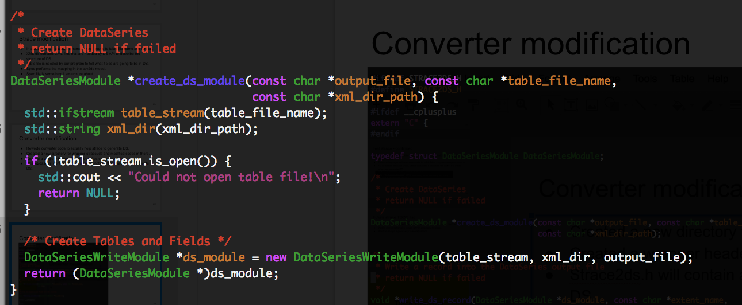
Converter modification - continue

Slide 210
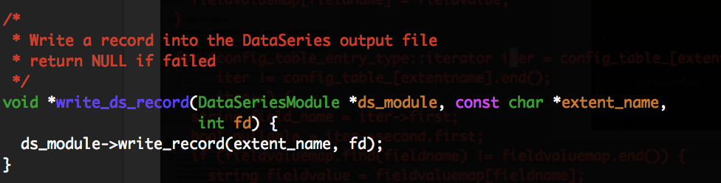
Converter modification - continue

Slide 211
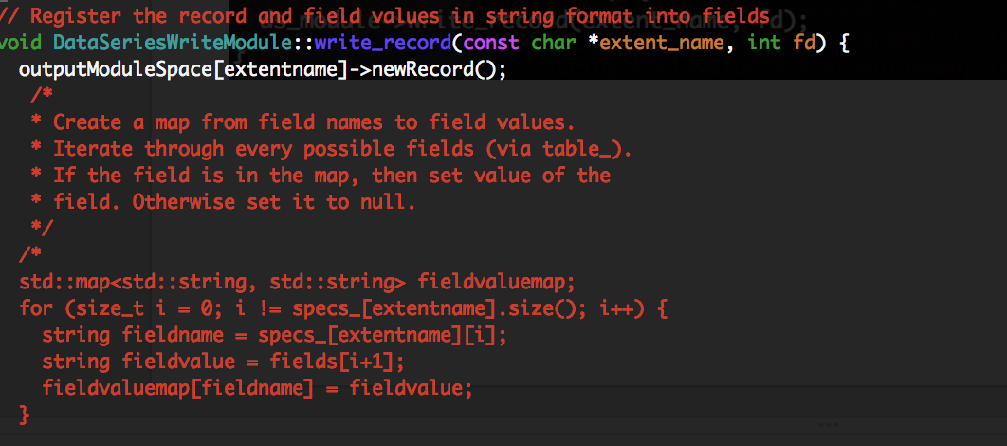
Converter modification - continue

Slide 212
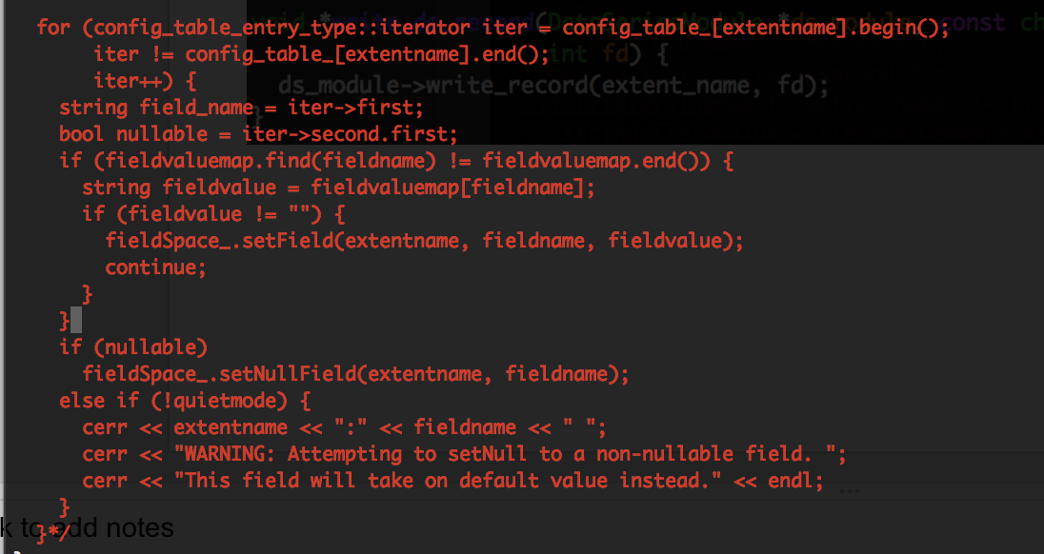
Converter modification - continue

Slide 213
Strace Modification
Called create_ds_module in the -X option, but missing xml_dir and table
Replaced dataseries_fname with dataseries_module
Need to include csv2ds in strace2ds
Do we put strace2ds.h inside strace or library? - library

Slide 214
Trace Replayer
May 23, 2016

Slide 215
Agenda
Wrapper strace2ds
Makefile
Questions

Slide 216
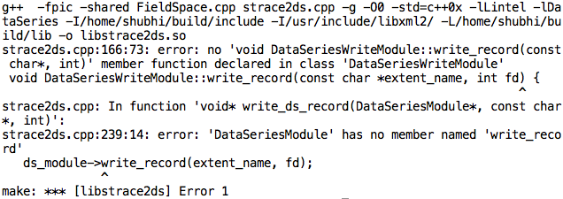
strace2ds : Makefile
Modified Makefile to link C++ dataseries with stace2ds.cpp
Tried to create library libstrace2ds.so
Unable to compile the current API’s

Slide 217
strace2ds : Makefile
Tried creating a connector_strace2ds.cpp and connector_strace2ds.h file to expose the C++ API to strace.
http://stackoverflow.com/questions/2744181/how-to-call-c-function-from-c
Followed this link. Is this the right way to do??

Slide 218
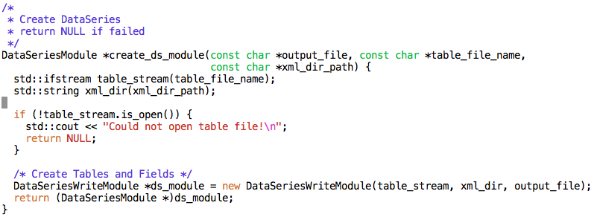
Questions
We need to pass xml directory path and table in strace to create a ds_module. How do we do that?

Slide 219
Trace Replayer
May 30, 2016

Slide 220
Agenda
Paper Discussion: File System Trace Replay Methods Through the Lens of Metrology
Open System Call
SetField()
Common Fields

Slide 221
Abstract:
Paper talks about various methods to evaluate the performance of file system methods through the replay of file system traces.
Analysis of two popular trace replay methods through the lens of metrology.
ARTC (compilation based)
TBBT (event based)

Slide 222
Methods to replay file system traces:
Based on code architecture
Compilation based: create the source code of the program that emulates the activity captured in the trace
Event based: Generic programs able to replay any arbitrary trace given as input.
Based on replay model
Closed : arrival of new request depend upon the completion of previous request.
Open :

Slide 223
Introduction
Issues:
Trace capture are biased in some cases.
Affected by background activity in experimental environment.
Workloads :
Microbench : sequence of file system related calls
Macrobench : emulates I/O activity of file server
Evaluation Metric :
Microbench : precision, bias and uncertainty
Macrobench : divergence between capture environment and replay environment.

Slide 224
Single - lab testing
Define the measurand
Quantity intended to be measured
Measurement procedure specification
Measurement method which specifies how to use measurement instrument.
How to obtain values of measurand and measurement conditions
Uncertainty source identification
Measurement characterisation
Bias, precision
Calibration analysis
Determination of measurement uncertainty

Slide 225
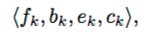
Measurand Specification
It is described as file system response time.
Considered as a sequence of events T, related to execution of file system functions, generated by the requests of trace replayer.
Each event t_{k} belonging to T is a tuple
f_{k} -> file system functions
b_{k},e_{k} -> timestamps before and after replay of functions
c_{k} -> arguments and return value

Slide 226
Measurement procedure specification
Measurement conditions
Experimental environment
Measurement instruments
Instruments:
ARTC : compilation based
TBBT : event based
Trace replayer function adjusted by ordering(FS) and timing(temporal) policy.
Measurement procedures
Recreate the file system state before trace replay.
Reflects the file system content at trace capture time.

Slide 227
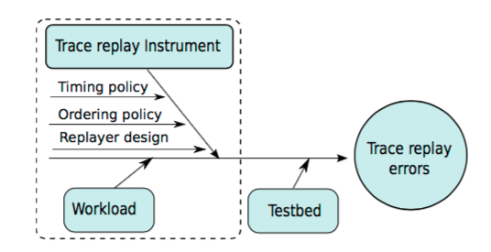
Uncertainty source identification

Slide 228
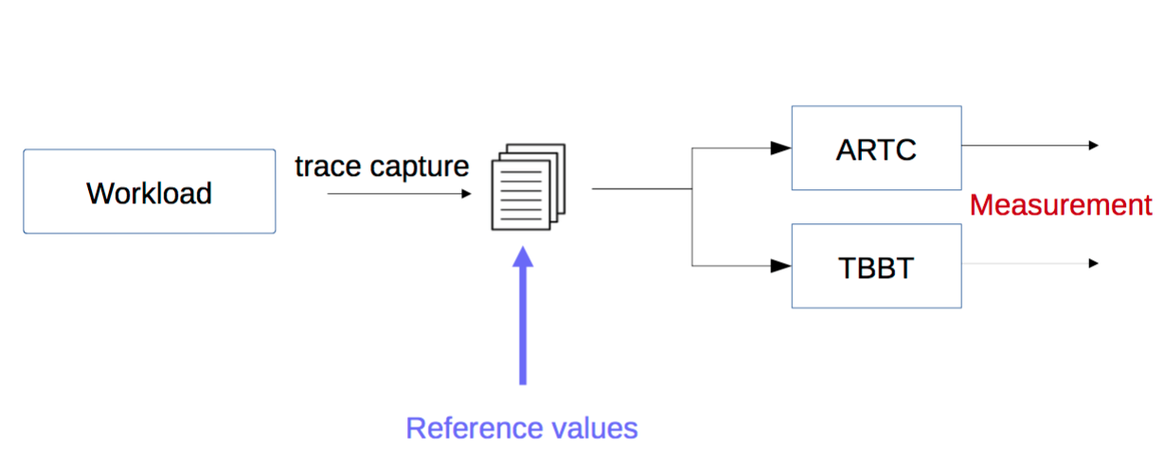
Measurement characterization
Measured values are compared to the true values of the measurand.

Slide 229
Microbench and Macrobench loads
Microbench
Load is given by number of worker threads performing file system requests
5000 requests in chunk of 4096 bytes
4 load levels: 1-4
4 load types: Random read (RR), random write (RW), sequential read (SR), sequential write (SR)
3 modes:
Without pause between requests
With a 10 microsecond pause
With a 50 microsecond pause
Macrobench
4 threads
Sequence of create, deletes, append, read, writes and stat.
Variable file sizes

Slide 230
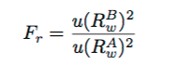
Determination of bias and precision
Precision
F - test to compare replay presion
u(R_{w}^{A}) is precision of method A
Fα,NB−1,NA−1 is the critical value of the F distribution with NB −1 and NA −1 degrees of freedom at a significance level α
B has poorer precision if F_{r} is greater than critical value.
Bias
Difference between expected value of trace replay and reference values.
Values obtained in determination of precision are compared

Slide 231
Calibration Analysis
Results of bias and precision are analysed.
Used to identify problems on design and implementation of replay tools.
Removing sources of problems, it is possible to reduce systematic errors.

Slide 232
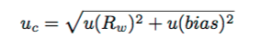
Measurement uncertainty
Combined standard uncertainty
u(R_{w}) -> random errors, u(bias) -> systematic errors
Results are reported as
[y_{m} - u_{c}, y_{m} + u_{c}] with CI near to 68%
y_{m} -> mean value of all experiments
Expanded uncertainties
For higher CIs
[y_{m} - 2.u_{c}, y_{m} +2. U_{c}] (95.5%) and [y_{m} - 3.u_{c}, y_{m} +3. U_{c}] (99.7%)

Slide 233
Microbench Results

Slide 234
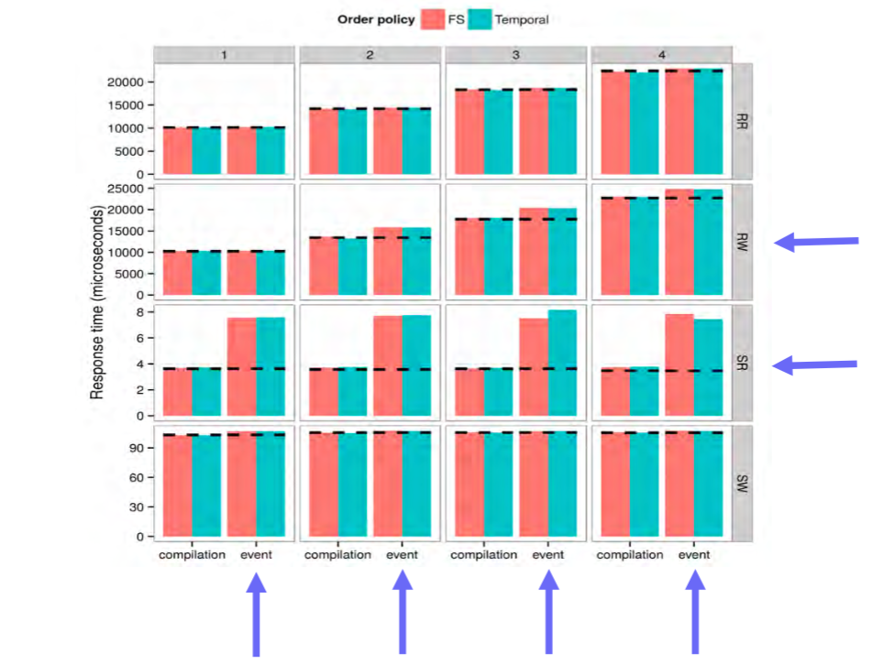
Bias Characterization

Slide 235
TBBT improvements
Sequential Read
Events that a worker thread will execute are assigned at the beginning
Ordering policy is enforced
Random Write
Abandon running replayer tool as real time process
Prevent preemption as replayer worker thread takes longer time to resume

Slide 236
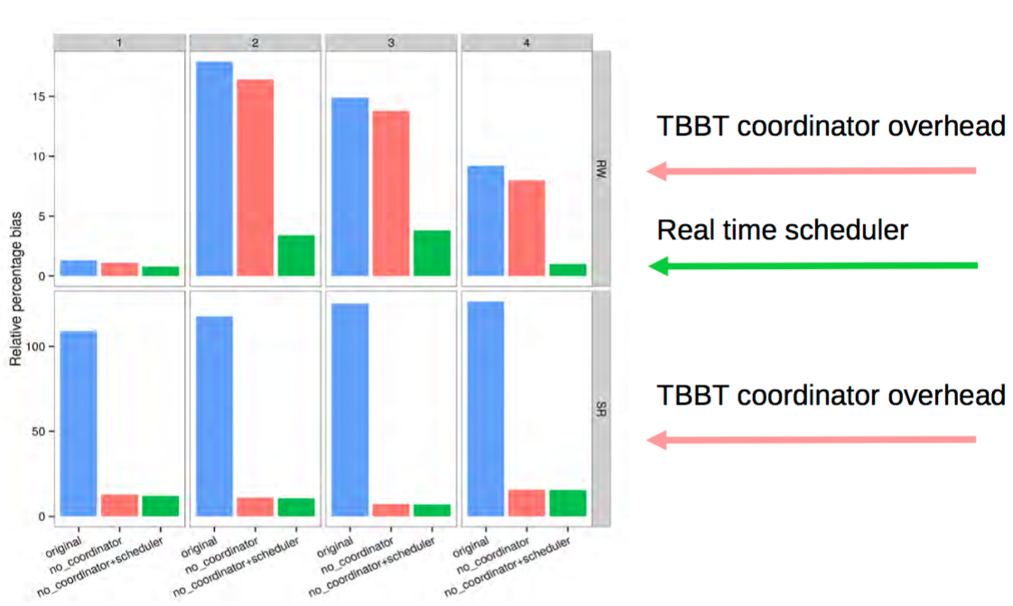
TBBT improvements

Slide 237
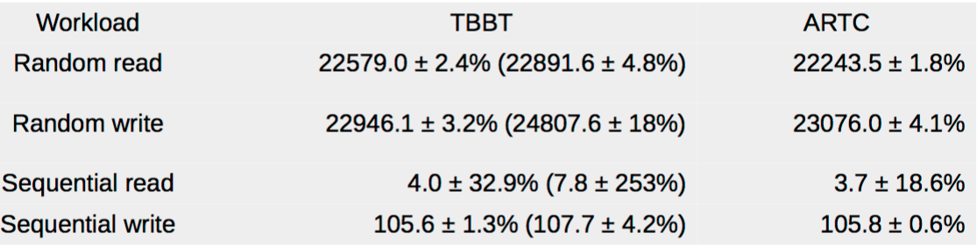
Uncertainty (95.5% CI)

Slide 238
Macrobench Results

Slide 239
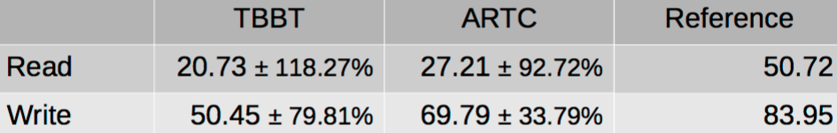
Uncertainty (95.5% CI)

Slide 240
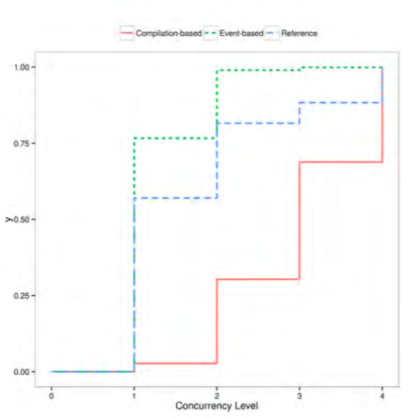
Empirical Cumulative Distribution function of concurrency level

Slide 241
Conclusion
Metrology can help in choosing the best instrument for the job.
ARTC replayer mostly performs better than TBBT
In some cases TBBT performs equivalently to ARTC
Replaying is affected by:
Choice of OS scheduler
Timestamp policy
Imposes limit of quantification at sub-millisecond range
Traced environment
Stability of measurement results

Slide 242
Open System Call
Modified SYS_FUNC(open) to call write_ds_record() function for open system call.
implemented makeOpenArgsMap() function to map values from system call to DS fields.
Questions:
Open system call has 3 arguments: path, flag, modes
According to SNIA document, each individual flag and mode bits are required to be set.
Should we implement another function in converter to decode individual fields?
Strace also decodes flag and prints in human readable format- should we create another function to make use of that string?

Slide 243
SetField()
Setting Variable32Field value in DataSeriesOutputModule::setField() is giving issues.
Example:
Values in makeOpenArgsMap() are set as
args_map[“given_pathname”] = &args[0]
field value is set as for eg: 0x195de8
When setField function is called, it gives segmentation fault.
case ExtentType::ft_variable32: ((Variable32Field *)(extents_[extent_name][field_name].first))->set((*(std::string *)field_value).c_str(), (*(std::string *)field_value).size()+1);

Slide 244
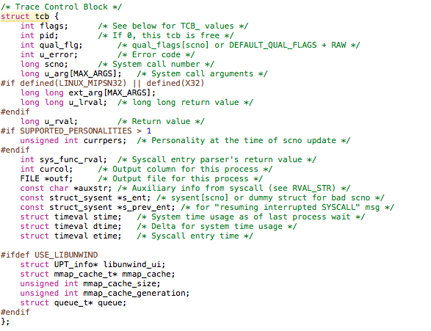
Common fields
Strace struct tcb:

Slide 245
Plans for next week
Complete open, read, write system call.
Extend converter to set common values like timestamps, errno, etc.
Download tools/software for TBBT/ARTC and study them a bit

Slide 246
Trace Replayer
June 3, 2016

Slide 247
Agenda
Strace code flow for printpath()
Dereferencing the tcp pointer for char * - wrapper code
Dereferencing the tcp pointer for char * - converter code
Dereferencing the tcp pointer for char * - strace code

Slide 248
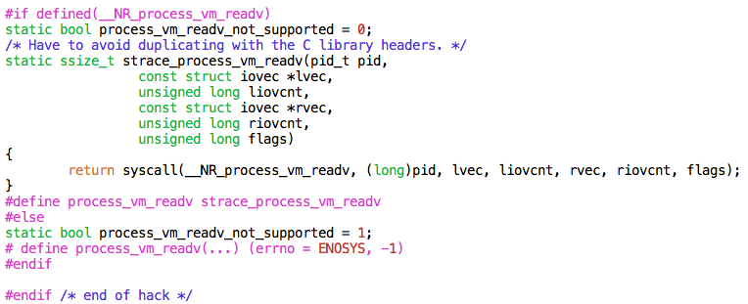
Strace code flow for printpath
printpath() internally calls umovestr() which then calls process_vm_readv() system call to copy the data at memory address.
Finally, it calls print_quote_string() function which decodes the string and prints it.

Slide 249
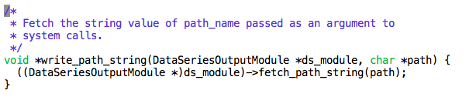
Dereferencing the tcp pointer for char * - wrapper code
Created a function called write_path_string() in our wrapper strace2ds.cpp file.

Slide 250
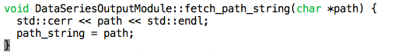
Dereferencing the tcp pointer for char * - converter code
Created a function called fetch_path_string() in our converter which stores the value of string path in global variable.

Slide 251
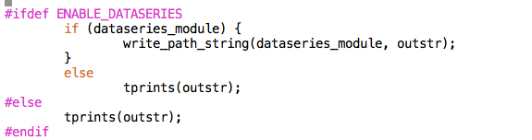
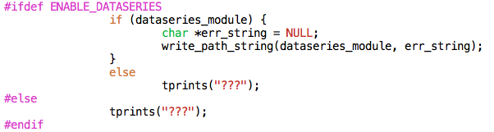
Dereferencing the tcp pointer for char * - strace code
Modified print_quote_string() in util.c to fetch the decode string for pathname.
Handling error conditions

Slide 252
TODOs
Weekend:
Fix the setField() function in converter to string name.
Add function for decoding flags and mode values for open system call in converter.
Next week:
Add common fields
Complete read and write() system call.

Slide 253
Trace Replayer
June 8, 2016

Slide 254
Agenda
setField()
process OpenFlags() and process Mode()
Mode Value
save_path_string()
Return Values
Replayer Makefile
Common Fields
Common Field Issues

Slide 255
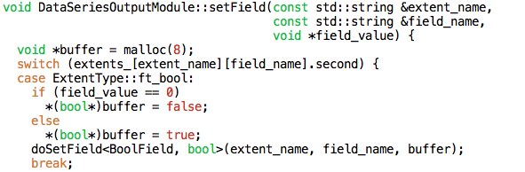
setField()
Fixed the setField function for Boolean values
Notes:
Declare:
Char buf;
…
Buf = false
Or
Buf = rtrue
Pass (void *)&buf -> to doSetField (then you don’t need to free/malloc).

Slide 256
processOpenFlags() and processMode()
processOpenFlags()
Added a function called processOpenFlags().
This function unwraps the flag value passed as an argument to open system call and sets the corresponding bits as TRUE.
processMode()
This function will unwraps the mode value and sets the corresponding mode bits as TRUE.
Ex: “0600” will set the “mode_R_others” and “mode_W_others” fields as TRUE.

Slide 257
Mode Value
Strace outputs the mode value in octal form. Ex “0600”
Fetching the value of mode from tcb->args returns the value in decimal.
Ex: “384” which is equivalent to “0600”
Questions:
How should we store the value of mode in DS field - 384 or 0600?
How do we display this in our replayer?

Slide 258
save_path_string()
Changed the function name from write_path_string() to save_path_string()
Strace prints the pathname with double quotes.
Ex: open(“/etc/ld.so.cache”, O_RDONLY|O_CLOEXEC)
Modified function to remove quotes from path_string.

Slide 259
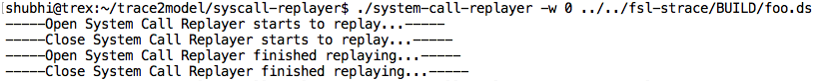
Return values
We can successfully play Open and Close system call.
On replaying, we get return value as ‘0’ for open system call.

Slide 260
Replayer Makefile
Modified Replayer makefile to change the path for dataseries library.

Slide 261
Common Fields
Added functionality to the library (mainly the writeRecord function in DataSeriesOutputModule.cpp) to receive and store more of the common field values
A timestamp, return value, error number, process ID
Added functionality to the replayer to accept, display process ID
Currently I’m getting a timestamp by calling gettimeofday(* struct timeval, NULL) in the SYS_FUNC(close) block

Slide 262
Common Fields: Issues
It has become apparent that the code in the SYS_FUNC blocks is executed before the actual system call (and before both the trace_syscall_entering and trace_syscall_exiting functions in syscall.c)
This means that we cannot get accurate values for time_called, time_returned, return_value, and errno_number from here
Possible solution: split writeRecord into two parts
The first could add the arguments/specific fields to the map
Could be called in the SYS_FUNC blocks as we have been doing
The second could add many of the common fields to the map (i.e. time_called, time_returned, return_value, errno_number) and actually write to a DS record
Could be called in the trace_syscall_exiting function in syscall.c

Slide 263
TO DO's for next week
Shubhi :
Add read and write system call.
Nina :
Prototype/proof of concept of writing to record from trace_syscall_exiting function in syscall.c
Mkdir and chdir system calls

Slide 264
Trace Replayer
June 15, 2016

Slide 265
Agenda
initArgsMap()
process_Flag_and_Mode_Args()
processOpenFlags() and processMode()
Error conditions
Open3()
strace2ds.h
Functions to save read/write buffer
Read and write system call
fetch_path_string() and fetch_buffer_data()
setField()
Common Fields
Time
System calls- mkdir, chdir, rmdir, unlink, truncate

Slide 266
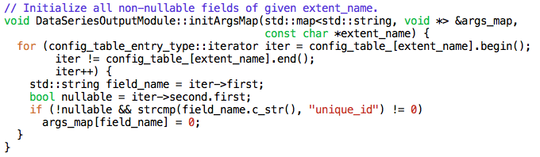
initArgsMap()
Added initArgsMap() functions to initially set all non-nullable fields to zero.
This helps to avoid initializing each and every field explicitly.

Slide 267
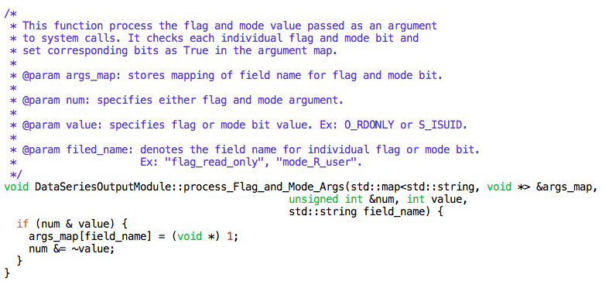
process_Flag_and_Mode_Args()
Added this function to check if flag or mode value is set or not and then masking that flag or mode bit.
Not sure about the name of the function??

Slide 268
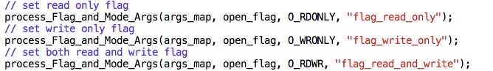
processOpenFlags() and processMode()
Modified these functions to use process_Flag_and_Mode_Args().
Modified return type to u_int so that caller can check if flag and mode bits are finally zero or not.
All flags are set as below: Eg-

Slide 269
Error conditions
What should be the behaviour of error conditions in converter such as unknown flag/mode value or NULL path?
Should we abort or continue the execution of strace?
Currently i am exiting the program with the error msg.

Slide 270
Open3()
Strace checks for the 3rd argument for open as :
if (tcp->u_arg[2] & O_CREAT)
Followed the same way to check for 3rd argument
Wrote a test program to check this
Prints mode value as: ‘037776332425206240’
Not sure about this mode value.
How to check for open3() condition?

Slide 271
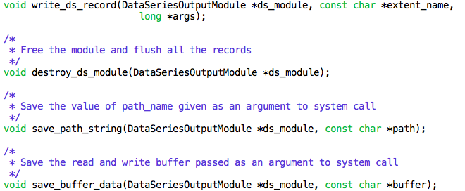
strace2ds.h
Modified return type from void* to void.
All functions inside this file are defined under ‘extern C’ block, so need to declare them as extern.

Slide 272
Functions to store read/write buffer
Added following functions to save read/write buffer data.
Fsl-strace: save_buffer_dataseries() -> declared as extern
Strace2ds-library:
Wrapper func: save_buffer_data() -> declared as extern
Converter func: fetch_buffer_data()

Slide 273
Read and Write system call
Fsl-strace:
Expanded switch statement to record read and write system call
Strace2ds-library:
Added makeReadArgsMap() and makeWriteArgsMap() function
Modified code to add records for read and write system call.

Slide 274
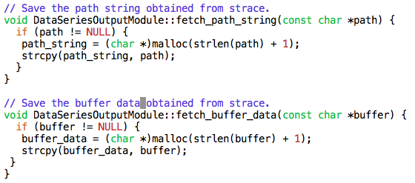
fetch_path_string() and fetch_buffer_string()
Modified these function to save pathname and buffer data as char * instead of std::string.
Now we need to make a copy of pathname and buffer data.
Freeing the buffer in destructor of dataseries module.

Slide 275
setField()
Modified set functions for Variable32Field
Since we are saving pathname and buffer data as char * instead of std::string, we need to modify the setField() functions for Variable32Field.

Slide 276
Common Fields
Our library now processes and stores the common fields time_called, time_returned, time_recorded, executing_pid, errno_number, return_value, and unique_id
The replayer can also display all of these fields with the -v option
Since printing these field values extends over more than one line, how do we want to format this output?

Slide 277
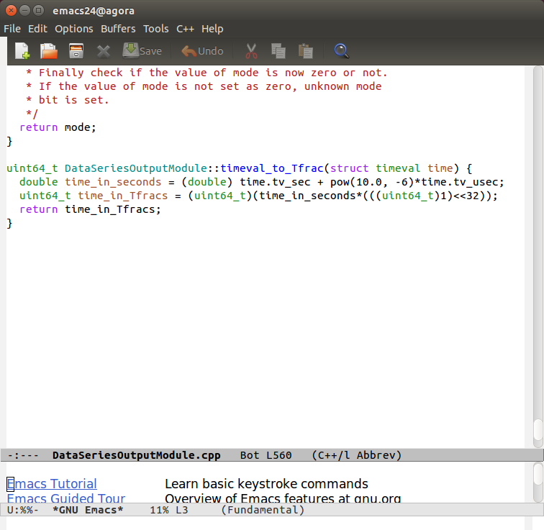
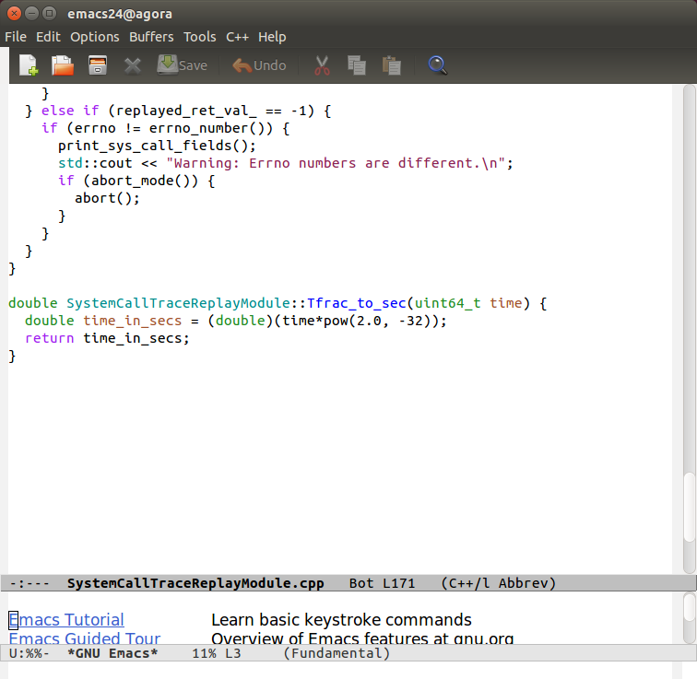
Time
Added a function timeval_to_Tfrac to the library to convert time units from seconds and microseconds (timeval) to Tfracs
Added a function Tfrac_to_sec to the replayer to convert time units from Tfracs to seconds
I checked the output of these converters
Do we want time to serve any sort of functionality in the replayer?

Slide 278
System Calls - mkdir, chdir, rmdir, unlink, truncate
Following the existing code for close/open, I added code to fsl-strace and strace2ds-library to support a few system calls with simple arguments that we can handle with helper functions from open:
Mkdir, chdir, rmdir, unlink, truncate
I wrote some small test programs in C to test different conditions of each of these (and open and close)
i.e. success, failure, some different mode values (some incorrect)
Upon replay, all seem to be working reasonably

Slide 279
Trace Replayer
June 20, 2016

Slide 280
Agenda
v_args argument in ds_write_record
ds_get_path()
ds_get_buffer()
Fixed memory leak

Slide 281
V_args in ds_write_record
Arguments such as pathname or read/write buffer passed to system calls cannot be referenced directly from tcp->u_args. These arguments are copied from the address space of a process being traced and stored in an array of pointers named as v_args.
V_args are further passed as an argument in ds_write_record() function which can be further used to fetch the actual pathname and buffer arguments and store into our dataseries.

Slide 282
ds_get_path()
Added function in util.c of strace code.
This function copies the actual pathname passed as an argument to the system call and returns a pointer to the buffer storing actual pathname.
This can be further used by system calls such as open(), mkdir(), chdir(), which has pathname as an arguments.

Slide 283
ds_get_buffer()
Added function in util.c of strace code.
This function copies the actual read/write buffer passed as an argument to the system call and returns a pointer to the buffer storing actual read or written data.
This can be further used by system calls such as read(), write(), pread(), etc. which has buffer as an arguments.

Slide 284
Fixed memory leak
Modified ds_get_path() and ds_get_buffer() function to handle error conditions properly.

Slide 285
Trace Replayer
June 27, 2016

Slide 286
Agenda
Bug in initArgsMap() function.
Bug in setField() function.
Modified setField() to pass var32_len argument.
getVariable32FieldLength() function
numRecord
File descriptor issue while replaying
Implementation of lseek, pread and pwrite system calls
Implemented simple system calls (i.e. chdir, link, truncate, etc.)
Implemented access
Implemented chmod

Slide 287
Bug in initArgsMap() function.
Previously, all the fields of a system call which are non-nullable are initialised as zero in the map.
This has a problem in setField() function. For example: if any variable32 field type is initialized to zero, this will cause segmentation fault when trying to fetch the actual pathname at that address.
SOLUTION:
Now, only non-nullable boolean fields are initialized to zero.
So, if variable32 field is not set, it will take on default value.

Slide 288
Bug in setField() function
case ExtentType::ft_variable32:
((Variable32Field *)(extents_[extent_name][field_name].first))->set((*(char **)field_value), strlen(*(char **)field_value) + 1);
For variable32 type fields, we used strlen function to determine the length of field_value passed.
This will work for field_value which refers to pathname.
But this does not work for read or write buffers as it may contain null characters.
Solution: Pass the length of buffer in the setField function.

Slide 289
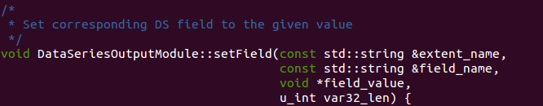

Modified setField() to add v32_len argument
To fix the bug in setField() function,
Added a new argument named as v32_len which contains the length of field_value of type variable32.
Added a new function getVariable32FieldLength() function which returns the length of variable32 type field_value.

Slide 290

getVariable32FieldLength()
This function returns the length of variable32 type field.

Slide 291
numRecord
This variable refers to the record number or “unique_id” for each record added in the dataseries file.
This variable was getting modified and was not set correctly.
Hence we had issues while replaying as the order of system calls to be replayed was changed.
SOLUTION:
Allocated memory to the record number in constructor of DataSeriesOutputModule and deallocating in the constructor.
Record_num_ = new u_int;
*record_num_ = 0;

Slide 292
File descriptor issue while replaying
Initially, we had issues while replaying because we were not setting return values, hence all the file descriptors were mapped to same default value.
After merging code for common fields, file descriptor issue has been resolved.
Now, we can accurately replay system calls in our replayer.

Slide 293

Implementation of lseek, pread, pwrite system calls
Added support for new system calls - lseek, pread and pwrite

Slide 294
Implemented simple system calls
Using the existing framework for pathnames
Chdir, mkdir, rmdir, link, symlink, unlink, truncate, creat
Some of these have the same arguments/specific fields
Chdir, rmdir, and unlink all only take a pathname
Mkdir, creat, and chmod all take a pathname and a mode
Should each of these individual calls have its own make___ArgsMap function, or can we have shared functions?
If shared, what should they be called (currently, makeChdirRmdirUnlinkArgsMap) and how should error messages be printed? (currently, "Chdir/Rmdir/Unlink: …”)?
Tested success and failure conditions for each

Slide 295
Implemented access
Removed redundant “pathname” field from the table and the xml file
This was noted by Leixiang in
Using the framework for open as an example, I created a function, processAccessMode
This function calls process_Flag_and_Mode_Args for each possible mode bit of access (R_OK, W_OK, X_OK, F_OK)
Tested success and failure conditions

Slide 296
Implemented chmod
Also pretty simple (has same arguments as mkdir)
Implemented in both the library and the replayer

Slide 297
To Do's for next week
Shubhi : stat, readv, writev
Nina : chmod, chown, lstat, fstat, readlink

Slide 298
Trace Replayer
July 5, 2016

Slide 299
Agenda
Stat system call.
Readv system call
Implemented chown, readlink
Implemented lstat, fstat
Implemented utime, utimes
Current status

Slide 300
Stat System Call
Fsl-strace:
Added ds_get_stat_buffer() to copy struct stat from the address space of process being traced.
Expanded switch statement in syscall.c to capture stat system call traces.
Strace2ds-library:
Added makeStatArgsMap() function to map the fields of stat system call with the dataseries field.
Added timespec_to_Tfrac() function to convert the time from timespec to uint64_t in Tfracs.

Slide 301

Readv system call - I
SNIA spec for readv
readv(descriptor, count, iov_number, buffer_ptr, bytes_requested, data_read)
First record
readv(descriptor, count, iov_number, bytes_requested, NULL).
Then for each readv vectors, record
readv(NULL, NULL, iov_number, bytes_requested, data_read)

Slide 302
Readv System Call - II
Ex: Strace for readv system call:
1459772343.142351 readv(3, [{"This", 4}, {"is our", 6}, {"system call", 11}, {"trace replayer", 14}], 4) = 45
It can be recorded as-
readv(3, 4, -1, 45, NULL)
readv(NULL, NULL, 0, 4, "This")
readv(NULL, NULL, 1, 6, "is our”)
readv(NULL, NULL, 2, 11, “system call”)
readv(NULL, NULL, 3, 14, "trace replayer")

Slide 303

Readv system call - III
Fsl-strace:
Added ds_get_iov_args() to copy the struct iovec from address space of process being traced.
Added ds_write_iov_record() to write the dataseries record for each of the iovec records.

Slide 304
Readv System Call - IV
Syscall-replayer
For replaying one system call, we have to fetch (1 + count) records, where count is the number of readv io vectors.
Wrote code to handle above.
We can replay readv system calls successfully.
Things yet to be handled:
Check each mode of our replayer if it plays correctly or not like warn mode, verify mode, verbose mode, etc.

Slide 305

Implemented chown, readlink
Implemented readlink in strace/library
Implemented chown in strace/library and replayer

Slide 306

Implemented lstat, fstat
Created BasicStatSystemCallTraceReplayModule base class
Has member variables common to stat, lstat, and fstat
Separate derived classes for stat, lstat, fstat

Slide 307

Implemented utime
Made ds_get_utimbuf function in fsl-strace/util.c

Slide 308

Implemented utimes
Made ds_get_timeval_pair function in fsl-strace/util.c

Slide 309

Implemented utimes, ctd.
Added Utimes module class in replayer, derived from Utime class
Added Tfrac_to_timeval function

Slide 310
Current Status
SNIA document supports 38 system calls.
Completed: 24
In progress: 2 (readv, writev)
Unsupported: 12 (mmap, fcntl, ioctl, fsync, execve, mknod, munmap, pipe, fork, exit, dup, dup2)
Dup, dup2, fork, mknod, exit
clone(similar to fork), rename

Slide 311
TODO for next week:
Complete readv and writev system call.
Document everything which we have supported till now.
Before implementing rest of the system calls, make replayer test to test thoroughly the system calls that has been supported now?
Any big program, we can trace and then replay and compare the performance?
Other calls that might be simple: fsync, mknod, pipe, exit, dup/dup2
Check for system calls that are not in SNIA- clone(similar to fork), renames
Try small utilities like command line (cp, mv, cat, etc)

Slide 312
Trace Replayer
July 14, 2016

Slide 313
Agenda
Writev system call.
prepareForProcessing() and completeProcessing()
rows_per_call
processed_rows
Other System Calls

Slide 314

Writev System call
Fsl-strace:
Added support to capture writev system call
Added new arguments - “const char *sys_call_name” to ds_write_iov_records() to distinguish between readv and writev system call.
Strace2ds-lib and syscall-replayer
Added code to support writev system call.

Slide 315
prepareForProcessing() and completeProcessing()
prepareForProcessing()
Removed this function from all the system call class modules.
completeProcessing()
Removed this function all the system call class modules
This function is now defined only in SystemCallTraceReplayModule class.
It performs the post checking after a system call is replayed and increment the series in the Extent Series by the number of rows processed per system call.
Question:
In case of write system call, where to open /dev/urandom file in case pattern data is set as ‘random’? Previously we used to do this in prepareForProcessing(). Now, we are doing this in processRow().

Slide 316
rows_per_call
Added new variable rows_per_call in SystemCallTraceModule class
This variable keeps track of the number of rows processed in replaying a single system call
Its default value is 1.
Its value can be overridden by those system calls which requires more than one row to process while replaying a single system call. Ex- readv and writev.

Slide 317
processed_rows
This is a public variable defined in RowAnalysisModule class defined in DataSeries.
We can use this variable to count the total number of rows processed by each system call for future statistics.
Also we can add another mode in our replayer, which can display the statistics of each system call after replayer has finished replaying.
Should we implement above functionality??

Slide 318
Other system calls
fork() and exit()
How to replay this? What behaviour should be checked?
ioctl()
Full specifications are not provided in the SNIA doc
mmap()/munmap()
When replaying, should we create a mapping from the traced memory address to the replayed one (like we do with file descriptors)?
execve()
getdents()
What values should be recorded as fields?

Slide 319
Trace Replayer
July 18, 2016

Slide 320
Agenda
What to do for Fork/Exit/Execve/Mmap/Munmap similar calls
Exit
Execve
Ioctl
Mmap/Munmap
Getdents
F- and -at system calls

Slide 321
What to do for Fork/Exit/Execve/Mmap/Munmap
Write records for them
During replay, print a message stating that they were recorded but will not be replayed
Could we create an OtherSystemCallTraceReplayModule class that handles this?

Slide 322
Exit
If exit system call is called while tracing any program, then record for exit should be the last record in our DS file.
If we replay exit, our replayer will terminate as calling exit terminates the program.
We do not have return values, errno and time returned for exit.

Slide 323
Execve
This is the first system call which is called when a program starts executing.
int execve(const char *filename, char *const argv[], char *const envp[]);
Argv[] and envp[] arguments appears to be local for one machine. Replaying ds file on another machine may not make sense.
Execve does not return on success but returns an errno on failure. How to record return values, errno and time returned.
How to differentiate between default execve and a program which calls execve?

Slide 324
Ioctl
int ioctl(int fd, unsigned long request, ...);
Strace handles all types of ioctl
Not sure how to handle all of them
We can capture file descriptor and command number
Difficult to record third argument (buffer) without knowing its size and type

Slide 325
Mmap/Munmap
void *mmap(void *addr, size_t length, int prot, int flags, int fd, off_t offset); int munmap(void *addr, size_t length);
How to capture ‘addr’ field?
Is it okay to use the same addr while replaying?
How do we maintain a mapping of traced and replaying addresses?

Slide 326
Getdents
Argument fields:
Descriptor
Buffer_address
Count
Other possible fields (members of a linux_dirent structure):
Inode
Offset
Length
File name
File type
We will need to handle this like we’re handling readv since there are multiple dirents

Slide 327
F- and -at system calls
Some of the command line commands use these instead of the more general calls (i.e. unlinkat, fstatat, etc.)
-at calls
Can be recorded easily in the same way we record other calls
We can implement them in the replayer by creating a child class of the more general system call
f- calls
Can be recorded easily in the same way we record other calls
To implement them in the replayer we need to either:
Create a separate class for each (i.e. have chmod and fchmod in separate files)
Or alter the parent class so that it’s more basic and have both calls derive from that (i.e. have a BasicChmod class which chmod and fchmod are children of)
These calls don’t have many parameters/fields
The -at system calls are often passed the AT_FDCWD macro
If we aren’t in the same directory when we replay calls like this, then we’ll get different behavior

Slide 328
TO DO’s for next week
Nina
Fix fcntl, commit
Getdents
Ioctl (general form)
Shubhi
Exit
Non-terminating/non-replayable system call handling
Execve plan
Both
Outline project presentation

Slide 329
Trace Replayer
July 25, 2016

Slide 330
Agenda
New System Calls Supported
isReplayable(), compare errno and return values
Function Pointers for makeSysCallArgsMap functions
Fixed Bugs
ioctl
mmap system call
Presentation Slides and Documentation

Slide 331
New System Calls
Added support for following system calls
_exit
execve
getdents
unlinkat
openat
mmap

Slide 332
isReplayable(), compare errno and return values
isReplayable()
Added isReplayable() function in SystemCallTraceReplayModule class
This function returns true if the system call is replayed by our replayer
Compare errno and return values
These values are compared only if the system call is being replayed.
If (isReplayable) then, compare_retval_and_errno()

Slide 333

Function Pointers for makeSysCallArgsMap function
Defined function pointer type for system call args map
Defined map which stores mapping of sys call name and address of its corresponding sys call args map function.
Added makeArgsFuncPtrTable()
Called in Contsructor of DataSeriesOutputModule class.
Initializes map with <syscall_name, address of ArgsMap function>
Removed long chain of if-else for makeSysCallArgsMap function
Now code if simplified to: If (syscall_name is in map), then, call function mapped to map[syscall_name]

Slide 334
Fixed Bugs
Strace2ds-library
Pathname bug
Strlen does not count the terminating null character
Added 1 to its length to get the full pathname
SysCall replayer
File descriptors issue
Added mapping of STDIN, STDOUT, STDOUT, AT_FDCWD to itself
Printing of Return value
Return type should be printed as ‘int64_t’ instead of ‘int’
Printing of Byte field
Needs to be converted to unsigned int to print the numeric value accurately

Slide 335
ioctl - I
Created ds_set_ioctl_size() and ds_get_ioctl_size() functions in wrapper code
Call setIoctlSize() and getIoctlSize() functions in DataSeriesOutputModule
Private member variable ioctl_size_
This seems to work
Added fields “ioctl_buffer” and “buffer_size” to table, SNIA doc for ioctl
Replayer verbose mode: printing only descriptor and request #
The actual parameter passed to the system call is probably an address
We can’t print the buffer data since we don’t know the type
Should we print the buffer size?
Will need to go through all of the ioctl calls supported by strace and insert #ifdef’ed ds_set_ioctl_size(...) statements

Slide 336
ioctl - II
Unsure how to test ioctl
Called for rm (and rm -r) and we can replay that ioctl call successfully
Called a few times for ls, ls -l and some of those replay successfully
For ls -l: Some were initially called on a socket created with the system call socket(), so they give an EBADF error upon replay (this is also true for a few system calls other than ioctl)
All of the ioctl requests called by these utilities are located in term.c (strace), so they’re in one specific subset of all possible ioctl requests

Slide 337
Mmap system call
Added support for mmap system call
SNIA document mentions only about MAP_FIXED, MAP_PRIVATE and MAP_SHARED flags
However, both man page and strace mentions about many other system calls.
Seems some of the missing flags from SNIA document are commonly used.
Hence, added support for more flags from man page and updated the SNIA document.

Slide 338
Presentation Slides and Documentation
Worked on presentation slides
Worked on README
Updated SNIA document

Slide 339
TO DO’s for next week

Slide 340
Trace Replayer
August 02, 2016

Slide 341
Agenda
New System Calls Supported
Syscall Replayer - changes
Fsl- strace and Strace2ds- library changes
Test Results
Minutes of meeting with Prof Geoff

Slide 342
New System Calls Supported
Added support for following system calls
munmap
linkat
fchmod
utimensat
mkdirat

Slide 343
Syscall Replayer Changes
urandom option
Added -p urandom option at run time to fill write buffers with random data
std::ifstream random_file_
Added std::ifstream random_file_ as a member of SystemCallTraceReplayModule base class and is removed from individual write related modules.
Now we open /dev/urandom file once before replayer begins if -p urandom option is provided.
Write buffer with repeated patterns
Modified filling write buffers for repeated patterns.

Slide 344
Fsl-strace and strace2ds-library changes
Fsl-strace
Removed redundant utility function from util.c
Now we use ‘ds_get_buffer()’ as one generic function to copy buffer of any type.
Strace2ds-library
Added missing access mode flags for fcntl(2) system call.

Slide 345
Test Results
We have tested following utilities successfully
ls
ls -l, ls - n
cp
cp -a, cp -s, cp -l
tar
Tar -cvf, tar - xvf, tar -cvzf, tar - xvzf, tar -t

Slide 346
Minutes of meeting with Prof. Geoff
Compare performance of strace with o/p > /dev/null vs our own version
How many more syscalls are there in Linux? What %age of syscalls we are supporting?
Need to establish file system state before certain system calls can succeed such as mv, cp.
Replayer needs option to replay subset of system calls.
Simulate exec(2) by stat(2)ing the executable file
Need to record which devices are opened/used.
What if replaying on OS has different devices?
How to capture mmap(2) calls?
How to verify large application is replayed successfully?
Need to support socket/network related system calls.

Slide 347
TO DO’s for next week

Slide 348
Trace Replayer
August 31, 2016

Slide 349
Agenda
New System Calls Supported
Programs Replayed successfully
Issues
Logger Implementation

Slide 350
New System Calls Supported
Added support for following system calls
statfs
fstatfs

Slide 351
Programs replayed successfully
Compilation of small c++ program using ‘g++’
Compilation of small utility: “tree” command using ‘make’
Compilation of our own replayer using ‘make’
Compilation of our own replayer using ‘make - j4’

Slide 352
Issues
Strace compilation
Figuring out why replayer is getting stucked
File descriptors
Traced program file descriptors interfere with our own replayer program file descriptors
Solution : Create A Logger for our own replayer and instead of printing replayer output to STDOUT and STDERR, save all the logs to a file.

Slide 353

Logger Implementation
Created 3 log levels
LOG_ERR, LOG_WARN, LOG_INFO

Slide 354

Logger Implementation
Each log message is written in a file along with
timestamp,
type of error message (ERR, WARN, INFO)
Filename
Line number
Added another replayer option ‘-l ARG’
It writes the log message specified in ARG
If ‘-l’ option is not provided, replayer does not create any default log file

Slide 355
TO DO’s for next week
-l option mandatory when warnings are printed
In default mode, if not provided, nothing’s printed
Leixiang to review/audit code
Test fd map for forked/cloned processes
Write small test program
Probably need to fix fd mapping design to be per pid
Test with small shell scripts

Slide 356
Trace Replayer
Sep. 7, 2016

Slide 357
Agenda
Replayer option -l
Programs tested and issues
Leixiang’s review
Fork

Slide 358

Replayer option: ‘-l’
Modified replayer options to make sure user provides a log file name when replayer runs in verbose, verify, warn or abort mode.

Slide 359
Programs tested and issues
Wrote a small program where both child and parent process writes to the same file
Was able to record and replay successfully.
Wrote a small script file to list the files in directories.
Was able to record successfully
However, unable to replay successfully.
Issues: Replayer gets stuck after certain point.
I avoided replaying ‘close()’ system call and then replayer was replaying successfully till the end.

Slide 360
Leixiang’s Review
Everything looks good to me
Minor issues:
coding style is not consistent: tab, method names, etc
Some code can be refactored into a method
Need to create a coding style sheet so that everyone follows
Many system call replay modules are implemented, but no test is implemented to make sure replaying works correctly.
Fixed some coding styles

Slide 361
Fork
File descriptors are stored in file descriptor table and process specific
Entries in file descriptor table point to open file description.
Man page: The child inherits copies of the parent's set of open file descriptors. Each file descriptor in the child refers to the same open file description (see open(2)) as the corresponding file descriptor in the parent. This means that the two file descriptors share open file status flags, file offset, and signal-driven I/O attributes (see the description of F_SETOWN and F_SETSIG in fcntl(2)).

Slide 362
Fork - continued
The term open file description is the one used by POSIX to refer to the entries in the system-wide table of open files. In other contexts, this object is variously also called an "open file object", a "file handle", an "open file table entry", or—in kernel-developer parlance—a struct file.
Each open(2) of a file creates a new open file description; thus, there may be multiple open file descriptions corresponding to a file inode.
close() closes a file descriptor, so that it no longer refers to any file and may be reused
If fd is the last file descriptor referring to the underlying open file description (see open(2)), the resources associated with the open file description are freed; if the descriptor was the last reference to a file which has been removed using unlink(2)the file is deleted.

Slide 363
Fork - conclusion
File descriptor points to an entry in file descriptor table
An entry in file descriptor table points to an file description
A file description points to an file inode
Calling open creates a file description
Calling close creates a file descriptor, a file description will be freed only if no fd points to it
In fork(), child copies parent’s file descriptor table
Child calling close() deletes the file descriptor entry in its own file descriptor table, not file description
Parent file descriptor still points to a valid file description

Slide 364
TO DO’s for next week
Leixiang:
Shubhi:
Nina:
Geoff says: check CLOSE_ON_EXEC calls, possible fcntl(2) call? Investigate.
Commit test cases; need master “make alltests” Makefile
Investigate fd table mapping, how to handle in all syscalls that manage fd’s.

Slide 365
Trace Replayer
Sep. 14, 2016

Slide 366
Duplicate Slide
Fcntl system call and FDUP_FD flag
FD Mapping Design Proposals
FD Mapping Design Plan
Things to capture in strace

Slide 367

Fcntl system call and F_DUPFD system call
Whenever, F_DUPFD flag is set, fcntl(2) copies the file descriptor.
Added mapping for this file descriptor in the map.

Slide 368
FD Mapping Design Proposals
2 proposals
Maintain Reference Counts
<actually fd, <replayed fd, reference count>>
Issues: Difficult to know for which file descriptors, reference count is increased.
Maintain per-pid file descriptor map
<pid, <actually, replayed fd>>
<replayed fd, reference count> mappings

Slide 369
FD Mapping Design Plan
Data Structure
<pid,
<traced fd,
<replayed fd, [flags]>>>
<traced fd, reference count>
Since our replayer will be running as single process, we cannot close the file descriptor until its reference count is not zero
So another mapping is also required

Slide 370
Things to capture in Fsl-strace
Capture fork(2) or clone(2) system call.
Capture flags
Capture parent process id.

Slide 371
TO DO’s for next week

Slide 372
Trace Replayer
Sep. 21 - 28, 2016

Slide 373
Agenda
In Progress: Clone
FileDescriptorManager Class
In Progress: Close, Open
Issues

Slide 374

In Progress: Clone
Mostly complete
Which arguments are actually required/Which are only required for certain flags
More testing needed
Needs to be adapted to the new file descriptor mapping system once that’s in place

Slide 375

FileDescriptorManager Class
Mostly complete, but some issues need to be resolved before proceeding.
How do we handle flags? Originally, it was a list of flag strings, but I changed it to a set. When I started to modify our replayer, I realized we only have flag encoding value.

Slide 376

FileDescriptorManager Class
Add a fd

Slide 377

FileDescriptorManager Class
remove a fd

Slide 378

FileDescriptorManager Class
get a fd

Slide 379

FileDescriptorManager Class
Kill a process = remove a fd table

Slide 380

FileDescriptoManager class
Fork - creating a file descriptor table

Slide 381
FileDescriptorManager Class
Other APIs: add_flag, add_flags, remove_flag, remove_flags, and clone_fd_table
Any other that are needed?
Issues
Is it better to do close inside of fd manager or player?

Slide 382
Flag management in C
Add: bitmap |= FLAG;
Turn off: bitmap &= ~FLAG;
Check if exists: if (bitmap & FLAG)
Can replace “FLAG” with “FLAG1||FLAG2||FLAG3…” to manipulate several flags at once.

Slide 383
In Progress: Close and Open
Modified existing close() system call module to use FileDescriptorManager class.
Modified existing open() system call module to use FileDescriptorManager class.
Need to test.

Slide 384
Issues
According to our new design, we are not closing the file descriptor unless reference count has reached zero. When close system call is called, we decrement the reference count but not actually close it. How do we compare the return values??
As per our new design,we are storing in map
<traced_fd, <replayed_fd, {list_of_flags}>>
In our replayer, we store only integer encoding of flags.
To maintain a list of flags, we need to decode integer encoding in our replayer.

Slide 385
TODO
Assertions in code (don’t decrement if rc<=0)
May need to handle AT_FDCWD specially (special value -100)
Encode flags as bitmap, not individual flags
Check if traced_fd doesn’t exist, return EBADF? (see close(2) man page)
Remove_fd: either do all work at caller or callee, not split
Use unsigned int for fd’s, flags, anywhere else makes sense
Use references (more efficient than copying structures)

Slide 386
Trace Replayer
Oct 5, 2016

Slide 387
Agenda
Finished clone
FileDescriptorManager
FileDescriptorManager initialization

Slide 388
Clone
Essentially finished
Have code for updating the FD Manager
Cannot really implement this until FD Manager is done

Slide 389
FileDescriptorManager Class
Flags is fixed. Now it is an int rather than a vector of strings.
Add more checking statements in each API method
Modified Open, Read, Write, and Close modules. Need more tests to verify that replayer is replaying with right file descriptors. Also need to write a function that will print out the content of file descriptor manager.

Slide 390

FileDescriptorManager Class
Add a fd

Slide 391

FileDescriptorManager Class
remove a fd

Slide 392

FileDescriptorManager Class
get a fd

Slide 393

FileDescriptorManager Class
Add flags/remove flags

Slide 394

FileDescriptorManager Class
Clone a process

Slide 395

FileDescriptoManager class
Kill a process

Slide 396
FileDescriptorManager Initialization
Problem
Before replaying, FileDescriptorManager has no file descriptor at all.
We need to inform FileDescriptorManager the first process pid and pass standard fds to it.
Ex: stdin, stdout, stderr, and etc.
Solution
To get the first process pid, we go through this list of system call records in order, find the first system call that has pid as non-zero value.
Now initialize the manager with given info.

Slide 397

FileDescriptorManager Initialization
Manager part

Slide 398

FileDescriptorManager Initilization
Replayer part

Slide 399
Logger Implementation
Working on SystemCallLogger class.
Currently the logger implementation is nested inside our replayer.
Problem:
Cannot use logger functions in FileDescriptorManger class.
Solution
Make a separate class for Logger.

Slide 400
TO DO’s for next week (1)
Write a funciton that can be invoked to print out the content of file descriptor manager. - Leixiang Wu
Do incremental testing: add one syscall at a time, and test -- not many all at once.
Document why fd type is int, not u_int (FDCWD == -100)
Document why flags is also int and not u_int (man page)
Remove_flags: use ~flags not ~flags
Add tests to add/remove_flags (pid/fd valid?)
Use assertions instead of abort() for debugging code

Slide 401
TO DO’s for next week (2)
Clone_fd_table, use &ref so you don’t make a second copy
Investigate clone(2) flags, discuss next time how we may handle each relevant flag (e.g., CLONE_FILES)
For now, don’t implement clone(2) support, but document what we might do

Slide 402
Trace Replayer
Oct 19, 2016

Slide 403
Agenda
Clone: order of arguments
FD Manager
Logger class : implementation

Slide 404

Clone: Order of Arguments

Slide 405

Clone: Order of Arguments (II)
Strace handles this by checking the system architecture and defining macros accordingly in clone.c (~30 lines of code)
Ex:
We don’t have access to these arguments in the syscall.c file where we’re getting most of our information
How should we handle this?

Slide 406
FD Manager
Wrote a function that can be invoked to print out the content of file descriptor manager
Documentation was done.
Removed flags: use ~flags not !flags
Replaced checking with assertions.
Added another function for getting flags from fd manager because dup, dup2, etc need flags for new fd.
Incrementally used fd manager in one syscall at a time
Going to email you the final fd manager version

Slide 407
SystemCallTraceReplay Logger
Completed the implementation of Logger Class.
We have a separate class for our logger.
The macros defined in logger class can be used our system call classes and FD manager class.

Slide 408

SystemCallTraceReplay Logger
We call the initialize() function in our replayer to initialize the object.

Slide 409

SystemCallTraceReplayLogger Macros
Notes:
Use ‘x’ not “x” for single chars. Combine “] “ (space char and ]). Use parents around (msg) and (TYPE). Use std::endl

Slide 410

SystemCallTraceReplayLogger Helper functions
Notes:
Why return char*? Why not use C++ strings?

Slide 411
TO DO’s for next week
Leixiang: original system open failed, but replay system succeeds. Close the replay system open fd and don’t put that entry in fd manager.
Leixiang: replay system open failed, but original system succeeds. Add that entry, still replay that.
Nina: accessor method get_clone_ctid_index to check argument order of clone call based on architecture

Slide 412
Trace Replayer
Oct 26, 2016

Slide 413
Agenda
FD Manager

Slide 414
FD Manager
Changed open module to close replayed fd if traced fd is -1 and replayed fd is a valid fd. Also, it will not add an entry in fd manager.
I would need logger class from Shubhi in order to print out the content of fd manager.
Added comments about these weird cases, ex: traced fd is -1 and replayed fd is a valid fd, etc
Tested with g++ a simple program - runs all the way to exit sys call
Tested with replayer make - runs all the way to exit sys call
Tested with strace compilation - runs all the way to exit sys call
Tested with strace ./configure - runs all the way to exit sys call
Note: replayer finishes so quickly. This is expected since no computation is done in replayer

Slide 415
Strace problem
Problems:
WARNING: Attempting to trace unsupported system call: rt_sigaction (13)
Get so many trace unsupported system call warnings in strace
Hard to see the output of traced program.
This is a problem, traced program and warning messages are being printed on the console.
No log file option in strace.

Slide 416
TO DO’s for next week
Leixiang: Use redirection to stderr warnings to /dev/null.
Verify strace sends our warnings to stderr
Leixiang: Verify that the output (file created, file content) of traced program is same as the output of replayer execution.
If works, try linux kernel config:
Make allyestconfig && make -j 4
Leixiang: while testing the fd manager, record a list of system calls that are warned by fsl-strace.
Leixiang: check with Shubhi about her status (help her to solve logger if it is needed)
Get a list of system calls that can be ignored such as kill, killpg, pause, sigaltstack, signal, signalfd, and all other sig*

Slide 417
Trace Replayer
Nov 2, 2016

Slide 418
Agenda
Last week to-dos and fsl-strace unsupported system calls
Vfork
SystemCallTraceReplayerLogger implementation

Slide 419
Strace
Used following command to verify that strace sends warnings to stderr:
STRACE2DS=~/strace2ds ./strace -X foo.ds /bin/cat stamp-h 2> /dev/null
Result: Yes, warnings are gone. Error messages from strace itself are also gone.
Our replayer failed to reproduce same output
Realized that -f is needed in order to trace child processes
After adding -f option to strace, our replayer still can’t reproduce
Found out that vfork is not being captured in our strace.
Nina found a flaw in our recorder. Helped her to fix the issue. It looks like we assume that every system call has at least one argument in the original strace2ds. Now the bug is fixed.

Slide 420
Strace
Reviewed Shubhi’s logger code. Gave some feedback.
Collected a lot of strace warnings.

Slide 421
List of system calls that are warned by fsl-strace
g++ open-prog.cpp
WARNING: Attempting to trace unsupported system call: brk (12)
WARNING: Attempting to trace unsupported system call: mprotect (10)
WARNING: Attempting to trace unsupported system call: arch_prctl (158)
WARNING: Attempting to trace unsupported system call: rt_sigaction (13)
WARNING: Attempting to trace unsupported system call: getrlimit (97)
WARNING: Attempting to trace unsupported system call: setrlimit (160)
WARNING: Attempting to trace unsupported system call: getpid (39)
WARNING: Attempting to trace unsupported system call: vfork (58)
WARNING: Attempting to trace unsupported system call: wait4 (61)
WARNING: Attempting to trace unsupported system call: getrusage (98)
WARNING: Attempting to trace unsupported system call: umask (95)

Slide 422
List of system calls that are warned by fsl-strace
Replayer make
WARNING: Attempting to trace unsupported system call: brk (12)
WARNING: Attempting to trace unsupported system call: mprotect (10)
WARNING: Attempting to trace unsupported system call: arch_prctl (158)
WARNING: Attempting to trace unsupported system call: getrlimit (97)
WARNING: Attempting to trace unsupported system call: setrlimit (160)
WARNING: Attempting to trace unsupported system call: rt_sigaction (13)
WARNING: Attempting to trace unsupported system call: getcwd (79)
WARNING: Attempting to trace unsupported system call: rt_sigprocmask (14)
WARNING: Attempting to trace unsupported system call: getpid (39)
WARNING: Attempting to trace unsupported system call: vfork (58)
WARNING: Attempting to trace unsupported system call: mremap (25)
WARNING: Attempting to trace unsupported system call: madvise (28)
WARNING: Attempting to trace unsupported system call: wait4 (61)
WARNING: Attempting to trace unsupported system call: getrusage (98)
WARNING: Attempting to trace unsupported system call: rt_sigreturn (15)
WARNING: Attempting to trace unsupported system call: umask (95)

Slide 423
List of system calls that are warned by fsl-strace
Strace compilation: ./build-fsl-strace
WARNING: Attempting to trace unsupported system call: brk (12)
WARNING: Attempting to trace unsupported system call: mprotect (10)
WARNING: Attempting to trace unsupported system call: arch_prctl (158)
WARNING: Attempting to trace unsupported system call: getuid (102)
WARNING: Attempting to trace unsupported system call: getgid (104)
WARNING: Attempting to trace unsupported system call: geteuid (107)
WARNING: Attempting to trace unsupported system call: getegid (108)
WARNING: Attempting to trace unsupported system call: rt_sigprocmask (14)
WARNING: Attempting to trace unsupported system call: rt_sigaction (13)
WARNING: Attempting to trace unsupported system call: uname (63)
WARNING: Attempting to trace unsupported system call: getpid (39)
WARNING: Attempting to trace unsupported system call: getppid (110)
WARNING: Attempting to trace unsupported system call: getpgrp (111)
WARNING: Attempting to trace unsupported system call: getrlimit (97)
Clone: These flags are not processed/unknown->0x11
Clone: Parent thread ID is set as NULL!!

Slide 424
List of system calls that are warned by fsl-strace
Strace compilation: continued
WARNING: Attempting to trace unsupported system call: nanosleep (35)
WARNING: Attempting to trace unsupported system call: wait4 (61)
WARNING: Attempting to trace unsupported system call: rt_sigreturn (15)
WARNING: Attempting to trace unsupported system call: umask (95)
WARNING: Attempting to trace unsupported system call: set_tid_address (218)
WARNING: Attempting to trace unsupported system call: set_robust_list (273)
WARNING: Attempting to trace unsupported system call: futex (202)
WARNING: Attempting to trace unsupported system call: getgroups (115)
WARNING: Attempting to trace unsupported system call: faccessat (269)
WARNING: Attempting to trace unsupported system call: newfstatat (262)
Statfs: These flag are not processed/unknown->0x20
WARNING: Attempting to trace unsupported system call: fadvise64 (221)
WARNING: Attempting to trace unsupported system call: fsetxattr (190)
WARNING: Attempting to trace unsupported system call: setrlimit (160)

Slide 425
List of system calls that are warned by fsl-strace
Strace compilation: continued
WARNING: Attempting to trace unsupported system call: getcwd (79)
WARNING: Attempting to trace unsupported system call: vfork (58)
WARNING: Attempting to trace unsupported system call: getrusage (98)
WARNING: Attempting to trace unsupported system call: sched_getaffinity (204)
WARNING: Attempting to trace unsupported system call: sigaltstack (131)
WARNING: Attempting to trace unsupported system call: fchmodat (268)

Slide 426
List of system calls that are warned by fsl-strace
Strace shell script: ./configure
WARNING: Attempting to trace unsupported system call: brk (12)
WARNING: Attempting to trace unsupported system call: mprotect (10)
WARNING: Attempting to trace unsupported system call: arch_prctl (158)
WARNING: Attempting to trace unsupported system call: getpid (39)
WARNING: Attempting to trace unsupported system call: rt_sigaction (13)
WARNING: Attempting to trace unsupported system call: geteuid (107)
WARNING: Attempting to trace unsupported system call: getppid (110)
Clone: These flags are not processed/unknown->0x11
Clone: Parent thread ID is set as NULL!!
WARNING: Attempting to trace unsupported system call: rt_sigreturn (15)
WARNING: Attempting to trace unsupported system call: wait4 (61)
WARNING: Attempting to trace unsupported system call: set_tid_address (218)
WARNING: Attempting to trace unsupported system call: set_robust_list (273)
WARNING: Attempting to trace unsupported system call: futex (202)

Slide 427
List of system calls that are warned by fsl-strace
Strace shell script: ./configure
WARNING: Attempting to trace unsupported system call: rt_sigprocmask (14)
WARNING: Attempting to trace unsupported system call: getrlimit (97)
WARNING: Attempting to trace unsupported system call: getuid (102)
WARNING: Attempting to trace unsupported system call: getgid (104)
WARNING: Attempting to trace unsupported system call: getegid (108)
WARNING: Attempting to trace unsupported system call: getgroups (115)
WARNING: Attempting to trace unsupported system call: faccessat (269)
WARNING: Attempting to trace unsupported system call: uname (63)
WARNING: Attempting to trace unsupported system call: getpgrp (111)
WARNING: Attempting to trace unsupported system call: newfstatat (262)
WARNING: Attempting to trace unsupported system call: umask (95)
Statfs: These flag are not processed/unknown->0x20

Slide 428
List of system calls that are warned by fsl-strace
Strace shell script: ./configure
WARNING: Attempting to trace unsupported system call: fadvise64 (221)
WARNING: Attempting to trace unsupported system call: fsetxattr (190)
WARNING: Attempting to trace unsupported system call: setrlimit (160)
WARNING: Attempting to trace unsupported system call: getcwd (79)
WARNING: Attempting to trace unsupported system call: vfork (58)
WARNING: Attempting to trace unsupported system call: nanosleep (35)
WARNING: Attempting to trace unsupported system call: getrusage (98)
WARNING: Attempting to trace unsupported system call: sched_getaffinity (204)
WARNING: Attempting to trace unsupported system call: sigaltstack (131)
WARNING: Attempting to trace unsupported system call: fchmodat (268)

Slide 429
vfork
Implemented vfork in library
Vfork is in the table as ‘vfork’ followed by three tab characters
no field name, nullable/not nullable, type since vfork has no specific fields
It must be in the table to generate an xml file for vfork, so it must be in the table in order to trace it
Was getting a warning message printed by the library “attempting to setNull to a non-nullable field”
Disabled the warning message if the field_name is an empty string
Implemented in the replayer a non-replayable call
Would need the FD Manager code to complete the implementation

Slide 430
SystemCallTraceReplayLogger Class - I
Completed the implementation of Logger class.
Modified the log file to always open in append mode.
Removed the macros previously used to print the log messages.
Created different function for info, error, warn and debug messages.
Each function can now take variable number of arguments. For ex:
template<typename...Args>
Void info(Args&&...args)

Slide 431

SystemCallTraceReplayLogger Class II

Slide 432

SystemCallTraceReplayLogger Class III
Implemented print_logs() function which calls itself recursively to combine the arguments in a stringstream
Overloaded print_logs() function to actually print the log messages
Since we are using templates, all the definition of template function must be defined in the header file itself, else compiler throws linking errors.

Slide 433
TODO’s for next week
Umask, faccessat, newfstatat, fsetxattr (also related extended attributes), fchmodat
Check if there are “other” syscalls in the same class of f*at, *xattr, etc.
Keep a set of unsupported but ignored system calls in recording
Just warn once on those (say “ignored syscall”)
other truly unsupported syscalls, warn each time
Investigate Statfs: These flag are not processed/unknown->0x20 kernel header file has it, but not man page. See LXR kernel headers
Check strace clone.c to see how it decodes flags. (0x11)
Clone ptid, ctid optional unless certain flags are encoded
Logger: review code, do we really need recursion?

Slide 434
Trace Replayer
Nov 9, 2016

Slide 435
Agenda
Untraced system calls
Print warning for ignored syscalls
Syscall logger file
Vfork
statfs
Clone signal

Slide 436
List of system calls that we decided to ignore
WARNING: Attempting to trace unsupported system call: brk (12)
WARNING: Attempting to trace unsupported system call: mprotect (10)
WARNING: Attempting to trace unsupported system call: arch_prctl (158)
WARNING: Attempting to trace unsupported system call: rt_sigaction (13)
WARNING: Attempting to trace unsupported system call: getpid (39)
WARNING: Attempting to trace unsupported system call: wait4 (61)
WARNING: Attempting to trace unsupported system call: getrusage (98)

Slide 437
List of system calls that we decided to ignore
WARNING: Attempting to trace unsupported system call: getcwd (79)
WARNING: Attempting to trace unsupported system call: rt_sigprocmask (14)
WARNING: Attempting to trace unsupported system call: mremap (25)
WARNING: Attempting to trace unsupported system call: madvise (28)
WARNING: Attempting to trace unsupported system call: rt_sigreturn (15)
WARNING: Attempting to trace unsupported system call: getuid (102)
WARNING: Attempting to trace unsupported system call: getgid (104)
WARNING: Attempting to trace unsupported system call: geteuid (107)
WARNING: Attempting to trace unsupported system call: getegid (108)
WARNING: Attempting to trace unsupported system call: uname (63)
WARNING: Attempting to trace unsupported system call: getppid (110)
WARNING: Attempting to trace unsupported system call: getpgrp (111)

Slide 438
List of system calls that we decided to ignore
WARNING: Attempting to trace unsupported system call: nanosleep (35)
WARNING: Attempting to trace unsupported system call: set_tid_address (218)
WARNING: Attempting to trace unsupported system call: set_robust_list (273)
WARNING: Attempting to trace unsupported system call: futex (202)
WARNING: Attempting to trace unsupported system call: getgroups (115)
WARNING: Attempting to trace unsupported system call: fadvise64 (221)
WARNING: Attempting to trace unsupported system call: sched_getaffinity (204)
WARNING: Attempting to trace unsupported system call: sigaltstack (131)

Slide 439
umask
#include <sys/types.h>
#include <sys/stat.h>
int main() {
umask(0777);
mkdir("./test", 0777);
return 0;
}
Result: ls: cannot open directory test: Permission denied
We need to capture umask

Slide 440
System calls that we need to capture
Umask - Need to find default
Strace: need to generate two umasks record so that replayer can sets umask to that default value.
Replayer: have a process/umask
Check clone and vfork to see if they have special flags
Clone has CLONE_FS that says child shares umask with parent!
Setrlimit, prlimit, getrlimit (need a special handle for max file descriptors)
Any system call that gets ENFILE errno, we will not replay
EFBIG, hit the size of file, we will not replay
ENOSPC, ENOQUOTA - also not replay, assume that they failed
Write should take original traced write return value NOT user passed in value (bytes to write).

Slide 441
System calls that we need to capture
faccessat
Newfstatat: The underlying system call employed by the glibc fstatat() wrapper function is actually called fstatat64() or, on some architectures, newfstatat().
Extended attribute system calls
Setxattr, lsetxattr, and fsetxattr
Listxattr, llistxattr, and flistxattr
Removexattr, lremovexattr, fremovexattr
Getxattr, lgetxattr, fgetxattr
fchmodat

Slide 442

Print warning for ignored syscall - I
In strace2ds-library, modified ds_print_warning() to print warning message only once for a non traced system calls.

Slide 443
Print warning for ignored syscall - II
Questions:
As per my implementation, for ALL the system calls that an application calls and that is not traced by our library, it is added to the set of igored_sys_call and prints a warning message only ONCE. Should we have a separate list for the system calls which we actually want to ignore and for the new system calls (unidentified) which application calls?

Slide 444
Syscall logger file - I
Completed the implementation of logger class
Modified each individual syscall module to use newly implemented logger functions.

Slide 445

Syscall logger file - II
Each line in the logger file will look like:
[YYYY-MM-DD] [HH:MM:SS] [TYPE] [msg]
Where TYPE can be INFO, ERR, WARN or DEBUG
Example:

Slide 446

Syscall Logger - III
Added a new function val2base()
This function formats the given value into the given manipulator like std::hex, std::decimal.
Not sure about the name of function.

Slide 447

Syscall Logger - IV
Some of the values are printed in std::fixed, std::hex, std::octal
Since, we are passing values directly to the print_log functions, hence we need to need to format the values as the way we want to print it.
It can be used as

Slide 448
Syscall Logger - V
Questions
The Logger class can be used by strace2ds-library.
Should we use the same log file as logger or create a different log file for strace2ds-library?

Slide 449
statfs
Issue: Warning message - Statfs: These flag are not processed/unknown->0x20
Man page doesn’t have this flag. However, statfs header file has it:
34 #define ST_VALID 0x0020 /* f_flags support is implemented */
Fixed it by calling process_Flag_and_Mode_Args(args_map, statfs_flags, 0x0020, "flags_valid");
We are using 0x0020 instead of ST_VALID, because when I used ST_VALID, it says ST_VALID is not defined.
Updated SNIA document and our table.
#ifndef ST_VALID
// some systems support this flag of statfs() but it’s missing from .h
# define ST_VALID 0x0020
#end if /* not ST_VALID */

Slide 450
vfork
Implemented vfork in library
Vfork is in the table as ‘vfork’ followed by three tab characters
no field name, nullable/not nullable, type since vfork has no specific fields
It must be in the table to generate an xml file for vfork, so it must be in the table in order to trace it
Was getting a warning message printed by the library “attempting to setNull to a non-nullable field”
Disabled the warning message if the field_name is an empty string
Implemented in the replayer a non-replayable call
Sent patches, approved, committed
Need to test!

Slide 451
clone fixes
Found documentation of clone signals
Working on adding tracing of those signals (the low bits of clone’s flags)
Changed clone code so that it only prints the “Parent/Child Thread ID not set” warning if a flag is set that expects that argument

Slide 452
TODO’s for next week
Add a warning message if original failed, but replay succeeds (depends on warn level)
Double check that we compare errno if original failed and we also failed.
See TODOs inside slides of this week’s slides.
Implement: fchmodat, umask

Slide 453
Trace Replayer
Nov 16, 2016

Slide 454
Agenda
Clone signals
Last week Todo’s
Fchmodat system call
umask

Slide 455
Clone - signals
Added function processCloneSignals() in library to check which signals are passed to clone as part of the flags argument
Added signal fields to table
Documented in the specification document

Slide 456
Last week TODO’s
Fsl-strace:
Added switch cases for system call which are chosen to be ignored while tracing.
Strace2ds-library:
Added ds_add_to_untraced_set() function which maintains the count of system call number to the number of times it is called
Syscall-replayer:
Added format_field_value() function in the SystemCallTraceReplayModule class.
This function formats the syscalls field values in the format we want to print it in the log file
Addresses Prof Geoff’s comment for SystemCallTraceReplayLogger class.
Sent patches to review

Slide 457


FchmodAt system call
Added support for fchmodat() system call in fsl-strace, strace2ds-library and syscall-replayer.
Fsl-strace:
strace2ds-library:
Syscall-replayer:

Slide 458
Umask
Checked clone and vfork to see if they have special flags
CLONE_FS: parent and child processes share same file system information, including umask
Changed FileDescriptorManager to be ReplayerResourcesManager
Defined following in ReplayerResourceManager
typedef std::map<pid_t, mode_t> UmaskTable;
Added clone_umask_table, update_umask, and remove_umask_table to ReplayerResourceManager
Not really sure how to handle CLONE_FS
Goal is to map a list of pids to a single umask
Don’t know how to ask trace application to invoke umask twice.
Can’t invoke umask in strace because that would trace strace process umask, not trace app.

Slide 459
TODO’s for next week
Format TODO slide as last slide of this week, so we can review it next week.
When/how to print stats?
Finish Fchmodat, then newfsstatat, then faccessat
Xattr calls less important, do after above
Don’t forget to update SNIA spec doc
Call umask twice in strace to generate default umask
Write small umask programs to make sure replayer handle umask CLONE_FS correctly. (create a file before umask, after umask, clone)
Not going to replay umask. Simulate it by updating the umask table.
Call umask(0) at the beginning of replaying.

Slide 460
Todo’s part 1
Investigate CLONE_THREAD and what we might have to do
Print warnings for supported/unsupported/unknown clone flags
Unknown - strace/library
Unsupported - replayer ?

Slide 461
Trace Replayer
Dec 2, 2016

Slide 462
Agenda
Last Week Work
FChmodat
Newfstatat
FAccessat
Umask
Boost::format()
Paper Summary
TRACER: A Trace Replay Tool to Evaluate Energy-Efficiency of Mass Storage Systems
File System Trace Replay Methods Through the Lens of Metrology
ROOT: Replaying Multithreaded Traces with Resource-Oriented Ordering
getrlimit, setrlimit, prlimit

Slide 463
Last Week Work - Shubhi
Implemented fchmodat(), newfstatat() and faccessat() syscalls.
Issues:
Flags issue in fchmodat():
int fchmodat(int dirfd, const char *pathname, mode_t mode, int flags);
Strace does not print the flag value for fchmodat
While capturing the flag value is set with some garbage value.
Hence, unable to replay.
For fchmodat(),
Flag can be either 0 or AT_SYMLINK_NOFOLLOW (as per man page this flag is currently not implemented for fchmodat)
Ques: Can we always pass flags = 0 while replaying
newfstatat

Slide 464
Last Week Work - Shubhi
Flags issue in faccessat()
int faccessat(int dirfd, const char *pathname, int mode, int flags);
Facing Same issue for faccessat.
Flags can be either 0 or ORed with AT_EACCESS or AT_SYMLINK_NOFOLLOW.
Ques: How to get the actual flag value passed.
newfstatat() issue:
As per man page: The underlying system call employed by the glibc fstatat() wrapper function is actually called fstatat64() or, on some architectures, newfstatat().
Tried calling newfsatat() syscall while replaying; gives compilation issues
However, On calling fstatat() the replayer succeeds.
But in strace, i cannot intercept the syscall with SEN_fstatat. It works with SEN_newfstatat.
Ques:
What should be the syscall we are implementing- newfstatat or fstatat?

Slide 465
Umask
A brief summary of last week
All the work that is required on strace or strace2ds side is done.
Updated system call modules that update umask table (ex, umask, exit, clone, vfork) - Under review
Factored a lot of code in replayer to make replayer easier to read and modify - Under review.
Added an assertion to make sure first record of replaying traces is umask.
Added initialization for umask in ReplayerResoucesManager
Added umask system call to SNIA document - Done
Updated system call modules that update umask table - Done
Added a helper function to do the mode bits & ~umask conversion
One last business that needs to be finished: modify all modules to use helper function

Slide 466
Boost::format()
As suggested by Prof Geoff, I removed the format_field_value() function.
Now using the boost::format() library to format values while printing.

Slide 467
TRACER: A Trace Replay Tool to Evaluate Energy-Efficiency of Mass Storage Systems
Due to a lack of way of evaluating energy-efficient storage systems and energy-saving techniques, this paper presents TRACER, an integrated schema for evaluating energy-efficiency of mass storage systems and judging energy-saving techniques. TRACER also contains a workload-control module to acquire power varying with workload modes and I/O load intensity.
It relies on existing trace-collecting and replaying techniques to replay/collect I/O traces.
The paper didn’t invent a new way to collect or replay traces.

Slide 468
TRACER
It consists four parts
Evaluation Host: a component to configure parameters and send queries to save and fetch test results from DB.
Workload Generator: a component in charge of collecting I/O traces and replaying the traces to reflect appropriate i/O workloads configured by the evaluation host.
They used a HP tool to collect traces.
Their replayer only load traces files with blktrace format.
They are using blktrace to replay.
Their trace information: storage device type, request size, random rate, and read rate.
Then they convert the traces to blktrace format.
Power Analyzer: track electrical current and voltage
Storage System under Test: system that is under the test.

Slide 469

TRACER

Slide 470
Paper Summary : File System Trace Replay Methods Through the Lens of Metrology
Paper talks about various methods to evaluate the performance of file system methods through the replay of file system traces
ARTC (compilation based)
TBBT (event based)
Various parameters discussed:
Issues:
Trace capture are biased in some cases.
Affected by background activity in experimental environment.
Workloads :
Microbench : sequence of file system related calls
Macrobench : emulates I/O activity of file server
Evaluation Metric :
Microbench : precision, bias and uncertainty
Macrobench : divergence between capture environment and replay environment.

Slide 471
Single - lab testing
Define the measurand
Quantity intended to be measured
Measurement procedure specification
Measurement method which specifies how to use measurement instrument.
How to obtain values of measurand and measurement conditions
Uncertainty source identification
Measurement characterisation
Bias, precision
Calibration analysis
Determination of measurement uncertainty

Slide 472
Measurand Specification
It is described as file system response time.
Considered as a sequence of events T, related to execution of file system functions, generated by the requests of trace replayer.
Each event t_{k} belonging to T is a tuple
f_{k} -> file system functions
b_{k},e_{k} -> timestamps before and after replay of functions
c_{k} -> arguments and return value

Slide 473
Measurement procedure specification
Measurement conditions
Experimental environment
Measurement instruments
Instruments:
ARTC : compilation based
TBBT : event based
Trace replayer function adjusted by ordering(FS) and timing(temporal) policy.
Measurement procedures
Recreate the file system state before trace replay.
Reflects the file system content at trace capture time.

Slide 474
Uncertainty source identification

Slide 475
Measurement characterization
Measured values are compared to the true values of the measurand.

Slide 476
Microbench and Macrobench loads
Microbench
Load is given by number of worker threads performing file system requests
5000 requests in chunk of 4096 bytes
4 load levels: 1-4
4 load types: Random read (RR), random write (RW), sequential read (SR), sequential write (SR)
3 modes:
Without pause between requests
With a 10 microsecond pause
With a 50 microsecond pause
Macrobench
4 threads
Sequence of create, deletes, append, read, writes and stat.
Variable file sizes

Slide 477
Paper Summary : ROOT: Replaying Multithreaded Traces with Resource-Oriented Ordering
Paper describes about a new method of incorporating the nondeterministic I/O behavior of multithreaded applications into trace replay.
Trace inputs:
Number of traces
Active vs passive collection
Inclusion of synchronisation information

Slide 478
Root: Ordering Heuristics
Trace Model:
A trace contains a totally-ordered series of actions.
Each action interacts with one or more resources; threads, keys, values, paths, and files are examples of resources.
Ordering Rules:
Stage Ordering
an action that creates a resource must be played before any uses of the resource, and also that any uses of the resource must be played before a deletion.
Sequential Ordering
forces all actions involving a resource to replay in the same order as in the original trace.
Name Ordering
requires that the action series of different generations of the same name are neither overlapped nor reordered during replay

Slide 479
ROOT with System Call Traces
Attempts to support realistic cross platform replay
Six types of resources: programs, threads, files, paths, file descriptors (FDs), and asynchronous I/O control blocks (AIOCBs).
Implementation:
Given a system-call trace and an initial file-tree snapshot collected on a source system, the ARTC compiler automatically generates a benchmark.
The ARTC replayer initializes an equivalent file-system tree on the target machine to match the snapshot.
The actions in the trace are replayed.
Stage, Sequential and Name Ordering
File- system APIs vary slightly across systems, so ARTC emulates recorded actions via the closest equivalent on the target machine when necessary

Slide 480
getrlimit, setrlimit, prlimit
It was identified in the November 9th meeting that we should capture the resource limit system calls
Do we want to replay these like we replay most system calls?
Do we need to do anything with the FD Manager (Replayer Resource Manager) for these system calls?
99% of the time, rlimit is the same for all processes, even if limited: so we can keep a simple rlimit value and set it once at start of replayer (and not try to maintain it accurately per PID).
We may be able to emulate FS-based rlimits like max file size ourselves, and prevent such limits for being exceeded.
Notes:
Getrlimit: probably don’t need to replay
Setrlimit: replay ones related to file size, but not to memory or FDs

Slide 481
TODO’s for next week
Update all modules that have mode bits to use helper function
Do similar business for file descriptor table
All should read this Root paper
Shubhi: Download ARTC and see how they can achieve 80 system calls?
Download latest code for strace

Slide 482
Trace Replayer
Dec 7, 2016

Slide 483
Agenda
File Descriptor Manager
Umask
TODO’s for next week

Slide 484
File Descriptor Manager
Completely re-write fd manager based on umask design.
Created FileDescriptorEntry class to wrap flags and fd
Created FileDescriptorTableEntry to manager a fd table.
Currently, all methods in those classes assume that fds pass to them are valid. Ex: CANNOT close a invalid file
I will address this issue once it looks good when all fds are valid.

Slide 485
Umask
Still working on modifying modules to use umask helper function to get mask value.
Questions:
Which mode value should we use when we compare the return result of a system call with original system call result? Ex: fstat
Decision: Don’t compare results for mode values.

Slide 486
TODO’s for next week
Finished all modules to use umask helper function
Start to work on modules to use new fd manager.
Setrlimit, prlimit
Notes:
If prlimit is done on any other process, ignore it.

Slide 487
Trace Replayer
Jan 31, 2017

Slide 488
Agenda
Winter Work Status
TODO’s for next week

Slide 489
Winter work overview
Freed modules after their all corresponding system calls are replayed.
Added version support to replayer, so we will replay any DS that has a version that is at least 1.00
Finished ReplayerResourcesManager based on umask design.
All modules now use umask helper function to get correct mode value.
Replaced all modules to use FD manager rather than fd map.
Fixed Makefile so that replay modules will rebuild if resources fd is updated
Handled the case where dup2 duplicates onto a descriptor that's currently open by getting fd from fd manager rather than arguments in DS.

Slide 490
Winter work overview - continued
Created a fd generator function in resources manager to generate an unused fd in replayer. This is intended to handle dup2 case where dup2 may use a fd that is currently used by the replayer, but not traced application.
Fixed comments style.

Slide 491
Question - How do we generate a ‘real’ free fd?
Originally, we use a for loop to generate a free fd in our replayer to handle the situation where dup2 cases (Duplicating onto a fd that the programmer knows it is unused).
That for loop has a flaw in it due to the logic in generator method.
This flaw was found when I notice that logs are not appended to the log file even though our replayer continues to run.
It was because generator function may return a fd that is our logger fd.
Before replaying, we could scan all fds using lseek to find all fds that are live and cache them as a set. However, it doesn’t handle the issue if we open a file in the middle of replaying (completely reasonable for a library to open a file)

Slide 492
README
Added introduction for new users - Patch waiting to be merged

Slide 493
TODOs for next week
Get settled with the source code, workflow and DataSeries. Start working on the ds repository.
Update design doc to mention special requirements, e.g., umask record must be first (and explain why)
Add a warning message if scanning more than one used fd (logger fd)
Add a validator that scans all fds and see if there are any weird fd and print warning.
Periodically call validator.
Separate validator into single function that checks one fd and a function that checks all fds.
Notes:
Validator - lseek on file

Slide 494
TODOs for next week - continued
Create a list of system calls that were planned to implement, but not implemented
Status check - what programs are working
Update design doc word file

Slide 495
Trace Replayer
Feb 7, 2017

Slide 496
Agenda
Design Doc
Replayer FD validator
Initial used fd scan
*Xattr implementations
TODO’s for next week

Slide 497
Design Doc
Update design doc to mention special requirements, e.g., umask record must be first (and explain why)
Will send it to you to review soon.

Slide 498
Replayer FD Validator
Created a single function that checks whether a replayer fd is in use.
Constructed a list of system calls that were planned to implemented, but not implemented and emailed them to you.
Wrote a function that scans all fds in all processes to detect any inconsistency between fds in kernel and resources manager. In ideal situation, fds in resources manager should be same as the fds in the replayer process. If an inconsistency is found for any reason, a warning message is printed to warn user.
Added a lot of comments to the code to explain inconsistency issues.
Changed replayer to support periodically scan fds (scan replayed every 10 system calls).

Slide 499
Initial used fds scan
Added a warning message to the log if there are more used fds than we expect
Ran replayer with a test program.
No warning message is printed. However, it is kind weird. Where is input file DS fd?

Slide 500
*Xattr implementations
Branches created
New students
SPEC doc?
Need to verify location
Partial implementation
Fsl-strace: added case setxattr case to syscall.c
Trace2model: need to update DataSeriesOutputModule.cpp to add support for setxattr
Testing issues (Solved)
Xattr system calls cannot be run over NFS
Workaround - trace system calls by reading /tmp/ or /bin/ or manpages

Slide 501
TODOs for next week
Leixiang:
Status check - what programs are working
Use strace to find out why DS trace file is not kept open.
Modify resources manager to open a file, so that we know for sure it scanning detects this. (Delete this afterward).
Explore how configure file in fsl-strace uses setrlimit and getrlimit.
Capture these setrlimit/getrlimit first (printing values in those values).
If have time, replay them by incrementally supporting more flags.
Darshan and Nehil:
Continue Work on *Xattrs

Slide 502
Trace Replayer
Feb 14, 2017

Slide 503
Agenda
Last week todos
Setrlimit/getrlimit
*Xattr implementations
TODO’s for next week

Slide 504
Why DS trace file is not kept open? - Investigation
DS library forks a new process and opens the trace file. Then it closes the trace file after the content.
18784 open("foo.ds", O_RDONLY) = 4
18784 fstat(4, {st_mode=S_IFREG|0644, st_size=6536, ...}) = 0
18784 pread(4, "DSv1xV4\22\360\336\274\232xV4\...", 40, 0) = 40
18784 pread(4, "\276\0\0\0\271\n\0\0004\0\0\0\2648\1\0\244\371G\245\...", 28, 40) = 28
18784 pread(4, "DataSeries: XmlType\0x\332ca\200\200?,\20\372\10\7\204^\3...", 2960, 68) = 2960
....
18786 futex(0x7fe5cc0009c8, FUTEX_WAIT_PRIVATE, 2, NULL <unfinished ...>
18792 futex(0x7fe5cc000a24, FUTEX_WAIT_PRIVATE, 4, NULL <unfinished ...>
18784 close(4) = 0

Slide 505
Double check resources manager fd scanning
Added open("test.txt", O_RDONLY); before initial scanning
Log file content:
2017-02-14 11:48:50[INFO] ---'umask' System Call Replayer has started replaying---
2017-02-14 11:48:50[INFO] Start initial fd scan. Cache all fds that are not known to the resources manager.
2017-02-14 11:48:50[WARN] Find multiple fds that are used by the replayer. Printing all of them
2017-02-14 11:48:50[WARN] 4
2017-02-14 11:48:50[WARN] 3
2017-02-14 11:48:50[INFO] System call 'umask' was executed with following arguments:umask:

Slide 506
Setrlimit and getrlimit in fsl-strace build-fsl-strace
Getrlimit and setrlimit are called many times in stracing build-fsl-strace
They are called many times in different processes.
Some examples:
29586 getrlimit(RLIMIT_NPROC, {rlim_cur=1031383, rlim_max=1031383}) = 0
29586 getrlimit(RLIMIT_NOFILE, {rlim_cur=1024, rlim_max=4*1024}) = 0
29593 getrlimit(RLIMIT_STACK, {rlim_cur=8192*1024, rlim_max=RLIM64_INFINITY}) = 0
29749 getrlimit(RLIMIT_STACK, {rlim_cur=8192*1024, rlim_max=RLIM64_INFINITY}) = 0
29749 setrlimit(RLIMIT_STACK, {rlim_cur=RLIM64_INFINITY, rlim_max=RLIM64_INFINITY}) = 0
29793 getrlimit(RLIMIT_AS, {rlim_cur=RLIM64_INFINITY, rlim_max=RLIM64_INFINITY}) = 0
29793 getrlimit(RLIMIT_RSS, {rlim_cur=RLIM64_INFINITY, rlim_max=RLIM64_INFINITY}) = 0

Slide 507
Capture setrlimit and getrlimit
Capture the basic arguments.
Still need to work/figure out capturing different resources arguments:
Ex: RLIMIT_AS, RLIMIT_CORE

Slide 508
*Xattr implementations
SPEC doc
Updated PosixSystemCallSemantics.doc w/ tables for setxattr, getxattr
Implementation
Fsl-strace: implemented tracing for setxattr, getxattr
Trace2model: added support for tracing s/getxattr
updated DataSeriesOutputModule.cpp
updated snia_syscall_fields.table, regenerated xmls
Tracing roughly tested
Pending
Review of design specification
More testing

Slide 509
TODOs for next week
Leixiang:
Code review x/setxattr, then Erez review
Document the limitation setrlimit/getrlimit
Just have 3 basic fields of setrlimit/getrlimit and leave additional resource in getrlimit/setrlimit
Finish simple infrastructure of setrlimit/getrlimit
Darshan and Nehil:
Continue Work on *Xattrs, replayer
Why does DS fork a process? Does it really open/close each time it wants to read some data? How much data? By extent? By record? By something else?
Is there an option for DS library NOT to fork? Can it open the foo.ds file ONCE and keep it open until the very end? Or, is there a way for DS library to mmap the entire foo.ds file and access it via mmap(2)?

Slide 510
Trace Replayer
Feb 21, 2017

Slide 511
Agenda
Last week todos
Setrlimit/getrlimit
*Xattr implementations
TODO’s for next week

Slide 512
Code review
Reviewed xattrs implementation
Gave Darshan and Nehil some feedback

Slide 513
DS opens trace file
Double checked that DS does forks a process and opens the trace file for many times. I have to look into why DS does this.

Slide 514
Setrlimit and getrlimit
Basic infrastructure of setrlimit and getrlimit are done.
We now do capture setrlimit and getrlimit in strace.
Our replayer executes getrlimit, but not setrlimit.
I need to figure out what resources can be supported in setrlimit and incrementally support each resource.

Slide 515
*Xattr implementations
Review
Updated code based on Leixiang’s review
Implementation
Implemented tracing
lsetxattr
fsetxattr
lgetxattr
fgetxattr
Testing
Tested tracing *xattr
Documentation
Updated SNIA documentation ref. *xattr

Slide 516
TODOs for next week
Send out setrlimit/getrlimit capturing code right now.
Send code to replay getrlimit, for review
Send email to professor Geoff to see if he knows why DS forks a process to open trace file
Why does DS fork a process? Does it really open/close each time it wants to read some data? How much data? By extent? By record? By something else?
Is there an option for DS library NOT to fork? Can it open the foo.ds file ONCE and keep it open until the very end? Or, is there a way for DS library to mmap the entire foo.ds file and access it via mmap(2)?
Send code to review for initial *xattar calls, capture.

Slide 517
Trace Replayer
Mar 7, 2017

Slide 518
Agenda
Last week todos
*xattr implementation update
SEN_lsetxattr, SEN_lgetxattr not required?
listxattr - issue
Capture process state
DS fork&open investigation
TODO’s for next week

Slide 519
*xattr implementation update
Investigated usage of ‘printstr’ in strace, identified memory allocation of user buffer in strace for xattr - name attribute
Calls printstr_ex which statically allocates (maxstrlen + 1) once, and reuses the allocated memory for every function call
Added new function - ‘ds_get_name’ in util.c for efficient copy of the name attribute in *xattr system calls
Allocates ‘NAME_MAX + 1’ and copies upto ‘min(len(name), NAME_MAX)’ bytes
Based on review - updated tracing of following system calls
setxattr, getxattr, fsetxattr, fgetxattr, lsetxattr, lgetxattr
Review completed, SNIA doc. updated
Replay of setxattr and getxattr completed

Slide 520
SEN_lsetxattr, SEN_lgetxattr not required?
Couldn’t generate dataseries trace for ‘lsetxattr’, ‘lgetxattr’ - tried multiple FS, OS.
Strace prints it to console, but not being logged to DS
Reason: Strace redirects handler for lsetxattr, lgetxattr systemcalls
lsetxattr is redirected to handler for setxattr, lgetxattr is redirected to handler for getxattr
The handler is set using syscallent.h - before syscall.c
So switch cases - SEN_lsetxattr, lgetxattr in fsl-strace/syscall.c are never encountered
For replaying, we have to log them separately
Two suggested ways to handle
While replaying setxattr - check if target is a link, correspondingly call lsetxattr, same for lget...
Add SEN_lsetxattr, lgetxattr, strace - syscallent.h on every architecture to separately log lsetxattr
Notes:
Audit syscallent.h - check mapping to same Func (Find bug elsewhere)

Slide 521
listxattr - tracing issue
Man page: listxattr ssize_t listxattr(const char *path, char *list, size_t size);
The list of names is returned as an unordered array of null- terminated character strings (attribute names are separated by null bytes ('\0')), like this: User.name1\0system.name1\0user.name2\0
Filesystems that implement POSIX ACLs using extended attributes might return a list like this: system.posix_acl_access\0system.posix_acl_default\0
The VFS imposes a limit of 64kB on the ‘list’ parameter
Break all names? Keep as is? Use continuation records like execve?

Slide 522
Continuation records - for reference
Continuation records
Because execve can accept an arbitrary number of arguments, continuation records are introduced to record all the arguments.
The first record must contain at least one of given_pathname and full_pathname, have a zero continuation_number, and have nulled values for both argument and environment.
Subsequent records have nulled values for given_pathname, full_pathname, argument_address, and environment_address, contain an incrementing continuation_number, and contain a non-null value for exactly one of argument and environment.
If system calls traces are captured using the Linux utility strace, common fields are added at last. So a new record must be added with continuation number equal to minus one (-1) to identify common fields record.

Slide 523
Capture process state
Maybe tpgid(controlling tty process group ID)?
Looked into strace to see if we can capture tid, sid, and pgid.
Strace man page information:
Using -f Trace child processes as they are created by currently traced processes as a result of the fork(2), vfork(2) and clone(2) system calls. Note that -p PID -f will attach all threads of process PID if it is multi-threaded, not only thread with thread_id = PID.
It looks like we can use -f to get all TID. However, strace prints TID as PID.
We mainly get system call information from struct tcb, but it doesn’t have any field for sid, and pgid.
Looked strace and ptrace man page. Didn’t find any information related to those 2 fields.
It may not be possible to capture these 2 fields

Slide 524
DS Open File Behavior
Emailed Professor Geoff and he suggested us to use DS examples to see if they are doing the same.
Used strace to capture running `ds2txt foo.ds`, `dsrepack foo.ds`, `dsselect foo.ds`, and `ds2ellardnfs`.
None of them fork&open input file more than 2 times.
Therefore, this means that our replayer did something unique to fork&open file to read.

Slide 525
Why our replayer fork&open a DS file
Did a little more digging.
Our replayer uses addSource function to tell DS to read this input DS files
Looked into DS code where addSource is located.
It is located in TypeIndexModule. It is a module that extracts all extents that have same extent type.
Suspect that this module keeps fork&open input file.
Commented out all modules except open and umask.
Now strace only shows that we fork&open input file twice.
Therefore, we are not using DS wrong.

Slide 526
Why our replayer fork&open a DS file
Why does DS fork a process?
DS forks a process because TypeIndexModule does this and all our replay modules use that module to extract extents.
Does it really open/close each time it wants to read some data?
No, it opens the file and read whole file to get all extents for a specific extent type.
Is there an option for DS library NOT to fork? Can it open the foo.ds file ONCE and keep it open until the very end? Or, is there a way for DS library to mmap the entire foo.ds file and access it via mmap(2)?
We can avoid fork if we don’t use TypeIndexModule, but then we have to reconstruct a new way to read DS file.

Slide 527
TODOs for next week
Update tracing based on SEN_lgetxattr, SEN_lsetxattr disc.
Continue work on replay of the traced *xattr system calls
Continue work on the tracing of remaining *xattr system calls
Figure out if more than 1 system call map to the same SEN - syscallent.h.
Create an excel sheet with system calls, sort them with type and figure out whether all “TF” types are captured. Also, can be used to ignore certain system calls just based on the type. Identify what we need to do by syscall type.
Trace, replay listxattr - list to be kept ‘as is’ - add to limitation

Slide 528
TODOs for next week
Paper writing plans
Document - like a technical paper
Draft by Semester end
Create template - sections, figure; fill as complete
See:
http://www3.cs.stonybrook.edu/~ezk/cse595-s15/paper-template.tar.gz
CVSROOT/fsl/docs/paper-writing-tips.txt
Content
Hurdles, limitations, workarounds - See Replayer README
Leixiang:
Check to see if ptrace allows you to capture uid, pgid, gid, uid.
Find out exactly where fork comes from first in Dataseries
How does ds2txt work? Why didn’t it need any fork&open?
Setrlimit and getrlimit

Slide 529
Trace Replayer
Mar 14, 2017

Slide 530
Agenda
Last week todos
*xattr implementation update
Created an excel sheet with system calls and its type. Some “TF” type system calls aren’t traced. Decide which all we want to trace.
We have a list of system calls mapping to the same SEN attribute. Need to decide on whether we want to trace.
Capture process state
DS fork&open investigation
TODO’s for next week

Slide 531
*xattr implementation update
Investigated duplicity of SEN_lsetxattr, SEN_setxattr, SEN_lgetxattr, SEN_getxattr
Syscall no. cannot be used to reliably distinguish between the system calls b/c on ARM architecture, the syscall no. is shuffled. Source: syscall.c #500 /* * Shuffle syscall numbers so that we don't have huge gaps in syscall table. * The shuffling should be an involution: shuffle_scno(shuffle_scno(n)) == n. */ #if defined(ARM) || defined(AARCH64) /* So far only 32-bit ARM needs this */ static long shuffle_scno(unsigned long scno)

Slide 532
*xattr implementation update
We have access to sysent struct, which contains the original system call name. Source: defs.h #205 typedef struct sysent { unsigned nargs; int sys_flags; int sen;
int (*sys_func)();
const char *sys_name;
} struct_sysent;

Slide 533
*xattr implementation update
Using the first character of the original system call name to identify original system call
Example: if (tcp->s_ent->sys_name[0] == 'l') /* lsetxattr implementation */ else /* setxattr implementation */

Slide 534
Tracing completed
Previously done - setxattr, getxattr, lsetxattr, fsetxattr, lgetxattr, fgetxattr (reviewed)
Updated - lsetxattr, lgetxattr
listxattr
llistxattr
flistxattr
removexattr
lremovexatt
fremovexattr

Slide 535
Replay completed
getxattr
setxattr
lsetxattr
fsetxattr
Expect patch this week

Slide 536
TF (Trace File) type system calls, Should we trace?
mknodat, symlinkat, renameat, umount2, mount, pivot_root, chroot, fchownat, quotactl, readlinkat, acct, swapon, swapoff, fanotify_mark, name_to_handle_at, renameat2
Excel link: https://docs.google.com/spreadsheets/d/15gLsm9FpE_6X-D9YdDrTBjjV29gvsE1eut4p41BmoCU/edit?usp=sharing
Of the above - only following considered in FSL-Strace so far
newfstatat - Traced as "fstatat"
getcwd : chosen not be traced by fsl-strace.

Slide 537
Duplicate SEN_ attributes
System calls with same SEN attribute name:- (Need special handling.)
lgetxattr -> getxattr, lsetxattr -> setxattr, (These we already discussed in last meeting)
llistxattr -> listxattr,
lremovexattr -> removexattr,
exit_group -> exit,
tkill -> kill

Slide 538
Capture process state
Read the entire man page of strace and ptrace.
The man page doesn’t mention anything about pgid or session id.
Googled online, nothing is found about this.
I emailed this question to strace email list.
It basically says capturing those information is out of scope of strace
He suggested us to use /proc/${pid}/stat or call getsid in calling program. However, we can’t use them since we don’t have the control of calling program.
I forwarded the email response to you.

Slide 539
DS Open File Behavior
DS is not creating a new process to open the input file. Instead, it is creating a thread to open the input file.
The fact that we use TypeIndexModule, it uses PThread (a thread in Lintel library to open input file) to read the content of DS file.
Strace treats pid as tid, rather than separating them out.
You will see clone when new thread is created
DS2txt is not creating a thread&open input file because it has only one TypeIndexModule and uses the structure of DS input file. However, we have to reorder the records to replay.
PThread is in IndexSourceModule.
Any thread related happens in IndexSourceModule.

Slide 540
TODOs for next week
Leixiang:
Setrlimit and getrlimit
Darshan:
Document lsetxattr, etc workaround
Nehil:
Investigate on exit_group and tkill system calls and find out why they are mapped to the same SEN attribute name.
Start with paper writing using the given template
Work on tracing/replaying system calls.
All
Identify DS forking + threads behaviour - study the code
When do they read some extents vs. all extents, do they close + reopen? Continue reading?
Can you get FD of DS files? Capture open & close file of DS file

Slide 541
TODOs for next week
Paper writing plans
Document - like a technical paper
Draft by Semester end
Create template - sections, figure; fill as complete
See:
http://www3.cs.stonybrook.edu/~ezk/cse595-s15/paper-template.tar.gz
CVSROOT/fsl/docs/paper-writing-tips.txt
Content
Hurdles, limitations, workarounds - See Replayer README

Slide 542
IDEA: Capture process state in /proc/<PID>/stat
Strace knows pid of traced process
Open /proc/<PID>/stat and parse it (see kernel .c file for order)
Design a way to open this file if a process state changes.
Will probably need our own data structure to hold extra /proc info by pid
Update this struct only when needed (not every call)
Every syscall record will write out common_fields encoded in new struct
Setsid and setpgid

Slide 543
Trace Replayer
Mar 21, 2017

Slide 544
Agenda
Last week todos
Capture process state design
Setpgid and setsid
Read extents investigation
kill, tkill, tgkill, exit, exit_group system calls
Paper writing - Abstract
TODO’s for next week

Slide 545
Capture process state
Design:
Strace knows pid of traced process.
Expand struct tcb to have pgid and sid.
Because tcb is per process and created only if fork/clone happens (checked it by looking the code), pgid and sid values of struct tcb will be initialized to 0 (allocatetcb calls memset).
There are two places that we can initialize pgid and sid:
In trace_syscall_exiting, we will check if pgid and sid are 0, if they are 0, open /proc/PID/stat and parse it.
In allocatetcb function, we will initialize them. (However, we are worried that strace may call other functions to allocate tcb and we may miss this).
Since users can change pgid and sid through setsid and setpgid system calls, we will only update pgid and sid inside of struct tcb when we see these system calls are being called.
Now we just need to add these two values to commont_fields and previous design for write these fields into ds for us.

Slide 546
Setsid and setpgid
Tracing:
Setsid and setpgid tracings are done.
All documents are updated to reflected this update.
Darshan and Nehil reviewed them. Will send it soon.
Replaying:
The fact that our replayer is a single-process, it doesn’t make sense for us to replay setsid and setpgid.

Slide 547
Read extents investigation
Wrote a small program that does open & close for a million times. (We want to generate a large DS file)
Generate a DS trace file for this program.
Use strace to trace the process of replaying of this program.
Found out that DS doesn’t close + reopen the file each time it wants to read some extents.
It keeps the file open until it finishes reading everything.
The thread lives throughout the replaying process.
Can’t get fd of DS input file because fd is private inside of DataSeriesSource.cpp (All of us will study TypeIndexModule code to come up a way to get DS input file fd)

Slide 548
kill, tkill, tgkill, _exit, and exit_group system calls
_exit: This system call terminates the calling process. exit_group: This system call terminates all the threads in the calling process’s thread group.
_exit : Traced but not replayable. _exit and exit_group have the same SEN attribute name. So, exit_group is currently traced as exit. We need to do special handling for this.
kill/tkill/tgkill: Used to send signals to a process/thread. We are currently not tracing these. tkill is obsolete but we might want to trace kill and tgkill.
kill, tgkill : Can’t replay tgkill?

Slide 549
Paper Writing - Started with Abstract
The problem: (The problem that we are trying to solve) → Since our TRACE-REPLAYER is useful as a benchmarking tool and analyzing the program traces for security purposes. Shall we talk about the importance of benchmarking I/O performance and finding security loopholes?
What others have done about it (WHY no good) → STRACE is already being used today. Shall we say what we add to STRACE?
What you did (WHY it’s better): → We added a number of system calls which were not traced by STRACE. We added the replay part. We used data series library to be able to query the trace file efficiently while replaying.
WHY your stuff is better (some results?): → What should we mention here?

Slide 550
TODOs for next week
Leixiang
Setrlimit and getrlimit
Nehil:
Darshan:
Patch to fix comment naming style - Camelcase to lowercase (review not needed)
All
Carefully study the code to understand the structure of TypeIndexModule
Find when DS finishes reading everything, is there a way for us to know? Done
If we know, can we kill the thread? Done

Slide 551
TODOs for next week
Design update
Change design - assign tcp sid, pgid values in allocatetcb, not in ‘if’
Modify DataSeries - add fd getter function
Update DataSeries limitation - does not return fd
Update fd map when new module created
Update fd map when series.clearExtent() in SystemCallTraceReplayModule.cpp i.e. DS descrutor called, ie. file closed

Slide 552
TODOs for next week
Mark thread related syscalls - not to be traced
Capture kill system call - not to be replayed however
Trace the kill signal number
Treat sigkill as exit in replay
Treat sigterm, etc - ignore + warn for now
Literature survey:
Start with tracefs, replayfs, and move ahead in time to see current situation
Read and summarize pros-cons of papers - each person a few
Review wisconsin paper

Slide 553
Trace Replayer
Mar 28, 2017

Slide 554
Agenda
/proc/<PID>/stat
Multithreaded support - finding
Tid
Getrlimit and setrlimit
TODO’s for next week

Slide 555
/proc/<PID>/stat
Implemented method to read and parse info
Question - why not use getsid(pid), etc. system call to get relevant info?

Slide 556
Multithreaded support - finding
‘Strace’ is a linux-only tool. ‘Fslstrace’ - a fork of ‘strace’, only supports linux
On linux, threads are the same as process, with shared memory
Since, we can trace multiple processes - we should be able to support multithreaded processes

Slide 557
Verify whether two threads open files correctly
Test case 1: Replaying following situation without any error: main thread opens a file and creates a thread A. Thread A successfully read data from the file that was open by main thread. Moreover, print out the fd table to make sure both threads refer to the same fd table.
Test case 2: Replaying following situation without any error: main thread opens a file and creates a thread A. Thread A opens another file. Both threads have same fd table. (Both fds appear in both tables).

Slide 558
Tid
Since Linux doesn’t differentiate thread and process, tid and pid are same on Linux systems.
Modified strace to write pid as tid in DS file.
Patch is sent.

Slide 559
Getrlimit and setrlimit
Getrlimit and setrlimit replay modules are finished.
We will replay getrlimit. We will compare the result if user wants us to compare the result. If user is not in default mode, we will print out warning messages.
As far as how we replay setrlimit, we will only replay if limit is infinity. Any other value, we will print a warning message if user is NOT in default mode.
Getrlimit patch is under Darshan and Nehil review.

Slide 560
TODOs for next week
Leixiang:
Delete module as soon after all of its system calls are replayed.
Put a comment in the code to state that pid and tid are same on Linux
Run replayer on build-fsl-strace and see what happens
Darshan:
Parse and keep all data from a raw structure - new structure in syscall.c/defs.h
Patch DS - return fd on open file
Nehil:
Document multithreaded support in README doc - syscall-replayer (Put it as future work).
Handling of kill, exit_group
Diff between current version and our version of Data Series.
Paper plan

Slide 561
Trace Replayer
Apr 4, 2017

Slide 562
Agenda
Last week TODOs
Replay build-fsl-strace script
Replay replayer make
TODO’s for next week

Slide 563
Last week TODOs
Added ‘getfd()’ to dataseries - review pending
Added ‘get_proc_info()’ to read ppid, pgid, sid, uid from /proc/<PID>/stat - review needs discussion
https://www.redhat.com/archives/axp-list/2001-January/msg00355.html
Added delete modules in a few places. It is under Nehil and Darshan review
kill system call - tracing done.
Difference between current version and our version of Data Series.
Paper summary

Slide 564
ROOT: Replaying Multithreaded Traces with Resource-Oriented Ordering
https://research.cs.wisc.edu/adsl/Publications/root-sosp13.pdf
Highlights
Approximate Replay Time Compiler
Replayer reads the entire trace and compiles a program to replay the trace. There is no reading of the trace file on replay - all mapping is hardcoded into the program by the compiler
There are resource based system call sequencing rules to support multithreaded applications
Stage ordering - Create resource before using
Sequential ordering - Follow sequential performance on resource
Name ordering - Diff. generations of same resource must not co-exist
A combination of above rules used based on resource type: FD, Path, I/O, etc
Can replay over 80 diff. system calls
Supports Linux, Mac OS X, FreeBSD, Illumos, w/ emulated system calls based on system

Slide 565
Replay build-fsl-strace script
Findings:
Got a warning about uncaptured ftruncate
Readlink: link value is set as NULL!
FAccessAt: unknown flags
Got a warning about uncaptured flock
Rt_sigsuspend is uncaptured.

Slide 566
FTruncate Module
Add ftruncate table to SNIA document.
Finish FTruncate modules
Load FTruncate module in replayer
Modify strace to generate ftruncate records.
Will send the patch out soon

Slide 567
Suppress warnings
Added rt_sigsuspend and sigreturn to ignored list.

Slide 568
Replay replayer makefile
Because build-fsl-strace is too complicated for us to test now, I shifted it to replay replayer Makefile.
Generated a DS file for replayer make without any problem.
However, we can’t replay due to assertion failed in fd manager.
Tried to debug
First bug found (fixed): In fcntl module,
Using if (command & F_DUPFD || command & F_DUPFD_CLOEXEC) {
Instead of
if (command == F_DUPFD || command == F_DUPFD_CLOEXEC) {

Slide 569
Replay replayer makefile - continued
Second bug found (not fixed): Execve module is not replaying things correctly
Execve should close all fds that have O_CLOEXEC and remove all those entries from fd manager.
Write a method in fd manager to get all traced fds. Iterate over those traced fds and see if its O_CLOEXEC flag is set.
However, pid is not captured in strace.
Will modify strace to store pid for execve. Then regenerate ds file and will check to see what happens.

Slide 570
kill system call, dataseries - difference between versions
kill system call - tracing done.
In trace_syscall_exiting.
What if the process sends a signal to kill itself?
Difference between current version and our version of Data Series.
https://docs.google.com/spreadsheets/d/134W3o9oU5wPevJQsCNlR6g3NmlF3gXxNqtSWZtQtg3A/edit?usp=sharing

Slide 571
TODOs for next week
Leixiang:
Send ftruncate patch
Fix execve to record pid and try to see what happen
Run strace 3 times -> original strace to /dev/null, original strace to output file, our strace.
Darshan:
Dataseries repo, LIntel repo, FSL branch creation, update using manual diff
Document diff. between ROOT and our approach
Nehil:
Patch for update in README doc about multithreaded support.
Patch for kill - tracing.
Work on repaying kill, Handling of exit_group

Slide 572
TODOs for next week
Readlink: link value is set as NULL!
FAccessAt: unknown flags
Got a warning about uncaptured flock
Paper plan

Slide 573
Trace Replayer
Apr 11, 2017

Slide 574
Agenda
Last week TODOs
Github repositories update
ROOT vs FSL-Trace Replay
Readlink investigation
Unique_id problem
Strace comparison
TODOs for next week

Slide 575
Last week TODOS
Updated `get_proc_info’ patch file sent - awaiting review
kill system call tracing done. -awaiting review
Multithreading support
Updated README, need to elaborate FD-Map first.
Would send a patch this week.
kill replay -testing remaining
Patch this week.

Slide 576
Github repositories update
Created 2 new repositories - need new upstream to push to
DataSeries
Lintel
install-script.sh has path dependency - needs to be fixed
DataSeries repository
Up to date
Github had a few typo, indentation and spacing fixes
Lintel
Up to date now
A few indentation fixes
Deptool added
Notes:
Login to scm.fsl, Go to /net/nap/scm/fslgit, and mkdir what you need, or better yet, “git clone --bare” from your current copy to fslgit. Call repos: fsl-DataSeries and fsl-Lintel. Be sure to setup files: description, config (group editable repo, etc.), and copy the “post-receive” hooks script for emails on commit. Make sure repo is chgrp -R fsl repo-dir; and “chmod a+rX repo-dir”. Finally test it using http://fslgit.fsl.cs.sunysb.edu:8080; and then check that you can git clone it and git push to it. Don’t forget to keep “master” branch unchanged, and “fsl” branch for our changes; every person can also have their own “dev” branches.

Slide 577
ROOT vs. FSL Trace Replay
ROOT | FSL Trace replay
Supports multithreaded application tracing and replay, using Resource Oriented Ordering | Doesn’t support multithreaded application tracing and replay yet
Portable | Linux only
Currently support strace output and a special dtrace-generated format, e.g. iBench Supports any trace format having following fields available: Entry/return timestamps Number ID of thread Type of call - open, read, etc Parameters Return value Ignores buffer pointers | Generates DataSeries Traces, and can replay these traces, having augmented strace information

Slide 578
ROOT vs. FSL Trace Replay
ROOT | FSL Trace replay
Requires FS snapshot of the trace environment and replay target environment Has a module dedicated to perform the lookup, on compilation | Assuming same structure at target. Can skip records on error
Executable replayer compiled on every target system, for every trace | Dynamic replayer, compiled once per architecture
Because of FS snapshot above - resources are hardcoded in the replayer | FS resources manager dynamically using FD Manager

Slide 579
Readlink Investigation
We were getting ‘Readlink: link value is set as NULL!’ when we strace build-fsl-strace.
Added print statements for readlink related arguments.
We used return value of readlink to allocate memory.
Found out that readlink may return -1. This cause v_args[1] to be null.
case SEN_readlink: /* readlink system call */
v_args[0] = ds_get_path(tcp, tcp->u_arg[0]);
v_args[1] = ds_get_buffer(tcp, tcp->u_arg[1],
tcp->u_rval);
ds_write_record(ds_module, "readlink", tcp->u_arg,
common_fields, v_args);
break;
Notes:
// if tcp->u_rval == 0:
// Try to malloc with 0 bytes. see what happens.
// Write a small file that reads file. See what we record and how replayer handles
// How did we handle this?
// < 0:
// put null for read buffer and skipe ds_get_buffer
// and set v_args[0] to null.
// We should only compare if it succeeds.
// Replay for all >= 0
// In Read module:
// int nbytes = bytes_requested_.val();
// char buffer[nbytes];
// Check what happns if nbytes -1.
// use sizeof to see what the buffer size is.

Slide 580
Execve/Vfork Problem
Fixed strace to record pid for every execve
However, replay operation of execve was before vfork.
Printed the unique_id. Found out that unique_id of execve is smaller than vfork.
Our replayer uses unique_id to execute a system call with smallest unique_id. Therefore, system call execution is out of sequence.
Unique_id is a instance variable of ds_module. Ds_module is an object of DataSeriesReplayModule (a class that has C++ wrappers of writting ds records)

Slide 581
Execve/Vfork Problem - continued
Everytime we try to write a sys call, we call writeRecord inside of ds_module.
writeRecord method increments unique_id.
Execve calls writeRecord() in strace enter funciton.
Vfork calls writeRecord() in strace exit function.
Vfork exit function is being invoked once.
Two solutions I can think of:
1. Put unique_id in strace rather than ds_module. Expand tcb struct to have this unique id
2. Add get_next_unique_id() function in ds_module. Expand tcb struct to have this unique id
Notes:
U=3
Entering: vfork1 (inc U=4)
Entering: vfork2 (inc U=5)
Exiting: vfork2 (use “U” but now using wrong value (5 not 4))
Exiting: vfork1 (use “U” but now using wrong value (5 not 4))
Entering: execve (int U=5)
Exiting: vfork (use “U” but now using wrong value (5 not 4))

Slide 582
Comparison - replayer make
make clean && time make
real 2m47.886s real 2m46.721s real 2m48.400s
user 2m33.683s user 2m32.929s user 2m34.231s
sys 0m13.096s sys 0m12.755s sys 0m13.119s

Slide 583
Comparison
make clean && time strace -f make 2> /dev/null
real 8m3.008s real 8m6.545s real 7m53.044s
user 5m26.235s user 5m31.060s user 5m20.510s
sys 3m55.448s sys 3m54.156s sys 3m49.609s
Real Mean 8m0.86567s standard deviation: 7.00082s
Report std.dev as percentage of mean, should be less than 5%

Slide 584
Comparison
make clean && time strace -o test.txt -f make
real 8m49.774s real 9m15.163s real 9m5.170s
user 5m41.731s user 5m55.671s user 5m55.997s
sys 4m26.101s sys 4m41.386s sys 4m27.255s
Mean real 9m3.369s sd: 12.78996s
Report std.dev in % relative to mean
Repot times in seconds
Report % slowness of this vs. previous runs

Slide 585
Comparison
make clean && time STRACE2DS=~/strace2ds ~/fsl-strace/BUILD/strace -f -X foo.ds make
real 23m41.329s real 23m19.473s real 23m25.549s
user 35m24.770s user 35m8.154s user 35m3.780s
sys 7m56.575s sys 7m39.796s sys 7m52.527s
Mean real 23m28.78367s sd: 11.28133s

Slide 586
TODOs for upcoming weeks
xattr replaying
mknodat
symlinkat
renameat
renameat2
fchownat (fchown is not implemented)
readlinkat

Slide 587
TODOs for next week
Nehil
See whether exit is called after kill. Thus, conclude if we don’t need to replay any signalling and Sig -9 when we get kill. (As exit system call which follows up would handle that). We might not need to remove any entry from FD map as exit would do it. (Verify this)
Darshan
IMP - Need to prepare the repositories for DataSeries and Lintel ASAP.
Take each feature and find which is better in each of them, ROOT or FSL Trace-Replay. Acknowledge the good points and criticize the bad ones.
Leixiang Wu
Write a small program that does vfork, vfork, vfork, and see what happens in race condition.
Continue readlink investigation
Profile strace, see why it is 2x times slower.

Slide 588
TODOs for next week
FAccessAt: unknown flags
Got a warning about uncaptured flock
Paper plan

Slide 589
Trace Replayer
Apr 18, 2017

Slide 590
Agenda
Last week TODOs
ROOT vs. FSL Trace Replay
TODOs for next week

Slide 591
Last week TODOs
Darshan:
FSL repositories for DataSeries and Lintel created (fsl-dataseries, fsl-lintel)
Updated install script with relative path dependencies
Implemented replay modules of *setxattr system calls
Patch waiting to be reviewed by Leixiang
Augmented tabulation of ROOT vs. FSL Trace Replay
Updated README with workaround for SEN duplication
Patch under review by Leixiang, Nehil
Nehil:
kill system call.

Slide 592
Readlink (Leixiang)
Wrote a small program that mallocs with 0 bytes
Returns a valid address, but expects you to not use it at all.
Wrote a small program that mallocs with negative bytes
Returns a buffer size with unsigned(negative value)
Wrote a small program that buf[-1]
Same behavior as malloc with negative size
Wrote a small program that memcmp two buffers with size being 0.
Returns 0, meaning two buffers are same even though the content is totally different
Remove warning message for fields that are nullable
Therefore, we wouldn’t have Readlink: null value warning message anymore
Changed strace to set buffer to null if return value of a system call is negative

Slide 593
Read module (Leixiang)
Modify the module to malloc a buffer with a size that is same as the length/count argument of system call.
To differentiate ourselves from ROOT replayer.

Slide 594
ROOT vs. FSL Trace Replay (Darshan)
ROOT | FSL Trace replay | Comment
Only a trace replay tool | Performs both tracing and replay of system calls | Subjective
Currently support strace output and a special dtrace-generated format, e.g. iBench Supports any trace format having following fields available: Entry/return timestamps Number ID of thread Type of call - open, read, etc Parameters Return value Ignores buffer pointers | Generates DataSeries Traces, having augmented strace information and can replay these traces | Root is more extensive

Slide 595
ROOT vs. FSL Trace Replay (Darshan)
ROOT | FSL Trace replay | Comment
Portable - UNIX support (Tested on Linux, FreeBSD, OSX, Illumos) | Linux only | ROOT is more extensive
Correctness is defined as: Matching return values of system calls | Correctness is defined as: Matching state of the trace and replay file contents | Subjective call. FSL better for dedup analysis
Supports multithreaded application replay, using Resource Oriented Programming - i.e. it maintains `correctness’, with limited execution constraints | No support for multithreaded application tracing or replay yet | Root is more extensive

Slide 596
ROOT vs. FSL Trace Replay (Darshan)
ROOT | FSL Trace replay | Comment
Replayer is compiled for every trace file, for every target system | Dynamic replayer, compiled once per architecture can be used across multiple trace files | FSL more extensive
Captures FS snapshot of the traced environment. Sets up the environment at target, before replay. | Assumes same structure at target. | Subjective
Resources are hardcoded into loadable libraries, comprised of C structs. Replayed will load the libraries as and when required | Resources managed dynamically using FD manager | Subjective

Slide 597
kill - SIGKILL, SIGTERM (Nehil)
In tracing, add exit point as a custom record - to say that process has been killed
In replay, on encountering kill system call, do nothing
In replay, on encountering an exit point, remove process entries from fd map

Slide 598
kill - SIGKILL, SIGTERM (Nehil)
Scenarios:
Traced process calls kill to itself with SIGTERM:
This is easily handled by fsl-strace. It does not call _exit after kill.
But, we know a block in strace.c where we can write to trace file an exit point.
In replay, use exit point to manage fd map.
Trace process calls kill to itself with SIGKILL:
This does not get traced because init kills the traced process.
In this case the trace file is garbled so we can't replay. We would have to flush writing to trace file. Also, add an entry point in trace file.
In replay, use exit point to manage fd map.

Slide 599
kill - SIGKILL, SIGTERM (Nehil)
An untraced process calls kill to traced process with SIGTERM:
The control comes to a block in strace.c, we would have a add a new entry there saying which process gets killed. Use this in replay.
An untraced process calls kill to traced process with SIGKILL:
The control comes to a block in strace.c, we would have to add a new entry there saying which process gets killed.

Slide 600
TODOs for next week
Leixiang:
Write a small program that does vfork, vfork, vfork, and see what happens in race condition.
Darshan:
Profile strace, see why it is 2x times slower.
FAccessAt: unknown flags
Investigate on data structures for header/footer of Dataseries. When are the headers and footers are written? We want to find a way to have Dataseries file which is not garbled on SIGKILL. Dataseries might have APIs to flush the footer. Need to find.
Nehil:
Common:

Slide 601
TODOs for next week
Got a warning about uncaptured flock
Paper plan
More code reg. uncaptured sys calls from last time

Slide 602
Trace Replayer
Apr 25, 2017

Slide 603
Agenda
Last week TODOs
TODOs for next week

Slide 604
Updates (Darshan)
Tracing implemented, reviewed and merged
mknodat
symlinkat
Replay implemented, reviewed and merged
setxattr, lsetxattr and fsetxattr
Updated README
Duplication in SEN_ - workaround details
DataSeries - Header/Footer structure, recovery
Profile fsl-strace

Slide 605

DataSeries - Header/Footer structure (Darshan)

Slide 606
DataSeries - Recoverable? (Darshan)
Yes - `dsrecover’.
DataSeries files include a trailer in order to make reading the files more efficient. However, it the writer of a file crashed, they may not have written the trailer, and they may have partially written an extent.
dsrecover attempts to read as much of a dataseries file as possible. If an individual extent is corrupt it will skip that extent and try to read the next one. It will keep trying until it either reaches the end of the file or it has up to fail-limit consecutive failures.

Slide 607
Profile fsl-strace (Darshan)
Too many malloc - free?
1,000,000 malloc and free takes 0.212 seconds, of random size from 1..1000
DataSeries compression?
Tried 9 different compression combinations
Found how to disable compression altogether
Compression level arguments passed to constructor of DataSeriesSink
Updated compression to 0 in DataSeriesOutputModule.cpp
No significant difference found
Max. time diff < 2%
Umovestr? Umoven?
To be investigated

Slide 608
Vfork race condition test (Leixiang)
Wrote a program that forks, then child forks, then child-child forks, then child-child-child forks.
The output of ENTER and EXITING always come in pair. This is good.

Slide 609
Vfork race condition test (Leixiang)
Wrote a program that calls forks twice in a row.
Entering always come in order and exiting always come in order. However, entering and exiting don’t always come in pair.
WARNING: Attempting to trace unsupported system call: clone entering. pid: (7474)
/home/leixiang/fsl-strace/BUILD/strace: Process 7475 attached
WARNING: Attempting to trace unsupported system call: clone exiting. pid: (7474)
WARNING: Attempting to trace unsupported system call: clone entering. pid: (7475)
WARNING: Attempting to trace unsupported system call: clone entering. pid: (7474)
/home/leixiang/fsl-strace/BUILD/strace: Process 7477 attached
/home/leixiang/fsl-strace/BUILD/strace: Process 7476 attached
WARNING: Attempting to trace unsupported system call: clone exiting. pid: (7475)
WARNING: Attempting to trace unsupported system call: clone exiting. pid: (7474)

Slide 610
Next unique id (Leixiang Wu)
Add a function in ds2strace to get next unique id
Changed tcp struct to have dsid field
Changed strace to record dsid field into common_fields
Removed using record_num_ and use dsid inside of common_fields as unique id.

Slide 611
A bug in DS2Strace (Leixiang Wu)
After remove unnecessary warning message, we trigger a bug
The bug was there because the code was initialize an address to 0.

Slide 612
Updates (Nehil)
Implemented and tested replay.
getxattr, lgetxattr and fgetxattr
Negative size buffer? conclusion?
If len is negative/zero
Updated README
Added fd-map design and multi-threaded support - pushed to master branch.
Need to address some existing comments. (#EZK)

Slide 613
TODOs for next week
Leixiang Wu:
Fix null bug
Run Makefile, find original time and add it to slides.
Add documentation about fields should be address, not values.
Implement flock
Nehil:
Get getxattr, lgetxattr and fgetxattr reviewed and push to master.
Update README.
renameat, renameat2, fchownat (fchown is not implemented), readlinkat - tracing, replaying

Slide 614
TODOs for next week
Darshan:
FAccessAt: unknown flags
Profiling continuation - fsl-strace
Umovestr, Umoven, Complete Applications
Mean, SD, Orginal time, Graphs - Bar plots (real, user, sys) stacked plots with error bars
Original program, strace, strace to file, strace to /dev/null, fsl-strace
Leixiang -> no need to do this. I have it. You will calculate stats based on my nums
Profile functions added, and glue code timing
Then go further down into DataSeries - fsync? force write?

Slide 615
TODOs for next week
Paper plan
More code reg. uncaptured sys calls from last time

Slide 616
Trace Replayer
(Summary Report)
May 5, 2017

Slide 617
Meeting w/ Geoff (Darshan & Nehil)
Added tracing support:
setxattr, lsetxattr, fsetxattr
getxattr, lgetxattr, fgetxattr
removexattr, lremovexattr, fremovexattr
listxattr, llistxattr, flistxattr
symlinkat, mknodat
Added replay support:
setxattr, lsetxattr, fsetxattr
getxattr, lgetxattr, fgetxattr
Read process metadata from proc info
Dataseries:
FSL repositories, difference calculated
Added trace fd getter method

Slide 618
Meeting w/ Geoff (Darshan & Nehil)
Profiling strace for execution overhead
Found list of "TF" type system calls that were left to be traced.
List of system calls that have the same SEN_ attribute name.
E.g. llistxattr was traced as listxattr, lremovexattr was traced as removexattr, etc
Workaround for SEN_duplication
kill system call issue - different possible signals.
Workaround for replay of kill, Need for clean exit.
Design updates to README
FD-Manager and Multi-threaded support.
Documentation of diff. between ROOT replayer and FSL Trace replayer

Slide 619
DataSeries - Header/Footer structure (Darshan)

Slide 620
Replayer (Leixiang Wu)
Added version support to replayer, so we will replay any DS that has a version that is at least 1.00
All modules use umask helper function to get correct mode value.
Created a fd generator function in resources manager to generate an unused fd in replayer. This is intended to handle dup2 case where dup2 may use a fd that is currently used by the replayer, but not traced application.
Handled the case where dup2 duplicates onto a descriptor that's currently open by getting fd from fd manager rather than arguments in DS.

Slide 621
Replayer Resources Manager (Leixiang Wu)
ReplayerResourcesManager is created based on umask design and all modules use this manager rather than fd map now.
Replayer scans the entire fds before replaying and record those fds to the cache (needed to avoid fd collision)
Wrote a function that scans all fds in all processes to detect any inconsistency between fds in kernel and resources manager. In ideal situation, fds in resources manager should be same as the fds in the replayer process. If an inconsistency is found for any reason, a warning message is printed to warn user.
Changed replayer to support periodically scan fds (scan replayed every 10 system calls).

Slide 622
DS input fd (Leixiang Wu)
Originally, the initial scanning didn’t find DS input file fd.
We thought we have a bug in replayer,
We did a lot of digging into DS code to find out that a thread is spawned to read extents belonging to a specific extent type. # of threads = # of modules
Our DS input file was too small, therefore, we have open/close many times, rather than keep files open.
DS keeps the file open until it finishes reading everything.
To solve it, we added a getter fd method in DS.

Slide 623
Process state & Bugs (Leixiang Wu)
Added replaying/tracing support
getrlimit/setrlimit for basic resources and unlimited resources.
Ftruncate
Tracing support for setsid and setpgid
Since Linux doesn’t differentiate thread and process, our strace writes pid as tid in ds file.
Fixed execve to record pid.

Slide 624
Process state & Bugs - continued (Leixiang Wu)
Unique id for execve and vfork was out of order. Therefore, replayer failed.
Execve is written to DS in strace enter func where vfork is written in exit function. (However, vfork enter is always before execve enter). Sometimes, vfork exit before execve enter is not guaranteed.
To fix this, added a ID generated in strace2ds library for strace to use.
Our strace adds 200% overhead to strace. We are profiling it.
Fixed a bug of mallocing negative bytes buffer.
Mallocing negative size result in huge buffer
Mallocing 0 size result in a valid buffer, but shouldn’t be used for anything
Read module use given count arg rather return value to malloc buffer.
I am still fixing bugs in replayer to make sure our replayer can produce the exact result as the original traced app.

Slide 625
TODO
Assess replaying dup2 w/o actually calling dup
Check whether close() flushes the fd on every close? Last close?
FS involved in any way?
Emulate strace reading and comparing string in strace.
Max. string length of strace buffer - also try the hex format
Try tracing with a single thread
Add timing for replay of 10^6 read system calls.
Test all - open, read, write, mixture with 10^6 operations, also include replay timing
Show professor Geoff how to checkout README.

Slide 626
TODO
Find if we can subtract the time taken by strace
Find accurate time taken by system call and insert delay in the replayer
So that we do not go faster the the traced application because of any CPU/IO overhead
Set time_recorded just before calling ds_write_record, so that we can compute the overhead by computing time_recorded - time_returned (i.e. time taken by FSL Strace)
Find out how strace deals with SIGKILL. It sometimes sends SIGKILL to itself. Try to flush DS data as soon as strace captures a SIGKILL. Get a better understanding of how and why strace uses SIGKILL. Maybe flush just before sending the kill?
Change extent_size, larger size -> tracing performance

Slide 627
TODOs for upcoming weeks
xattr replaying
renameat
renameat2
fchownat (fchown is not implemented)
Readlinkat

Slide 628
Trace Replayer
May 9, 2017

Slide 629
Agenda
Our strace performance analysis
flock
TODOs for next week

Slide 630

Comparison - replayer make (Leixiang & Darshan)

Slide 631
Comparison - original make (Leixiang & Darshan)
make clean && time make
real 2m47.886s real 2m46.721s real 2m48.400s
user 2m33.683s user 2m32.929s user 2m34.231s
sys 0m13.096s sys 0m12.755s sys 0m13.119s

Slide 632
Comparison - null make (Leixiang & Darshan)
make clean && time strace -f make 2> /dev/null
real 8m3.008s real 8m6.545s real 7m53.044s
user 5m26.235s user 5m31.060s user 5m20.510s
sys 3m55.448s sys 3m54.156s sys 3m49.609s
Real Mean 8m0.86567s standard deviation: 7.00082s
Report std.dev as percentage of mean, should be less than 5%

Slide 633
Comparison - file make (Leixiang & Darshan)
make clean && time strace -o test.txt -f make
real 8m49.774s real 9m15.163s real 9m5.170s
user 5m41.731s user 5m55.671s user 5m55.997s
sys 4m26.101s sys 4m41.386s sys 4m27.255s
Mean real 9m3.369s sd: 12.78996s
Report std.dev in % relative to mean
Report times in seconds
Report % slowness of this vs. previous runs

Slide 634
Comparison - our make (Leixiang & Darshan)
make clean && time STRACE2DS=~/strace2ds ~/fsl-strace/BUILD/strace -f -X foo.ds make
real 23m41.329s real 23m19.473s real 23m25.549s
user 35m24.770s user 35m8.154s user 35m3.780s
sys 7m56.575s sys 7m39.796s sys 7m52.527s
Mean real 23m28.78367s sd: 11.28133s

Slide 635

FSL Strace profiling

Slide 636

FSL Strace profiling

Slide 637
FSL Strace profiling
Removed call to ds_get_buffer in tracing 10^6 read() system calls, reading 0 bytes
Time with ds_get_buffer
real 4m7.251s
user 2m57.664s
sys 1m58.104s
Time without ds_get_buffer
real 0m0.397s
user 0m0.070s
sys 0m0.035s

Slide 638
Bugs fixed
Fix null bug caused by common_fields uses pointers rather than values
Run Makefile, find original time and add it to slides.
Add documentation about fields should be address, not values.

Slide 639
Flock
Tracing support for flock is done.
Flock Replay Questions:
Do we replay flock?
If we do, how do we replay?
LOCK_SH
Place a shared lock - multiple processes can hold a lock at same time
LOCK_EX
Place an exclusive lock - only one process can hold a lock at at time.
LOCK_UN
Release an existing lock held by this process
A lock is also released when all fds are closed (those fds need to come from vfork/dup2)
A file either has LOCK_SH or LOCK_EX, but not both.
Clone can make the lock shared because flock is associated with open file table entry.

Slide 640
Flock - continued
A process may only hold one type of lock on a file.
Flock Replay Questions:
Flock may block a process if someone else holds the lock
How do we replay this?
How do we maintain the state?
LOCK_NB can be used to send nonblocking request

Slide 641
Replay of getxattr, lgetxattr and fgetxattr (Nehil)
Discussion about the patch.

Slide 642
TODO
Limit amount of data that is captured to the trace w/ the -s option?
Investigate direct access of traced process memory? New linux w/ large address space and mmap (leverage 64-bit addr spc)
Check if DS and strace2ds library use any optimization to compile
Should use gcc/g++ -O2 at least
Email Professor Geoff about flock
Why DS doesn’t have unsigned int32/64? How easy to add?
Cleanup build-all/install scripts in all packages, as per Geoff.

Slide 643
TODO
Tests
Use a larger extent_size
Replace repeated xmalloc w/ single xmalloc and reuse buffer
Do all tests separately for testing
Use `gprof’ to see the time spent on calls
Interesting to see gprof on a traced process
Plots:
Units
Smiley faces
Consistency and symmetry

Slide 644
Trace Replayer
May 16, 2017

Slide 645
Dup2 w/o actually calling dup?
A successful close does NOT guarantee that the data has been successfully saved to disk since kernel uses the buffer cache to defer writes.
FS doesn’t flush when file is closed.
If we need data is physically stored on disk, use fsync.
We can NOT simply replay it by adding an entry to our fd mananger.
I asked Professor Geoff before:
2. Is traced fd to replayed fd one to one mapping? Is there a case where one traced fd maps to two replayed fd? -> Professor Geoff said it should be one-to-one
Therefore, I made the assumption this one-to-one mapping assumption when I implemented fd manager.
Simply adding an entry in fd manager will cause problems if close is executed (many-to-one problem)

Slide 646
Dup2 w/o actually calling dup? (con’)
To solve it, we could call dup. Add an entry in our table for new fd.
Of course, we would check fd manager first to see if traced dup2 is trying to dup onto a fd that is in use (we can check it by using fd manager).

Slide 647
Optimization
Dataseries uses -O3
# Anecdotal testing on a 64-core Opteron machine (limited to 32 total threads of
# DataSeries) showed about 50% speedup with O3 as compared with O2.
CMAKE_CXX_FLAGS="-g -O3"
Strace2ds library doesn’t use any optimization
libtool: compile: g++ -DHAVE_CONFIG_H -I. -I.. -I/usr/local/dataseries/include -I/usr/include/libxml2 -MT strace2ds.lo -MD -MP -MF .deps/strace2ds.Tpo -c ../strace2ds.cpp -fPIC -DPIC -o .libs/strace2ds.o

Slide 648

Full DS Built-in Field Types

Slide 649
Full DS Built-in Field Types - cont’
DS doesn’t have unsigned field types because it is one of their open questions (they may implement it if they have time). Unsigned type is one of items in their TODO list.
Didn’t find any instructions of how to add unsigned field type
Each field type has its own class.
We can start it off by building a class for unsigned.
We can search for all the classes that use those field type classes
Modify one by one.
Very error-prone because we don’t know if we miss any important place that we need to modify.

Slide 650
Script fix
Fixed buildall to install strace2ds to ~/lib/ rather than ~
Fixed buildall to install only if user passes in ‘install’ argument
Fixed fsl-strace to look for ~/lib/strace2ds rather than ~/strace2ds

Slide 651
TODO
Generate a DS file based on different order of snia table
Email dup2 new design to Professor Geoff and see if it is going to work.
Add -O2 to strace2ds library
Limitation of DS leads to not having unsigned data types-> Add this to README
Meet new members to how to build, paper (ROOT), create branch.

Slide 652
Trace Replayer
May 31, 2017

Slide 653
TODO
Be able to rebuild entire system
Capture and replay traces of small and larger programs
Review slides from last 3-4 meetings
Write C program to reproduce performance experiments
Rerun experiments as per slides 635-6, report numbers.
Start new set of slides for next week’s meeting
Modify fsl-strace to malloc buffer once, reuse it for read(2) syscalls, thus avoiding repeated malloc/free.
Re-measure performance, compare to unmodified fsl-strace.

Slide 654
Trace Replayer
June 7, 2017

Slide 655
One Million Read Syscalls (Maryia)
Source for readtest.c:
for(i = 0; i < 1000000; i++){
if(read(fd, buf, 1) < 0){ /*read one byte*/
perror("read");
return -1;
}
if(i%1000 == 0){ /*rewind fd every once in a while*/
if(lseek(fd, 0, SEEK_SET) < 0){
perror("lseek");
return -1;
}
}
}
I found that the code runs much faster if I rewind fd every 1000 reads instead of every one read, because lseek(2) isn’t also called a million times.

Slide 656
Original Program
$ time ./a.out
real 0m0.441s 0m0.444s 0m0.444s
user 0m0.061s 0m0.081s 0m0.044s
sys 0m0.380s 0m0.363s 0m0.399s

Slide 657
Redirect stderr to /dev/null
$ time strace -f ./a.out 2> /dev/null
real 1m0.367s 1m19.183s 1m19.448s
user 0m13.462s 0m16.657s 0m17.189s
sys 1m7.008s 1m28.699s 1m28.872s

Slide 658
Strace to a File
$ time strace -o test.txt -f ./a.out
real 1m23.721s 1m27.295s 1m24.301s
user 0m16.266s 0m17.318s 0m16.294s
sys 1m33.342s 1m36.987s 1m34.048s

Slide 659
Fsl-strace
$ time STRACE2DS=~/lib/strace2ds ../strace -f -X foo.ds ./a.out
real 1m51.124s 1m46.974s 1m43.285s
user 2m1.668s 2m2.445s 1m52.894s
sys 1m41.663s 1m36.857s 1m33.773s
Again, we observe that the fsl-strace program executes a considerable amount of time in user mode.

Slide 660
Modified fsl-strace to reuse buffers for ds_get_name() and ds_get_buffer()
real 1m42.767s 1m43.148s 1m51.264s
user 1m55.595s 1m57.563s 1m59.573s
sys 1m34.320s 1m35.227s 1m55.127s
As you can see, it made almost no difference. We’ll probably need to investigate umovestr() and umoven().

Slide 661
TODO
Get program code from MS students before they left to internship.
Use GNU “/usr/bin/time -v”
Rerun everything 10 times
Don’t use vanilla ‘strace’ on system, compile ours w/o changes.
Rebuild 3 versions of strace from git repo: unmodified (master branch), ds branch, and experimental per-person branch (using “malloc/free” optimizations)
Create your own branches, commit, and push your new branches
Study diff(1), patch(1), and git-diff commands
Study git-branch and git-checkout
Reproduce to get rid of ds_get_buffer().

Slide 662
Trace Replayer
June 14, 2017

Slide 663
More results (Maryia)
After everything has been run 10 times, here are the averages listed as elapsed, user and sys time in seconds, respectively:
Original a.out: 0.317, 0.032, 0.273. Stddev: 0.114, 0.017, 0.087
Original strace: 65.342, 14.832, 72,344. Stddev: 3.899, 0.954, 4.460
foo.ds produced: 110.965, 121.036, 100.304. Stddev: 5.772, 4.644, 4.452
DataSeries enabled, but strace to /dev/null:
87.277, 20.488, 96.482 Stddev: 6.214, 1.583, 6.768
Two buffers reused: 104.409, 116.949, 95.421 Stddev: 4.467, 3.231, 2.914
No ds_get_buffer(): 109.089, 119.547, 99.953 Stddev: 7.811, 4.371, 7.360
Raw data: https://docs.google.com/a/stonybrook.edu/spreadsheets/d/16ExjSuOESVxlUTi9-JWHSFFIP393oFSbsqQXKtA_Utc/edit?usp=sharing

Slide 664
More results (Maryia)
After everything has been run 10 times, here are the averages listed as elapsed, user and sys time in seconds, respectively:
Program | Real | Std Dev | User | Std Dev | Sys | Std Dev
1a: original | .317 | .114 | .032 | .017 | .273 | .087
2b: vanilla strace | 65.342 | 3.899 | 14.832 | .0954 | 72.344 | 4.460
4d: fslstrace to file | 110.965 | 5.772 | 121.036 | 4.644 | 100.304 | 4.452
4b: fslstrace to /dev/null | 87.277 | 6.214 | 20.488 | 1.583 | 96.482 | 6.768
preallocated buffers | 104.409 | 4.467 | 116.949 | 3.231 | 95.421 | 2.914
no ds_get_buffer | 109.089 | 7.811 | 119.547 | 4.371 | 99.953 | 7.360

Slide 665
Observations:
Reusing two buffers seemed to take the most CPU percentage.
If anything, getting rid of ds_get_buffer() resulted in slightly longer running time than reusing buffers. Looks like neither this function nor any of its callees are responsible for the overhead.
When compiled with the flag to enable DataSeries, the following command took longer to run than the original version on the “master” branch. The CPU percentage was nearly the same:
$ ./strace -f ./a.out 2> /dev/null
Putting back ds_get_buffer() but getting rid of umove*() didn’t make much of a difference either.
Suggestion: investigate ds_write_record() with 10^6 fchmod(2) or lseek(2) calls? Impression after one run: real time decreased but it still took more user time than sys time.

Slide 666
TODO
Present results graphically, with error bars showing std.dev
Get gnuplot scripts from students, study GNUplot and Excel
Calc std.dev as % of the mean, not raw number
Include links to google sheets from google slides, of raw numbers
Can plot graphs in google slides as well.

Slide 667
TODO: Experiments
Original a.out
Run1: ./a.out
Original strace from master branch: call it strace-master
Run1: ./strace-master a.out 2> file
Run2: ./strace-master a.out 2> /dev/null
Rebuild strace without --enable-dataseries from ds branch, call it strace-ds0
Run1: ./strace-ds0 a.out 2> file
Run2: ./strace-ds0 a.out 2> /dev/null
Rebuild strace with --enable-dataseries, from ds branch, called it strace-ds1
Run1: ./strace-ds1 a.out 2> file
Run2: ./strace-ds1 a.out 2> /dev/null
Run3: ./strace-ds1 -X foo.ds a.out 2> file
Run3: ./strace-ds1 -X foo.ds a.out 2> /dev/null
Modify fsl-strace to not call ds_write_record in SEN_READ: call it strace-ds2
Run1: ./strace-ds2 -X foo.ds a.out 2> file

Slide 668
Trace Replayer
June 21, 2017

Slide 669
Experiment Results
Found the culprit responsible for the overhead. It was ds_write_record(). Results from experiment 5a show that user time decreased significantly, however, they are slightly unstable (high % error). See the spreadsheet from slide 663 for more info.
The overhead is possibly due to heavy usage of std::map.
Possible reasons 4a-b takes slightly longer than 2a-b:
Larger binary executable/ memory footprint?
Too many DS_SET_IOCTL_SIZE()/ “if(ds_module){...}”?
syscall.c: get_proc_info()?
...although the results from 6/18/17 were very similar between these four experiments, so it’s probably not a serious issue.

Slide 670

FSL strace profiling (10^6 read syscalls)

Slide 671
Todo
Study and use gprof/prof/Oprofile (for C/C++ code), to find top-most few functions that consume the most user cycles
Try to comment out subparts of ds_write_record, such as setField functions
Study OSDI 2006 “OSprof” paper (see fsl web site)
Check which std::map’s need to be ordered, unordered, or hashmaps
Find out which gcc feature inserts start/end time counters on functions

Slide 672
Trace Replayer
June 28, 2017

Slide 673
std::map vs. std::unordered_map (Maryia)
The elements in std::map are generally sorted by their key in a tree-like data structure. If there is no need to keep the elements sorted, std::unordered_map (formerly known as hash_map) would be better. It is faster than std::map to access elements by their key, however, it is less efficient for range iterations through a subset of elements (from cplusplus.com). It is also known to use more memory than std::map (a very large array).
Average time complexity for element lookup in std::unordered_map is usually O(1) (vs. O(log n) for std::map). However, with a poorly chosen hash function it can be as high as O(n), because of the “bucket sorting”. May not be efficient with too many insertions/deletions.

Slide 674
Experiment results (Kevin)
Removed setField and setFieldNull from writeRecord
User: 47.04 System: 78.51
Removed setField
User: 51.37 System: 78.92
Removed setFieldNull
User: 113.44 System: 93.89

Slide 675
More Experiments (Maryia)
Command being timed: $ ../strace[-ds1] -X foo.ds ./a.out 2> /dev/null
4d: unmodified libstrace2ds
7. Comment out some functions (in libstrace2ds git repo)
removed getVariable32FieldLength()
removed setField()
removed setFieldNull()
According to the results, looks like setField() was responsible for the most overhead (setFieldNull() was never called with read syscalls). Although it looks like getVariable32FieldLength() is also adding some overhead, probably due to a lot of map lookups.

Slide 676

More Experiments

Slide 677


Slide 678
Todo
ALL: Study code: which std::map’s need to be ordered, unordered, or hashmaps
If using hashmap, may need to redefine the hash fxn
ALL: Preserve binaries so we know which one we’re running: strace-ds1, strace-ds2, etc.
Maryia: Find out where we construct each module, pass default size of write unit to DS file (default is 4KB). Change to 4M, see if it helps speed up setField (which writes data out)(DataSeriesOutputModule.cpp L33). Probably in the strace2ds library.
Study and use gprof/prof/Oprofile (for C/C++ code), to find top-most few functions that consume the most user cycles
Find out which gcc feature inserts start/end time counters on functions
Maryia+Mayur: getVariable32FieldLength(): find out usage of this d-s, figure out a more efficient map::XXX type to use, eval performance
Mayur: set up account, clone git repos, read papers and READMEs, be able to reproduce tests and performance numbers, review project gslides, study code.
Leixiang: check if code was committed to fix bug where we call setFieldNull on a non-nullable field.
Erez: check if all other students have pending code that wasn’t committed to any strace2ds project GIT repos.

Slide 679
Trace Replayer
July 5, 2017

Slide 680
Gprof results (Maryia)
Flat profile:
Each sample counts as 0.01 seconds.
% cumulative self self total
time seconds seconds calls ms/call ms/call name
16.90 2.39 2.39 45046589 0.00 0.00 std::map<std::string, std::map<std::string, std::pair<void*, ExtentType::fieldType>, std::less<std::string>, std::allocator<std::pair<std::string const, std::pair<void*, ExtentType::fieldType> > > >, std::less<std::string>, std::allocator<std::pair<std::string const, std::map<std::string, std::pair<void*, ExtentType::fieldType>, std::less<std::string>, std::allocator<std::pair<std::string const, std::pair<void*, ExtentType::fieldType> > > > > > >::operator[](std::string const&)
13.79 4.34 1.95 45046412 0.00 0.00 std::map<std::string, std::pair<void*, ExtentType::fieldType>, std::less<std::string>, std::allocator<std::pair<std::string const, std::pair<void*, ExtentType::fieldType> > > >::operator[](std::string const&)
8.91 5.60 1.26 34032651 0.00 0.00 std::map<std::string, void*, std::less<std::string>, std::allocator<std::pair<std::string const, void*> > >::operator[](std::string const&)
7.85 6.71 1.11 1000989 0.00 0.01 DataSeriesOutputModule::writeRecord(char const*, long*, void**, void**)
7.21 7.73 1.02 19020155 0.00 0.00 std::map<std::string, std::map<std::string, std::pair<bool, ExtentType::fieldType>, std::less<std::string>, std::allocator<std::pair<std::string const, std::pair<bool, ExtentType::fieldType> > > >, std::less<std::string>, std::allocator<std::pair<std::string const, std::map<std::string, std::pair<bool, ExtentType::fieldType>, std::less<std::string>, std::allocator<std::pair<std::string const, std::pair<bool, ExtentType::fieldType> > > > > > >::operator[](std::string const&)
6.08 8.59 0.86 1000983 0.00 0.00 get_scno
4.17 9.18 0.59 trace
3.18 9.63 0.45 2001899 0.00 0.01 trace_syscall
…
…

Slide 681
Issues (Maryia)
We observe that std::map has been responsible for the overhead the whole time. But, how exactly? Is it:
Just the nature of C++ and its objects?
Something specific to the std::map container (constant sorting/tree structure)?
The overloading of the [] operator?
Or, the excessive nesting of the std::map objects?
It’s worth noting that all functions associated with std::_Rb_tree and std::binary_search took < 2% of the time. That’s probably not it.
The problem is most likely the [] operator overloading. From cplusplus.com: mapped_type& operator[] (const key_type& k) is equivalent to (*((this->insert(make_pair(k,mapped_type()))).first)).second if the element does not exist. Is this the problem, or is it something else that C++ does under the hood?
Gprof results (after some deciphering):
(16.90 %) extents_[extent_name] (ExtentMap[])
(13.79 %) extents_[extent_name][field_name] (FieldMap[])
(8.91 %) sys_call_args_map[std::string const&] (SysCallArgsMap[])
(7.85 %) DataSeriesOutputModule::writeRecord()
(7.21 %) config_table_[extent_name] (it’s worth noting that config_table_[extent_name][field_name] took 0.00% time) (config_table_type[])
(6.08 %) get_scno()
(4.17 %) trace() ...

Slide 682
Issues (Cont..) (Mayur)
In Most of the places for searching the key in map we are using the find() function whose time complexity is O(log(n)) .
We can have a clever implementation where this can be implemented in O(1) time.
If we are able to achieve this, then at the instances where we are iterating through map to find a key, we can replace map by unordered_map and improve performance (as the iteration will be removed).

Slide 683
Experiment results (Maryia)
4d: Unmodified libstrace2ds
7d: Changed default size of write unit from 4KB to 0x400000 (4,194,304₁₀) bytes
See raw data spreadsheet for more info.
https://docs.google.com/a/stonybrook.edu/spreadsheets/d/16ExjSuOESVxlUTi9-JWHSFFIP393oFSbsqQXKtA_Utc/edit?usp=sharing
Experiment # | Real | User | Sys | %CPU
4d | 92.11 | 107.277 | 86.199 | 209.8
7d | 100.281 | 99.124 | 69.796 | 168.2

Slide 684
getVariable32FieldLength() (Mayur)
SetField() needs the length of the field being set.
If the type of the field is variable32 then getVariable32FieldLength() is invoked.
Standard string functions(strlen) does not work for buffer data that is read or written.
We can use strlen directly if the field_name refers to the path name passed to the system call.
Such field_names are: "given_pathname", "given_oldpathname", "given_newpathname", "target_pathname", "given_oldname", "given_newname", "argument"
But if the field_name refers to the actual data that is to be read or written(buffer), Then length of the buffer must be the return value of the system call
Such field names include: "data_read", "data_written", "link_value", "dirent_buffer"

Slide 685
TODO
Maryia: Repeat all of our experiments (since our code changed, fewer “setFieldNull” warnings)
Repeat experiments 4d/7d with extent sizes 4KB, 40KB, 400KB, 4MB.
ALL: Strace: does it have a “max_syscalls” #define in strace? Y: global “int nsyscalls” in strace code.
ALL: See if ExtentMap can change from <syscallname,FieldMap> to fixed size array indexing [SCNO]
Be careful with special syscalls that use the same number (l/setxattr)
Why we use .find()? Can we use [] instead?
ALL: Is “extent_name” in ExtentMap, OutputModuleMap, and SysCallArgsMap, all the same thing -- i.e., syscall number? If so, we can use a fixed size array for all three.
Mayur: How are we using the all 7 std::map’s? Lookups for all? Iterators?
Mayur: can in ds_* we calc str/buf length, pass to strace2ds lib, record it in args_map, then eliminate getVariable32FIeldLength()
Check if we calc the field length anyway when we store it in DS (maybe we can skip that too?)

Slide 686
Trace Replayer
July 13, 2017

Slide 687
Purposely renaming extents_ (Maryia)
maryia@trex:~/trace2model/strace2ds-library/BUILD$ make
make all-am
make[1]: Entering directory `/home/maryia/trace2model/strace2ds-library/BUILD'
/bin/bash ./libtool --tag=CXX --mode=compile g++ -DHAVE_CONFIG_H -I. -I.. -O3 -I/usr/local/dataseries/include -I/usr/include/libxml2 -MT DataSeriesOutputModule.lo -MD -MP -MF .deps/DataSeriesOutputModule.Tpo -c -o DataSeriesOutputModule.lo ../DataSeriesOutputModule.cpp
libtool: compile: g++ -DHAVE_CONFIG_H -I. -I.. -O3 -I/usr/local/dataseries/include -I/usr/include/libxml2 -MT DataSeriesOutputModule.lo -MD -MP -MF .deps/DataSeriesOutputModule.Tpo -c ../DataSeriesOutputModule.cpp -fPIC -DPIC -o .libs/DataSeriesOutputModule.o
../DataSeriesOutputModule.cpp: In member function 'bool DataSeriesOutputModule::writeRecord(const char*, long int*, void**, void**)':
../DataSeriesOutputModule.cpp:340:11: error: 'extents_' was not declared in this scope
if (extents_[extent_name][field_name].second == ExtentType::ft_variable32) {
^
../DataSeriesOutputModule.cpp: In member function 'void DataSeriesOutputModule::addField(const string&, const string&, void*, ExtentType::fieldType)':
../DataSeriesOutputModule.cpp:501:3: error: 'extents_' was not declared in this scope
extents_[extent_name][field_name] = std::make_pair(field, field_type);
^
../DataSeriesOutputModule.cpp: In member function 'void DataSeriesOutputModule::setField(const string&, const string&, void*, u_int)':
../DataSeriesOutputModule.cpp:512:11: error: 'extents_' was not declared in this scope
switch (extents_[extent_name][field_name].second) {
^
../DataSeriesOutputModule.cpp: In member function 'void DataSeriesOutputModule::setFieldNull(const string&, const string&)':
../DataSeriesOutputModule.cpp:554:11: error: 'extents_' was not declared in this scope
switch (extents_[extent_name][field_name].second) {
^
../DataSeriesOutputModule.cpp: In member function 'void DataSeriesOutputModule::doSetField(const string&, const string&, void*)':
../DataSeriesOutputModule.cpp:585:18: error: 'extents_' was not declared in this scope
((FieldType *)(extents_[extent_name][field_name].first))->set(
^
../DataSeriesOutputModule.cpp: In member function 'void DataSeriesOutputModule::initArgsMap(SysCallArgsMap&, const char*)':
../DataSeriesOutputModule.cpp:646:22: error: 'extents_' was not declared in this scope
if (!nullable && extents_[extent_name][field_name].second == ExtentType::ft_bool)
^
make[1]: *** [DataSeriesOutputModule.lo] Error 1
make[1]: Leaving directory `/home/maryia/trace2model/strace2ds-library/BUILD'
make: *** [all] Error 2

Slide 688

Experiment Results (Maryia)
4KB == 4096B, 40KB == 40,960B, 400KB == 409,600B, 4MB == 4,194,304B
Real, User and Sys: left y-axis. %CPU: right y-axis.

Slide 689
Issues (Maryia)
Functions that need extent_name as an arg:
writeRecord() -> setField[Null]() -> doSetField()
initArgsMap() (subscripts config_table_ and extents_)
addExtent() -> addField()
initConfigTable() adds entries to config_table_ based on syscall name string from table file. It does that inside DataSeriesOutputModule() constructor.
Might need to modify ~/lib/strace2ds/tables/snia_syscall_fields.table file to include SCNOs as well. Even if the entries are sorted by their respective SCNOs, there’s still the problem with the special syscalls that use the same SCNOs (l/setxattr). Those can be given values such as nsyscalls +1, +2, etc., for the sole purpose of being given a unique index into the array.

Slide 690
Eliminating getVariable32FIeldLength() (Mayur)
In order to do this we can calculate the length of the path being passed inside the umovestr() function pass it to get_ds_path() and from there to the syscall.c file using pointers.
We can then add this to the v_args[] and through that pass to the strace2ds library wherein we can store it to the sys_call_args_map.
For calculation of length we will have to consider two places:
process_vm_readv() is supported.
process_vm_readv() is not supported. I was able to get the length and cross check it with strlen for one of the system call.
For the ds_get_buffer call we can make use of the return value and add it to v_args[].
Difficulties in Implementation:
Will have to modify all the function calls for umovestr(), ds_get_path, ds_get_name().
Will need to make changes to each and every system call that uses these functions both in strace as well as in the library.

Slide 691
Maps (Mayur)
config_table_entry_type: Iterate, Lookup
config_table_type: Iterate
OutputModuleMap: Iterate
SysCallArgsMap: Lookup
FuncPtrMap: Lookup
ExtentMap: Lookup
FieldMap: Lookup
Why we use .find()? Can we use [] instead? Or vice verse?! Returns a reference to the object that is associated with a particular key. If the map does not already contain such an object, operator[] inserts the default object data_type().
source:http://www.sgi.com/tech/stl/Map.html

Slide 692
TODO
Maryia: S688: add Y2 axis w/ CPU time
Maryia: Carry on experiment with 4 MB as default size using a simple ls command to confirm the speed up.
Maryia: Submit patch to change 4K -> 4MB, with comment explaining
Maryia: Change extents_ to use hashmap
Does hashmap use unordered linked lists in each bucket? If not, what do they use?
Try w/ default hash fxn
See if there’s a way to dump the hash table stats
No. of buckets, and no. of items in each bucket
Study how to override hash function, see if there’s a point in trying a new one

Slide 693
TODO 2
Maryia: If hash fxn doesn’t improve, we’ll have to create a separate indexing structure into extents_
If it works, then apply hashmap to other d-s (note: watch out if any code expects to iterate in sorted order)
Mayur: send code patch to review
See if we can use global struct tcb to store lengths, rather than changing each syscall in strace
Mayur: check if table-based d-s require iterations in sorted order or not?
Ask Leixiang if he knows
Mayur: ask Leixiang about .find vs. [], do we need .find?

Slide 694
Trace Replayer
July 19, 2017

Slide 695

Experiment Results (Maryia)
The only type changed to std::unordered_map was ExtentMap
1a: std::map, 4KB
1b: std::map, 4MB
1c: std::unordered_map, 4KB
1d: std::unordered_map, 4MB
1e: std::unordered_map, 4MB, rehashed to 100 buckets

Slide 696
std::unordered_map (extents_) Debugging Data (Maryia)
The following results were the same for every run (with no rehashing):
bucket_count: 97
load_factor: 0.762887
max_load_factor : 1
size (num of elements): 74
Num elements in each bucket, respectively: 1,0,2,0,0,1,1,0,1,1,0,1,0,1,2,2,0,4,0,2,0,1,0,1,1,0,0,0,0,1,0,0,2, 0,1,2,0,1,0,2,0,0,1,2,1,1,0,2,0,1,4,2,0,2,0,0,1,1,0,1,0,2,1,0,0,1,0,2,0,1,0,1,0,2,1,0,1,0,0,1,2,1,1,1,2,0,0,2,1,0, 0,0,1,0,0,0,0.
Obviously it did not improve performance at all, and there are quite a few collisions as well. At this time, it is still not known whether too much user time is an issue with C++ containers in general, or just a bad hash fxn.
Note about [] operator overloading: be careful about what the return value is assigned to. The return value is of reference type, and if it’s assigned to an object declared on the stack, it will be copied, which is expensive.

Slide 697
Hmm...well, this is interesting... (Maryia)
Gprof results for ExtentMap as std::map
Each sample counts as 0.01 seconds.
% cumulative self self total
time seconds seconds calls ms/call ms/call name
18.86 2.12 2.12 45049733 0.00 0.00 std::map<std::string, std::map<std::string, std::pair<void*, ExtentType::fieldType>, std::less<std::string>, std::allocator<std::pair<std::string const, std::pair<void*, ExtentType::fieldType> > > >, std::less<std::string>, std::allocator<std::pair<std::string const, std::map<std::string, std::pair<void*, ExtentType::fieldType>, std::less<std::string>, std::allocator<std::pair<std::string const, std::pair<void*, ExtentType::fieldType> > > > > > >::operator[](std::string const&)
15.48 3.86 1.74 45049730 0.00 0.00 std::map<std::string, std::pair<void*, ExtentType::fieldType>, std::less<std::string>, std::allocator<std::pair<std::string const, std::pair<void*, ExtentType::fieldType> > > >::operator[](std::string const&)
9.70 4.95 1.09 1001043 0.00 0.01 DataSeriesOutputModule::writeRecord(char const*, long*, void**, void**)
8.36 5.89 0.94 34035040 0.00 0.00 std::map<std::string, void*, std::less<std::string>, std::allocator<std::pair<std::string const, void*>>> ::operator[](std::string const&)
5.78 6.54 0.65 19021438 0.00 0.00 std::map<std::string, std::map<std::string, std::pair<bool, ExtentType::fieldType>, std::less<std::string>, std::allocator<std::pair<std::string const, std::pair<bool, ExtentType::fieldType> > > >, std::less<std::string>, std::allocator<std::pair<std::string const, std::map<std::string, std::pair<bool, ExtentType::fieldType>, std::less<std::string>, std::allocator<std::pair<std::string const, std::pair<bool, ExtentType::fieldType> > > > > > >::operator[](std::string const&)
4.36 7.03 0.49 2002055 0.00 0.00 trace_syscall

Slide 698
Gprof Results (continued)
Here, extent_map is std::unordered_map and was rehashed to 100 at the start.
Each sample counts as 0.01 seconds.
% cumulative self self total
time seconds seconds calls ms/call ms/call name
16.25 1.62 1.62 1001043 0.00 0.01 DataSeriesOutputModule::writeRecord(char const*, long*, void**, void**)
14.04 3.02 1.40 45049733 0.00 0.00 std::map<std::string, std::pair<void*, ExtentType::fieldType>, std::less<std::string>, std::allocator<std::pair<std::string const, std::pair<void*, ExtentType::fieldType> > > >::operator[](std::string const&)
10.83 4.10 1.08 34037778 0.00 0.00 std::__detail::_Map_base<std::string, std::pair<std::string const, std::map<std::string, std::pair<void*, ExtentType::fieldType>, std::less<std::string>, std::allocator<std::pair<std::string const, std::pair<void*, ExtentType::fieldType> > > > >,std::allocator <std::pair<std::string const, std::map<std::string, std::pair<void*, ExtentType::fieldType>, std::less<std::string>, std::allocator<std::pair<std::string const, std::pair<void*, ExtentType::fieldType> > > > > >, std::__detail::_Select1st, std::equal_to<std::string>, std::hash<std::string>, std::__detail::_Mod_range_hashing, std::__detail::_Default_ranged_hash, std::__detail::_Prime_rehash_policy, std::__detail::_Hashtable_traits<true, false, true>, true>::operator[](std::string const&)
6.82 4.78 0.68 2002055 0.00 0.00 trace_syscall
4.61 5.24 0.46 11011955 0.00 0.00 std::__detail::_Map_base<std::string, std::pair<std::string const, std::map<std::string, std::pair<void*, ExtentType::fieldType>, std::less<std::string>, std::allocator<std::pair<std::string const, std::pair<void*, ExtentType::fieldType> > > > >,std::allocator<std::pair <std::string const, std::map<std::string, std::pair<void*, ExtentType::fieldType>, std::less<std::string>, std::allocator<std::pair<std::string const, std::pair<void*, ExtentType::fieldType> > > > > >, std::__detail::_Select1st, std::equal_to<std::string>, std::hash<std::string>, std::__detail::_Mod_range_hashing, std::__detail::_Default_ranged_hash, std::__detail::_Prime_rehash_policy, std::__detail::_Hashtable_traits<true, false, true>, true>::operator[](std::string&&)
4.51 5.69 0.45 12011415 0.00 0.00 std::map<std::string, void*, std::less<std::string>, std::allocator<std::pair<std::string const, void*>>> ::operator[](std::string&&)
4.11 6.10 0.41 1001029 0.00 0.00 qual_flags
3.91 6.49 0.39 11011687 0.00 0.00 std::map<std::string, void*, std::less<std::string>, std::allocator<std::pair<std::string const, void*>>> ::operator[](std::string const&)
3.91 6.88 0.39 trace

Slide 699
Using global struct tcb to store lengths (Mayur)
We are trying to eliminate the need of getVariable32FieldLength() and we are able to calculate the length on strace side.
In order to pass this length to the library we can make use of global struct tcb.
The changes involve adding two new elements, an array of path lengths and current index to enter length in.
This way we wouldn’t have to worry about modifying each and every system call on strace side.
Although we will have to pass this array in each of the ds_write_record() call.
We will also have to do it on the library side, because the fieldnames aren’t ordered and we cannot map array indices to each field name.
I tried this implementation for the ‘access’ system call and it works.

Slide 700
Maps (Mayur)
None of the maps in the library require access in sorted order.
So it is safe to use unordered maps if there is a chance of increasing performance.
find() can be replaced by [] in the code.

Slide 701
TODO 1
General: .find should be used in conditionals; [] in assignments.
Note this convention for all future code we write or review
Kevin: check uses of .find and [] in code, verify or identify possible problems
Leixiang: no mapped objects need to be in sorted order
So we can use a hashmap everywhere
Maryia: can increase load-factor from 1.0 to 2-3
Num of buckets is ideally a prime number
All: use 4MB default extent size from now on
Maryia: why s695 experiments 1d slower than 1b?
Possible “read()” was in a bucket with 2+ elts and read was NOT 1st elt in unordered_map
Need to override hash fxn probably
What’s default hash fxn? Tuned for integers? Custom hash fxn for strings?

Slide 702
TODO 2
Maryia: spreadsheet with bucket number, num elts, and list of elts’ key used to hash (e.g., syscall name)
Kevin: what does “std::string&&” mean syntactically (from s698)
Mayur: Define “int v_args_len[DS_MAX_ARGS]
ds_get_path passes &int; pass v_args_len to write_record

Slide 703
Trace Replayer
July 26, 2017

Slide 704
Different type of references (Kevin)
#include <iostream>
int retZ() {
return 0;
}
int main()
{
int num = retZ();
//Create error since referencing a temporary variable that is not saved in this scope.
//int& lrnum = retZ();
int& lrnum = num; // same as C doing “int *lrnum = &num”
int&& rrnum = retZ(); // creates local/anonymous variable in THIS context, and a reference to it
std::cout << "integer:" << num << "\n" << "lvalue reference:" << lrnum << "\n" << "rvalue reference:" << rrnum << "\n";
}
rvalue references allow programmers to avoid logically unnecessary copying and to provide perfect forwarding functions
This is a new feature in -std=c++11
http://www.artima.com/cppsource/rvalue.html https://en.wikipedia.org/wiki/C%2B%2B11#Rvalue_references_and_move_constructors

Slide 705
Stats for std::unordered_map (Maryia)
https://docs.google.com/document/d/1l83e_R4mbGzhIItSAHS-BwNMb_3WPlP7J_bByu7_Wq8/edit
C++ STL has template specializations of std::hash for various data types, depending on what is specified as the key type for the map. See the google doc for the string specification.
Converting ExtentMap to array for faster access:
Modifying the table file with a script to include system-specific SCNOs would be the easiest, but if that’s out of the question…
Could hardcode SCNOs for now, for testing purposes.
The file “/usr/include/asm-generic/unistd.h” contains architecture-specific mappings to SCNOs.
Use syscallent.sh to parse it and create “syscallent.h” file for the library?
When initializing the array using only strings from table file, still would require O(n) search time for each syscall. Which means O(n²) total?
FieldMap type is going to be more difficult to convert to an array, as the field names can’t all be enumerated. Perhaps an unordered_map would suffice for that.

Slide 706
Getting rid of getVariable32FieldLength() (Mayur)
Changed SysCallArgsMap from map<extent name, void *> to map<extent name, pair<void *, long>>.
The second argument to pair will store the lengths of the first argument.
We will have to populate the second argument separately in each system call.
Instead of passing the lengths from global struct tcb made use of another array of lengths v_args_lens[] and passed it to the writeRecord function.
Tested these changes for a system call Access.

Slide 707
TODO 1
Mariya: study hash fxn for “string”, how it works exactly to convert a string to a bucket number
Mariya/Kevin: parse fsl-strace/linux/x86_64/syscallent.h and add SCNO’s to our table file; then change library code to read SCNOs.
Need a one-time script to parse sycallent.h and put in SCNOs
How to edit *.table file? Where do we add SCNO (what about setsid)?
~/trace2model/strace2ds-library/tables/... ← gets installed into lib/strace2ds/tables/…

Slide 708
TODO 2
Mayur: create your own branches, commit code to work around “getfieldlen” for read+l[l]seek, review patches in your branches.
Test under profiler the time taken by “getfieldlen” fxns, before and after changes
If all works out, we’ll make changes to the entirety of the code base.
Erez: get physical machine set up for perf experiments
All: rerun experiments on new physical machine

Slide 709
Trace Replayer
Aug 4, 2017

Slide 710
Experimental Results (Mayur)
After Removing getVariable32FieldLength % cumulative self self total time seconds seconds calls ms/call ms/call name 0.00 11.01 0.00 23 0.00 0.00 DataSeriesOutputModule::getVariable32FieldLength(std::map<std::string, void*, std::less<std::string>, std::allocator<std::pair<std::string const, void*> > >&, std::string const&) Physical Machine 0.00 10.82 0.00 25 0.00 0.00 DataSeriesOutputModule::getVariable32FieldLength(std::map<std::string, void*, std::less<std::string>, std::allocator<std::pair<std::string const, void*> > >&, std::string const&)
Original Code % cumulative self self total time seconds seconds calls ms/call ms/call name 1.09 9.71 0.12 DataSeriesOutputModule::getVariable32FieldLength(std::map<std::string, void*, std::less<std::string>, std::allocator<std::pair<std::string const, void*> > >&, std::string const&) Physical Machine 0.33 8.83 0.03 1000029 0.00 0.00 DataSeriesOutputModule::getVariable32FieldLength(std::map<std::string, void*, std::less<std::string>, std::allocator<std::pair<std::string const, void*> > >&, std::string const&)

Slide 711
Experimental Results (Mayur)
The percentage of total execution time spent in getVariable32FieldLength is about 1% of the total run time.
When we get rid of this function the time spent is negligible. So we might get a speedup of 1% although can’t be sure about it.
One more interesting thing I observed is that the total user, system execution time increased with this change. This might be due to the overhead of maintaining two maps. We can be sure about this performance change only when we keep a single map and eliminate the getVariable32FieldLength() completely.

Slide 712
Converting std::maps to arrays (Maryia)
Unfortunately, it made absolutely no difference in performance. But it might help to save memory, if that is of concern (less bookkeeping for map containers).
To convert std::maps to arrays:
We do not need to match architecture-specific SCNOs at all! It works as long as the enumerations in the table are consistent everywhere, including strace.
Along with ExtentMap, config_table_type and OutputModuleMap had to be converted to arrays as well.
WriteRecord() had to take both SCNO and extent_name as arguments. InitArgsMap() had to take a SCNO as well.
All xml files had to be renamed to use syscall numbers rather than names. We could also create symlinks, to prevent make from complaining about the filename targets.
We probably did all we could for libstrace2ds. The evidence suggests that the performance bottleneck is actually in libDataSeries, or maybe even libLintel. The reason it’s not showing up in gprof results is because not all libraries are linked statically, yielding inaccurate results.
Speedup due to removal of strace2ds functions: perhaps the time spent on those functions was negligible, but the flushing of the extents is what actually consumed a lot of CPU cycles.
Issues:
Building the static version of libDataSeries, with -pg flag, so it too can be profiled.
Are any of these optimization patches for libstrace2ds worth committing and pushing?

Slide 713
TODO: Experiments on physical machine
Original a.out
Run1: ./a.out
Original strace from master branch: call it strace-master
Run1: ./strace-master a.out 2> /dev/null
Rebuild strace without --enable-dataseries from ds branch, call it strace-ds0
Run1: ./strace-ds0 a.out 2> /dev/null
Rebuild strace with --enable-dataseries, from ds branch, called it strace-ds1
Run1: ./strace-ds1 a.out 2> /dev/null
Run2: ./strace-ds1 -X foo.ds a.out 2> /dev/null
Run all DS experiments with 4MB extent size
Get times (use, sys, elapsed), and CPU utilization; plot graphs as in s695.
Run 4a and 4b with gprof
Try to build against ~ezk/dataseries (manually built static libs with -pg)
Erez: email Geoff about problems building statics
Try kcachegrind on cacheline.fsl

Slide 714
Trace Replayer
Aug 9, 2017

Slide 715
callgrind results (Maryia)
The only profiler we have that works on dynamic libraries (compiled with -g flag).
Note: instead of the test program doing 10^6 read syscalls, it had to be changed to 10^5 because the former was taking an abnormally long time when ran through strace/valgrind. But, the resulting proportions are always similar, no matter what binary is ran through strace. The experiment being profiled is 4b.
IR: stands for Instructions Read
callgrind is only useful if the program being profiled is CPU-bound (which seems to be the case here). It would not be useful for programs that are IO-bound or multiple processes.
According to these results, extents_ subscripting only took 1% of the CPU instructions, but some unknown functions from libz and libbz2 took anywhere from 8% to 33.7%! String memcmp(3) (libc): 10%!
These results indicate that the major bottleneck has to do with DataSeries compression… but wasn’t that already disproved? (see slide 607)
--tree=caller option indicates that memcmp(3) bottleneck is due to std::string::compare(std::string const&) in some std::map operations. With some std::maps converted to arrays, memcmp(3) time dropped to 3.7%. With some references saved and reused, it dropped to 5%.

Slide 716
callgrind results (topmost, 4b) (Maryia)
-------------------------------------------------------------------------------- Ir -------------------------------------------------------------------------------- 22,534,660,761 PROGRAM TOTALS -------------------------------------------------------------------------------- Ir file:function -------------------------------------------------------------------------------- 7,602,420,453 ???:0x0000000000002a30 [/lib/x86_64-linux-gnu/libz.so.1.2.8] 2,269,244,235 /build/eglibc-SvCtMH/eglibc-2.19/string/../sysdeps/x86_64/multiarch/memcmp-sse4.S:__memcmp_sse4_1 [/lib/x86_64-linux-gnu/libc-2.19.so] 1,870,809,885 ???:0x0000000000001f10 [/lib/x86_64-linux-gnu/libbz2.so.1.0.4] 1,158,992,901 ???:BZ2_compressBlock [/lib/x86_64-linux-gnu/libbz2.so.1.0.4] 850,103,036 ???:0x0000000000004ea0 [/usr/lib/x86_64-linux-gnu/liblz4.so.1.0.0] 820,863,544 ???:0x00000000000013c0 [/lib/x86_64-linux-gnu/libbz2.so.1.0.4] 749,531,108 ???:0x00000000000015f0 [/lib/x86_64-linux-gnu/libbz2.so.1.0.4] 532,801,050 /build/eglibc-SvCtMH/eglibc-2.19/malloc/malloc.c:_int_free [/lib/x86_64-linux-gnu/libc-2.19.so] 435,786,648 ???:0x000000000000a550 [/lib/x86_64-linux-gnu/libbz2.so.1.0.4] 424,184,558 /build/eglibc-SvCtMH/eglibc-2.19/malloc/malloc.c:_int_malloc [/lib/x86_64-linux-gnu/libc-2.19.so] 361,641,010 ???:0x00000000000034f0 [/lib/x86_64-linux-gnu/libz.so.1.2.8] 347,224,023 /usr/include/c++/4.8/bits/basic_string.h:std::map<std::string, std::map<std::string, std::pair<void*, ExtentType::fieldType>, std::less<std::string>, std::allocator<std::pair<std::string const, std::pair<void*, ExtentType::fieldType> > > >, std::less<std::string>, std::allocator<std::pair<std::string const, std::map<std::string, std::pair<void*, ExtentType::fieldType>, std::less<std::string>, std::allocator<std::pair<std::string const, std::pair<void*, ExtentType::fieldType> > > > > > >::operator[](std::string const&) 322,239,156 /build/eglibc-SvCtMH/eglibc-2.19/malloc/malloc.c:malloc [/lib/x86_64-linux-gnu/libc-2.19.so] 232,955,673 /usr/include/c++/4.8/bits/basic_string.h:std::map<std::string, std::pair<void*, ExtentType::fieldType>, std::less<std::string>, std::allocator<std::pair<std::string const, std::pair<void*, ExtentType::fieldType> > > >::operator[](std::string const&) 224,498,251 ???:char* std::string::_S_construct<char const*>(char const*, char const*, std::allocator<char> const&, std::forward_iterator_tag) [/usr/lib/x86_64-linux-gnu/libstdc++.so.6.0.19] 219,672,671 ???:0x0000000000002c00 [/lib/x86_64-linux-gnu/libz.so.1.2.8] 211,983,028 /usr/include/c++/4.8/bits/stl_tree.h:std::map<std::string, std::map<std::string, std::pair<void*, ExtentType::fieldType>, std::less<std::string>, std::allocator<std::pair<std::string const, std::pair<void*, ExtentType::fieldType> > > >, std::less<std::string>, std::allocator<std::pair<std::string const, std::map<std::string, std::pair<void*, ExtentType::fieldType>, std::less<std::string>, std::allocator<std::pair<std::string const, std::pair<void*, ExtentType::fieldType> > > > > > >::operator[](std::string const&)

Slide 717
Experiment Results (Maryia)
New baselines established, run on physical machine.
Faster times, less standard deviation.
Two new experiments added:
5. ExtentMap, config_table_type and OutputModuleMap in libstrace2ds replaced with arrays
a. Run1: ./strace-ds2 -X foo.ds a.out 2> /dev/null
6. Some std::map subscripting removed (references to elements saved and reused)
a. Run1: ./strace-ds3 -X foo.ds a.out 2> /dev/null
Raw Data Link.
For some reason, now we ARE starting to see some difference between 4b and 5a/6a (possibly due to removal of debug flags from library?). But if we can find a way around the (more serious) libz/libbz2 bottlenecks, are the 5a/6a patches really worth it? 6a patch probably wouldn’t hurt, and would make the code more readable.
Issue with 3a: if strace is not configured with --enable-dataseries, ENABLE_DATASERIES is defined to a value of 0, but it is still being defined! We need to #undef it, to truly turn off dataseries.
Issue with static libraries: they build and install correctly, but when linked with strace, there are still a lot of undefined references to other libraries.

Slide 718

Experiment Results (cont.)

Slide 719
callgrind results for 6a (topmost) (Maryia)
-------------------------------------------------------------------------------- Ir -------------------------------------------------------------------------------- 18,859,744,111 PROGRAM TOTALS -------------------------------------------------------------------------------- Ir file:function -------------------------------------------------------------------------------- 7,747,764,404 ???:0x0000000000002a30 [/lib/x86_64-linux-gnu/libz.so.1.2.8] 1,894,812,630 ???:0x0000000000001f10 [/lib/x86_64-linux-gnu/libbz2.so.1.0.4] 1,108,989,257 ???:BZ2_compressBlock [/lib/x86_64-linux-gnu/libbz2.so.1.0.4] 958,230,680 /build/eglibc-SvCtMH/eglibc-2.19/string/../sysdeps/x86_64/multiarch/memcmp-sse4.S:__memcmp_sse4_1 [/lib/x86_64-linux-gnu/libc-2.19.so] 820,590,758 ???:0x00000000000013c0 [/lib/x86_64-linux-gnu/libbz2.so.1.0.4] 749,550,517 ???:0x00000000000015f0 [/lib/x86_64-linux-gnu/libbz2.so.1.0.4] 730,377,365 ???:0x0000000000004ea0 [/usr/lib/x86_64-linux-gnu/liblz4.so.1.0.0] 434,696,402 ???:0x000000000000a550 [/lib/x86_64-linux-gnu/libbz2.so.1.0.4] 361,140,352 ???:0x00000000000034f0 [/lib/x86_64-linux-gnu/libz.so.1.2.8] 329,490,955 /build/eglibc-SvCtMH/eglibc-2.19/malloc/malloc.c:_int_free [/lib/x86_64-linux-gnu/libc-2.19.so] 261,362,833 /build/eglibc-SvCtMH/eglibc-2.19/malloc/malloc.c:_int_malloc [/lib/x86_64-linux-gnu/libc-2.19.so] 219,672,630 ???:0x0000000000002c00 [/lib/x86_64-linux-gnu/libz.so.1.2.8] 197,259,469 /build/eglibc-SvCtMH/eglibc-2.19/malloc/malloc.c:malloc [/lib/x86_64-linux-gnu/libc-2.19.so] 192,993,006 /home/ezk/projects/DataSeries/src/liblzf-1.6/lzf_c.c:lzf_compress [/usr/local/dataseries/lib/libDataSeries.so.0.0] 147,793,920 /usr/include/c++/4.8/bits/basic_string.h:DataSeriesOutputModule::writeRecord(char const*, long*, void**, void**) 131,238,575 /usr/include/c++/4.8/bits/basic_string.h:std::map<std::string, std::map<std::string, std::pair<void*, ExtentType::fieldType>, std::less<std::string>, std::allocator<std::pair<std::string const, std::pair<void*, ExtentType::fieldType> > > >, std::less<std::string>, std::allocator<std::pair<std::string const, std::map<std::string, std::pair<void*, ExtentType::fieldType>, std::less<std::string>, std::allocator<std::pair<std::string const, std::pair<void*, ExtentType::fieldType> > > > > > >::operator[](std::string const&) 130,654,799 /usr/include/c++/4.8/bits/stl_tree.h:DataSeriesOutputModule::writeRecord(char const*, long*, void**, void**) 119,864,251 ???:char* std::string::_S_construct<char const*>(char const*, char const*, std::allocator<char> const&, std::forward_iterator_tag) [/usr/lib/x86_64-linux-gnu/libstdc++.so.6.0.19] 112,706,324 ???:std::string::compare(std::string const&) const [/usr/lib/x86_64-linux-gnu/libstdc++.so.6.0.19] 102,186,252 ???:0x000000000000a3f0 [/lib/x86_64-linux-gnu/libbz2.so.1.0.4]

Slide 720
Todo
Maryia: Someone please take a look at DataSeriesOutputModule::makeSymlinkatArgsMap(): shouldn't it call initArgsMap(args_map,"symlinkat") instead of "linkat"?
Generate patch to review
Erez: resolve #if/def ENABLE_DATASERIES in strace2ds sources
Maryia: find out how to turn off all compression in dataseries, test to see if it helps and how much [see S607]
Also check a few levels: 1, 3, 6, and 9
Mayur: look at sprof (tools to analyze I/O bottlenecks)

Slide 721
Trace Replayer
Aug 16, 2017

Slide 722


Screenshots from kcachegrind (4b) (Maryia)

Slide 723
Compression Experiments (Maryia)
Compression disabled
compression_modes: 0, level: 0
Let DS pick the best algorithm
compression_modes: all, level: 1
compression_modes: all, level: 3
compression_modes: all, level: 6
compression_modes: all, level: 9 (default)
Random algorithm (bz2)
compression_modes: 4, level: 1
compression_modes: 4, level: 9
Note: no significant difference found between levels 1, 3, 6 and 9 when bz2 is chosen.

Slide 724

Compression Experiments (cont.)

Slide 725
Callgrind topmost results for 1a and 2a (Maryia)
1a: Ir
7,864,195,533 PROGRAM TOTALS
2,269,287,221 /build/eglibc-SvCtMH/eglibc-2.19/string/../sysdeps/x86_64/multiarch/memcmp-sse4.S:__memcmp_sse4_1 [/lib/x86_64-linux-gnu/libc-2.19.so]
532,864,999 /build/eglibc-SvCtMH/eglibc-2.19/malloc/malloc.c:_int_free [/lib/x86_64-linux-gnu/libc-2.19.so]
424,131,558 /build/eglibc-SvCtMH/eglibc-2.19/malloc/malloc.c:_int_malloc [/lib/x86_64-linux-gnu/libc-2.19.so]
347,229,287 /usr/include/c++/4.8/bits/basic_string.h:std::map<std::string, std::map<std::string, std::pair<void*, ExtentType::fieldType>, std::less<std::string>, std::allocator<std::pair<std::string const, std::pair<void*, ExtentType::fieldType> > > >, std::less<std::string>, std::allocator<std::pair<std::string const, std::map<std::string, std::pair<void*, ExtentType::fieldType>, std::less<std::string>, std::allocator<std::pair<std::string const, std::pair<void*, ExtentType::fieldType> > > > > > >::operator[](std::string const&)
322,220,341 /build/eglibc-SvCtMH/eglibc-2.19/malloc/malloc.c:malloc [/lib/x86_64-linux-gnu/libc-2.19.so]
232,960,811 /usr/include/c++/4.8/bits/basic_string.h:std::map<std::string, std::pair<void*, ExtentType::fieldType>, std::less<std::string>, std::allocator<std::pair<std::string const, std::pair<void*, ExtentType::fieldType> > > >::operator[](std::string const&)
224,502,499 ???:char* std::string::_S_construct<char const*>(char const*, char const*, std::allocator<char> const&, std::forward_iterator_tag) [/usr/lib/x86_64-linux-gnu/libstdc++.so.6.0.19]
2a:Ir 14,860,374,251 PROGRAM TOTALS 2,269,287,221 /build/eglibc-SvCtMH/eglibc-2.19/string/../sysdeps/x86_64/multiarch/memcmp-sse4.S:__memcmp_sse4_1 [/lib/x86_64-linux-gnu/libc-2.19.so] 1,908,687,410 ???:0x0000000000001f10 [/lib/x86_64-linux-gnu/libbz2.so.1.0.4] 1,087,440,708 ???:BZ2_compressBlock [/lib/x86_64-linux-gnu/libbz2.so.1.0.4] 850,518,733 ???:0x0000000000004ea0 [/usr/lib/x86_64-linux-gnu/liblz4.so.1.0.0] 781,643,532 ???:0x00000000000015f0 [/lib/x86_64-linux-gnu/libbz2.so.1.0.4] 755,063,834 ???:0x00000000000013c0 [/lib/x86_64-linux-gnu/libbz2.so.1.0.4] 532,918,409 /build/eglibc-SvCtMH/eglibc-2.19/malloc/malloc.c:_int_free [/lib/x86_64-linux-gnu/libc-2.19.so] 434,211,925 ???:0x000000000000a550 [/lib/x86_64-linux-gnu/libbz2.so.1.0.4] 424,203,227 /build/eglibc-SvCtMH/eglibc-2.19/malloc/malloc.c:_int_malloc [/lib/x86_64-linux-gnu/libc-2.19.so] 347,229,287 /usr/include/c++/4.8/bits/basic_string.h:std::map<std::string, std::map<std::string, std::pair<void*, ExtentType::fieldType>, std::less<std::string>, std::allocator<std::pair<std::string const, std::pair<void*, ExtentType::fieldType> > > >, std::less<std::string>, std::allocator<std::pair<std::string const, std::map<std::string, std::pair<void*, ExtentType::fieldType>, std::less<std::string>, std::allocator<std::pair<std::string const, std::pair<void*, ExtentType::fieldType> > > > > > >::operator[](std::string const&)

Slide 726
Callgrind topmost results for 3a and 3d (Maryia)
3a: Ir
12,972,236,306 PROGRAM TOTALS 2,269,244,235 /build/eglibc-SvCtMH/eglibc-2.19/string/../sysdeps/x86_64/multiarch/memcmp-sse4.S:__memcmp_sse4_1 [/lib/x86_64-linux-gnu/libc-2.19.so] 1,762,931,767 ???:0x0000000000001f10 [/lib/x86_64-linux-gnu/libbz2.so.1.0.4] 1,082,337,219 ???:BZ2_compressBlock [/lib/x86_64-linux-gnu/libbz2.so.1.0.4] 781,529,946 ???:0x00000000000015f0 [/lib/x86_64-linux-gnu/libbz2.so.1.0.4] 755,048,209 ???:0x00000000000013c0 [/lib/x86_64-linux-gnu/libbz2.so.1.0.4] 532,867,753 /build/eglibc-SvCtMH/eglibc-2.19/malloc/malloc.c:_int_free [/lib/x86_64-linux-gnu/libc-2.19.so] 434,206,208 ???:0x000000000000a550 [/lib/x86_64-linux-gnu/libbz2.so.1.0.4] 424,117,177 /build/eglibc-SvCtMH/eglibc-2.19/malloc/malloc.c:_int_malloc [/lib/x86_64-linux-gnu/libc-2.19.so] 347,224,023 /usr/include/c++/4.8/bits/basic_string.h:std::map<std::string, std::map<std::string, std::pair<void*, ExtentType::fieldType>, std::less<std::string>, std::allocator<std::pair<std::string const, std::pair<void*, ExtentType::fieldType> > > >, std::less<std::string>, std::allocator<std::pair<std::string const, std::map<std::string, std::pair<void*, ExtentType::fieldType>, std::less<std::string>, std::allocator<std::pair<std::string const, std::pair<void*, ExtentType::fieldType> > > > > > >::operator[](std::string const&) 322,219,725 /build/eglibc-SvCtMH/eglibc-2.19/malloc/malloc.c:malloc [/lib/x86_64-linux-gnu/libc-2.19.so]
3d: Ir
12,951,504,925 PROGRAM TOTALS 2,269,244,235 /build/eglibc-SvCtMH/eglibc-2.19/string/../sysdeps/x86_64/multiarch/memcmp-sse4.S:__memcmp_sse4_1 [/lib/x86_64-linux-gnu/libc-2.19.so] 1,798,495,708 ???:0x0000000000001f10 [/lib/x86_64-linux-gnu/libbz2.so.1.0.4] 1,150,515,017 ???:BZ2_compressBlock [/lib/x86_64-linux-gnu/libbz2.so.1.0.4] 818,802,407 ???:0x00000000000013c0 [/lib/x86_64-linux-gnu/libbz2.so.1.0.4] 749,552,495 ???:0x00000000000015f0 [/lib/x86_64-linux-gnu/libbz2.so.1.0.4] 532,750,504 /build/eglibc-SvCtMH/eglibc-2.19/malloc/malloc.c:_int_free [/lib/x86_64-linux-gnu/libc-2.19.so] 435,646,756 ???:0x000000000000a550 [/lib/x86_64-linux-gnu/libbz2.so.1.0.4] 424,116,561 /build/eglibc-SvCtMH/eglibc-2.19/malloc/malloc.c:_int_malloc [/lib/x86_64-linux-gnu/libc-2.19.so] 347,224,023 /usr/include/c++/4.8/bits/basic_string.h:std::map<std::string, std::map<std::string, std::pair<void*, ExtentType::fieldType>, std::less<std::string>, std::allocator<std::pair<std::string const, std::pair<void*, ExtentType::fieldType> > > >, std::less<std::string>, std::allocator<std::pair<std::string const, std::map<std::string, std::pair<void*, ExtentType::fieldType>, std::less<std::string>, std::allocator<std::pair<std::string const, std::pair<void*, ExtentType::fieldType> > > > > > >::operator[](std::string const&) 322,219,241 /build/eglibc-SvCtMH/eglibc-2.19/malloc/malloc.c:malloc [/lib/x86_64-linux-gnu/libc-2.19.so]

Slide 727
Performance analysis using Perf (ls) (Mayur)
# Overhead Command Shared Object 40.15% strace libbz2.so.1.0.4 15.40% strace [kernel.kallsyms] 11.11% strace libc-2.19.so 6.57% strace libz.so.1.2.8 5.56% strace libxml2.so.2.9.1 4.04% strace libstdc++.so.6.0.19 3.79% strace libstrace2ds.so.0.0.0 3.54% strace libDataSeries.so.0.0 2.53% strace liblz4.so.1.0.0 2.27% strace ld-2.19.so 2.02% ls [kernel.kallsyms] 0.76% strace strace 0.76% ls ls 0.76% ls libc-2.19.so 0.25% strace libgcc_s.so.1 0.25% strace libLintel.so.0.0 0.25% strace [vdso]

Slide 728
Performance analysis using Perf (a.out) (Mayur)
22.15% strace libz.so.1.2.8 18.52% strace libc-2.19.so 16.62% strace libbz2.so.1.0.4 13.67% strace libstrace2ds.so.0.0.0 7.73% strace [kernel.kallsyms] 6.45% a.out [kernel.kallsyms] 5.82% strace libstdc++.so.6.0.19 3.91% strace liblz4.so.1.0.0 3.88% strace strace 0.76% strace libDataSeries.so.0.0 0.18% strace libLintel.so.0.0 0.15% strace libsnappy.so.1.1.4 0.15% strace [vdso] 0.00% strace libxml2.so.2.9.1 0.00% strace ld-2.19.so 0.00% a.out libc-2.19.so 0.00% strace libgcc_s.so.1 0.00% strace libpthread-2.19.so 0.00% a.out ld-2.19.so

Slide 729
Performance analysis using Perf (a.out library) (Mayur)
22.80% strace [.] std::map<std::string, std::map<std::string, std::pair<void*, ExtentType::fieldType>, std::less<std::string>, std::allocator<std::pair<std::string const, std::pair<void*, ExtentType::fieldType> > > >, std::less<std::string>, std::allocator<std::pair<std::string const, std::map<std::string, std::pair<void*, ExtentType::fieldType>, std::less<std::string>, std::allocator<std::pair<std::string const, std::pair<void*, ExtentType::fieldType> > > > > > >::operator[](std::string const&)
18.66% strace [.] std::map<std::string, std::pair<void*, ExtentType::fieldType>, std::less<std::string>, std::allocator<std::pair<std::string const, std::pair<void*, ExtentType::fieldType> > > >::operator[](std::string const&)
13.64% strace [.] std::map<std::string, void*, std::less<std::string>, std::allocator<std::pair<std::string const, void*> > >::operator[](std::string const&)
8.02% strace [.] std::map<std::string, std::map<std::string, std::pair<bool, ExtentType::fieldType>, std::less<std::string>, std::allocator<std::pair<std::string const, std::pair<bool, ExtentType::fieldType> > > >, std::less<std::string>, std::allocator<std::pair<std::string const, std::map<std::string, std::pair<bool, ExtentType::fieldType>, std::less<std::string>, std::allocator<std::pair<std::string const, std::pair<bool, ExtentType::fieldType> > > > > > >::operator[](std::string const&)
6.55% strace [.] std::_Rb_tree<std::string, std::pair<std::string const, void*>, std::_Select1st<std::pair<std::string const, void*> >, std::less<std::string>, std::allocator<std::pair<std::string const, void*> > >::find(std::string const&)
5.57% strace [.] DataSeriesOutputModule::writeRecord(char const*, long*, void**, void**)
4.18% strace [.] memcmp@plt

Slide 730
Performance analysis using Perf (page faults) (Mayur)
# Samples: 2K of event 'faults' # Event count (approx.): 86356 # Overhead Command Shared Object 42.92% strace libbz2.so.1.0.4 37.33% strace libc-2.19.so 12.68% strace liblz4.so.1.0.0 1.93% strace libDataSeries.so.0.0 1.81% strace ld-2.19.so 1.77% strace libz.so.1.2.8 1.44% strace libsnappy.so.1.1.4 0.06% strace libpthread-2.19.so 0.05% strace libstrace2ds.so.0.0.0 0.00% strace [kernel.kallsyms] 0.00% a.out libc-2.19.so 0.00% strace strace

Slide 731
Profiling Tools
Gprof: old, doesn’t work for shared libs
Sprof: bugs with “RT_CONSISTENT”, dl_open; no fixes known
Callgrind: works
Kcachegrind: graphical representation of callgrind raw output
Perf: works, gives you also page faults, and more

Slide 732
Todo1
Maryia
patches to fix wrong printfs in code
Kcachegrind (s722): what are the % numbs below each function?
And what’s the “25x” to right of an error
What’s the hex numbered functions
Patch to turn off compression by default (can always use ds-repack to compress a ds file)
Rerun no-compr experiments:
and patches to use syscall-numbers instead of strings (avoid memcmp so much)
Create branches in git for new table/xml files (with syscall numbers)

Slide 733
Todo2
Mayur
Verify that malloc/free in strace2ds is what’s taking up a lot of (relative) time (after compression is off)
Kevin: patches to reuse buffer (avoid malloc/free so much)
Rerun page fault experiments after compression is off, and drill down
Produce output of other metrics from perf (interrupts?)

Slide 734
Trace Replayer
Aug 23, 2017

Slide 735
Perf Data Analysis After removing Compression (Mayur)
# Samples: 161K of event 'cpu-clock' # Event count (approx.): 40343500000 # Overhead Command Shared Object 32.98% strace libc-2.19.so 24.23% strace libstrace2ds.so.0.0.0 13.66% strace [kernel.kallsyms] 12.58% a.out [kernel.kallsyms] 9.26% strace libstdc++.so.6.0.19 5.91% strace strace 0.57% strace libDataSeries.so.0.0 0.35% strace libLintel.so.0.0 0.28% strace [vdso] 0.17% strace libz.so.1.2.8 0.01% strace libxml2.so.2.9.1 0.01% strace ld-2.19.so 0.00% a.out libc-2.19.so 0.00% strace libgcc_s.so.1 0.00% a.out ld-2.19.so

Slide 736
Perf Data Analysis After removing Compression (Mayur)
# Samples: 1K of event 'faults' # Event count (approx.): 55519 # Overhead Command Shared Object 93.73% strace libc-2.19.so 2.98% strace libDataSeries.so.0.0 2.80% strace ld-2.19.so 0.34% strace [unknown] 0.12% strace libstrace2ds.so.0.0.0 0.03% strace libpthread-2.19.so 0.01% strace [kernel.kallsyms] 0.00% strace strace 0.00% strace libgcc_s.so.1

Slide 737
Perf Data Analysis After removing Compression (Mayur)
Disassembly of section .text: 000000000002fab0 <std::map<std::string, std::map<std::string, std::pair<void*, ExtentType::fieldType>, std::less<std::string>, std::allocator<std::pair<st * is created using default values, which is then returned. * * Lookup requires logarithmic time. */ mapped_type& operator[](const key_type& __k) push %r15 Size_type count(const key_type& __k) const; Iterator lower_bound(const key_type& __k) { return _M_lower_bound(_M_begin(), _M_end(), __k); }

Slide 738
Perf Data Analysis After removing Compression (Mayur)
Couldn’t find anything related to interrupts on perf
Was able to dig in cache references and cache misses by the code Cache Misses: 88.13% strace [kernel.kallsyms] [k] 0xffffffff8113f171 8.08% strace libc-2.19.so [.] __memcpy_sse2_unaligned 0.96% strace libstdc++.so.6.0.19 [.] 0x000000000005b6b1 0.63% strace libDataSeries.so.0.0 [.] Extent::packData(Extent::ByteArray&, unsigned int, unsigned int, unsigned int*, unsigned int*, unsigned int*) 0.57% a.out [kernel.kallsyms] [k] 0xffffffff81029b12 0.49% strace libz.so.1.2.8 [.] adler32 0.22% strace libgcc_s.so.1 [.] 0x000000000000f480

Slide 739
Experiment Results (Maryia)
Vanilla strace (master branch)
./strace-master ./a.out 2> /dev/null
Original strace with --enable-dataseries, ds branch. No more compression.
./strace-ds1 -X foo.ds ./a.out
Branch maryia_arrays
./strace-ds2 -X foo.ds ./a.out
Branch “maryia arrays”: ExtentMap, config_table_type and OutputModuleMap in libstrace2ds replaced with arrays. FieldMap subscripting reduced by saving and reusing references as much as possible. New table file created to include SCNOs and two shell scripts added to create and delete symlinks to *.xml files. Note: need to checkout the branch with the same name in strace as well.
TODO: create a header file with an enum for syscall names, to make the code more readable and less error prone?
Note: no difference found when reusing two buffers for ds_get_name() and ds_get_buffer() in addition to checking out branch “maryia_arrays”.

Slide 740

Experiment Results (cont.)

Slide 741
Callgrind results (maryia_arrays)
3,345,386,867 PROGRAM TOTALS
893,008,035 /build/eglibc-SvCtMH/eglibc-2.19/string/../sysdeps/x86_64/multiarch/memcmp-sse4.S:__memcmp_sse4_1 [/lib/x86_64-linux-gnu/libc-2.19.so] 195,824,463 /build/eglibc-SvCtMH/eglibc-2.19/malloc/malloc.c:_int_free [/lib/x86_64-linux-gnu/libc-2.19.so] 169,634,685 /usr/include/c++/4.8/bits/basic_string.h:DataSeriesOutputModule::writeRecord(char const*, int, long*, void**, void**) 154,549,573 /build/eglibc-SvCtMH/eglibc-2.19/malloc/malloc.c:_int_malloc [/lib/x86_64-linux-gnu/libc-2.19.so] 142,682,499 /usr/include/c++/4.8/bits/basic_string.h:std::map<std::string, void*, std::less<std::string>, std::allocator<std::pair<std::string const, void*> > >::operator[](std::string const&) 128,951,711 /usr/include/c++/4.8/bits/stl_tree.h:DataSeriesOutputModule::writeRecord(char const*, int, long*, void**, void**) 115,431,460 /build/eglibc-SvCtMH/eglibc-2.19/malloc/malloc.c:malloc [/lib/x86_64-linux-gnu/libc-2.19.so] 95,388,995 /usr/include/c++/4.8/bits/stl_tree.h:std::map<std::string, void*, std::less<std::string>, std::allocator<std::pair<std::string const, void*> > >::operator[](std::string const&) 85,195,425 /home/ezk/projects/Lintel/src/HashFns.cpp:lintel::bobJenkinsHash(unsigned int, void const*, unsigned long) [/usr/local/dataseries/lib/libLintel.so.0.0] 82,350,672 /usr/include/c++/4.8/bits/stl_map.h:std::map<std::string, void*, std::less<std::string>, std::allocator<std::pair<std::string const, void*> > >::operator[](std::string const&) [/home/maryia/lib/strace2ds/lib/libstrace2ds.so.0.0.0]

Slide 742

Kcachegrind results for maryia_arrays

Slide 743


Kcachegrind callgraphs (malloc/free)

Slide 744

Kcachegrind callgraphs (memcmp)

Slide 745
Todo1
Install XQuartz for Mac (X11 server) if you want to display graphical app from trex.fsl on your mac
Find out where C++ objects get destroyed (via inheritance)
Use SEN_* numbers in library, passed from strace, can be mapped to internal indices;

Slide 746
Trace Replayer
Aug 31, 2017

Slide 747
Alternatives to arrays (Maryia)
Since using arrays requires changes to be made to fsl-strace by passing randomly-assigned syscall numbers to ds_write_record(), perhaps this idea should be abandoned. Especially since the same performance can be achieved by using the right C++ container, and by reducing the calls to operator[] as much as possible. Std::unordered_map turned out to be helpful, as it’s better to hash a string once than memcmp-ing O(log n) times for each call to operator[].
Even with arrays, memcmp(3) takes 26.7% of CPU cycles. In 4b, std::_Hash_bytes() only takes 13.5%!
Can override the default hash fxn to minimize collisions and keep the complexity as close to O(1) as possible. We don’t need anything too fancy, just one that’s “good enough” for a certain subset of strings (i.e. Linux syscall names).
Experiments 3a-4b don’t require any changes to fsl-strace code. Note that using std::unordered_map requires “-std=c++11” flag to be added to Makefile.
Experiments:
1a: original fsl-strace
2a: branch “maryia_arrays”
3a: just std::unordered_map, no reusing references
4a: just reusing references to elements
4b: reusing references to elements+ std::unordered_map (all structures changed except untraced_sys_call_counts_)

Slide 748

Experiment Results (Maryia)

Slide 749
Summary over Summer (Mayur)
In summer we tried to analyze and improve performance of fsl-strace.
The major changes which resulted in improvement in performance were:
Use a physical machine, not a VM: rerun ALL experiments
Switch default extent size from 4K to 4M
Tried different sizes b/t 4K..4M.
Disabling compression: With compression enabled, various compression algorithms are run on the ds file to achieve most compression. Disabling that saved a major chunk of the time.
Use of unordered maps instead maps: unordered_maps are stored as hashmaps whereas maps are stored as Rb trees, so unordered_maps are much faster.
Reference reuse: getting returned values from maps as reference and storing it instead of iterating through maps again and again.

Slide 750
Summary over Summer (Mayur)
Tools used for performance analysis:
Gprof: old, doesn’t work for shared libs
Sprof: bugs with “RT_CONSISTENT”, dl_open; no fixes known
Callgrind: works
Kcachegrind: graphical representation of callgrind raw output
Perf: works, gives you also page faults, cache references and misses, cpu cycles.

Slide 751
Summary over Summer (Mayur)
Things tried but didn’t result in significant performance gains:
Getting rid of the getVariable32FieldLength(): Changes were made in umovestr() to get the string length along with the buffer and were passed to library to avoid recalculation.
Using arrays instead of maps: Maps: outputModules, fieldMaps, config_table_entry_type were changed to arrays indexed using random numbers from tables file. Although this gave performance gains similar to hashmaps but needed a lot of changes in code.
Reuse of buffers in strace: Buffers in ds_get_name() and ds_get_buffer() were reused to avoid malloc and free.

Slide 752
TODO 1
Nehil:
Add SC No. in parameter sent to strace2ds
Cache based indexing
Code review of patches
Mariya:
Patch for unordered_map
Replaying “ls -al” failed? Provide ds file to inspect
Kevin:
Check if replay works correctly
Check for system calls which are traced but not replayed or vice versa
Check if we can add more system calls
Notes:
Dumping hash table
Profile hash function (see if it is bottleneck)
Almost all maps to unordered_maps.
2 stages in pt 2 (maps -> unordered maps) - Try if it improves, and then fine tune hash function/ hash table size
Need to have SC number for caching

Slide 753
TODO 2
Mayur:
Work with Kevin on replaying.
Darshan:
Map reserve all elements in the beginning
Reserve nearest next prime
Dumping the hash table will help
Is hash still expensive?
Custom hash - use SC No. to hash on the fly
Custom hash function
Code review of patches

Slide 754
Trace Replayer
Sep 7, 2017

Slide 755
Replayer
Trex:
Generated ls -al trace file works on replayers from both systems
Crossroads
Generated ls -al trace file does not work on replayers from both systems
Generated ls -a trace file does work
Generated ls -l trace file does not work
Workaround: use “ls -lan” (-n will not open sockes to nscd -- Name Cache Service Daemon)
system-call-replayer: ReplayerResourcesManager.cpp:458: int FileDescriptorTableEntry::get_flags(int): Assertion `fd_table_.find(traced_fd) != fd_table_.end()' failed.
Aborted (core dumped)
only crossroads one use this function
https://docs.google.com/a/stonybrook.edu/document/d/1sqGPiM2NrKI6arbrV38T65-LnqT7Ihhf_KrT2Dahads/edit?usp=sharing
What does aio library do? C++
Maryia: asynchronous I/O. Possible race conditions?
Notes:
Install lib aio on crossroads

Slide 756
Nehil
Reviewed Maryia’s changes.
Made changes to have Cache based indexing. Still remaining, lot of code changes.
Change impact: fsl-strace: Use Struct tcb object to extract system call number.
Send syscall num in ds_write_record to trace2model.
Use sen.h/syscallent.h in trace2model to decode the number to system call.
Creation of XML files per system call - by syscall number or keep as is?
config_table gets populated in init, so, we might have to include syscallent.h, to be able to convert config_table map to array.
2 ways to implement arrays instead of maps:
Statically store an array for all system calls. Use syscall num as index
Use footer in data series trace file to create random numbers at runtime.
Notes:
Patch 1: Unordered maps
Patch 2: + reusing references (not all at once, incrementally)
Patch 3: On top of this, use array based caching.

Slide 757
(Darshan) ls -al replay failure Crossroads investigation
Issue:
Trace file generated for “ls -al” in Crossroads cannot be replayed.
However, the same works as intended on Trex.
Assertion failure: `fd_table_.find(traced_fd) != fd_table_.end()'
Different set of system calls occur on Crossroads and Trex
fcntl
getrlimit
Note: Linux versions different between trex and crossroads
Culprit for bug:
fcntl. (Replaying getrlimit does not use FD table)
Trying to close, and use fcntl on an FD which is returned via socket()
socket() is not implemented for replay
close() does not abort, but fcntl() has an assertion for FD to exist, which fails.
Solution: replay socket() OR add failsafe in fcntl() replay

Slide 758
Darshan
Updated codebases, build environments on trex, crossroads
Note - /usr/bin in crossroads contains dataseries binary files (ds2txt, dsrecover, etc.).
Another copy at the default location /usr/local/dataseries/bin
They appear to be built using an older dataseries codebase. Binary last modified 2011(crossroads /usr/bin) v/s. 2016 (trex, crossroads /usr/local/.../)
Static compile time hash construction
Patch pending benchmarking
Code review of patches
Suggestion: Use gerrit? (https://www.gerritcodereview.com/)

Slide 759
TODO
Nehil:
Caching implementation - Array of nullptrs. Lookup from unordered_map when array location is nullptr.
Maryia:
Unordered_map - checkin patch
Kevin:
Testing programs (Check Existing Scripts first)
Mayur:
Handle sockets minimally, then handle replay the invocations of that fd so that the behaviour is simulated
Darshan:
Baseline checkin - reuse reference

Slide 760
Todo2
Erez:
Install sgdp1.fsl with ubuntu14-lts

Slide 761
Trace Replayer
Sep 14, 2017

Slide 762
Memory Leaks in libstrace2ds (Maryia)
Over 2MB of leaked memory is reported by Valgrind. Note that this does NOT increase with program runtime.
Memory reported as “still reachable” might possibly be due to memory pooling by the STL library. Instead of being immediately returned to the OS, freed heap memory is kept in a pool for later reuse.
74 blocks => 74 syscalls supported. Maps are the possible sources of leaks. Note that it became 75 blocks after “socket” was added.
In DataSeriesOutputModule constructor, new ExtentSeries and std::string objects are being created for every syscall. Same with *Field objects in every call to addExtent(). Those are never destroyed.
Solution: in DataSeriesOutputModule destructor, iterate through extents_ and see if those pointers can be accessed and freed.
More detailed Valgrind results:
==30514== 2,076,535 (7,104 direct, 2,069,431 indirect) bytes in 74 blocks are definitely lost in loss record 108 of 108 ==30514== at 0x4C2B0E0: operator new(unsigned long) (in /usr/lib/valgrind/vgpreload_memcheck-amd64-linux.so) ==30514== by 0x4E5E9AD: DataSeriesOutputModule::DataSeriesOutputModule(std::basic_ifstream<char, std::char_traits<char> >&, std::string, char const*) (in /home/maryia/lib/strace2ds/lib/libstrace2ds.so.0.0.0) ==30514== by 0x4E70EAA: ds_create_module (in /home/maryia/lib/strace2ds/lib/libstrace2ds.so.0.0.0) ==30514== by 0x41CCF6: init (strace.c:1817) ==30514== by 0x402C79: main (strace.c:2523) ==30514== ==30514== LEAK SUMMARY: ==30514== definitely lost: 7,104 bytes in 74 blocks ==30514== indirectly lost: 2,069,431 bytes in 28,463 blocks ==30514== possibly lost: 56,653 bytes in 909 blocks ==30514== still reachable: 22,399 bytes in 298 blocks ==30514== suppressed: 0 bytes in 0 blocks ==30514== Reachable blocks (those to which a pointer was found) are not shown.

Slide 763
Caching implementation (Nehil)
Use common_fields to send system call number to strace2ds
Changes:
fsl-strace: Added another field to common_fields to store syscall number instead of changing write_record method signature.
strace2ds: Initialized arrays for caching purpose. Lookup cache before unordered_map
Maps in consideration:
FuncPtrMap - Value of type: SysCallArgsMapFuncPtr - Cache Implemented
OutputModuleMap - Value of type: OutputModule* - Cache Implemented
ExtentMap - Value of type: FieldMap - Cache Implemented
config_table_type - Value of type: config_table_entry_type - Cache Implemented
untraced_sys_call_counts_ - It’s a map with key as syscall number (Convert that to array?)
SysCallArgsMap - (Not system call name based, so no caching)
FieldMap - (std::pair<void *, ExtentType::fieldType>) - (Not system call name based, so no caching)
config_table_entry_type - (std::pair<bool, ExtentType::fieldType>) - (Not system call name based, so no caching)
Notes:
Array for untraced_sys_call_counts_ of type long

Slide 764
Reuse reference (Darshan)
Big patch
Main changes:
Reduced map lookup calls
Replaced iterator based for loops to enhanced for loops with const reference
for(type::iterator iter = data.begin(); iter != data.end(); iter++) has been changed to for(auto const &iter : data)
No performance difference, but eliminates need to create reference
setField(extent_name, field_name, …) updated to setField(extent_field_value_&, ...)
Maryia had done the same update
Patch pending internal review

Slide 765
Unordered_map (Darshan)
Can consider unordered_map implementations other than std::unordered_map
For strings as key, we may want to try tsl::array_map
Detailed comparison - https://tessil.github.io//other/hash_table_benchmark.html

Slide 766
TODO
Nehil
Make minor changes to complete caching implementation
Get the cached array code reviewed and patched in
Assess cached array performance improvement
Later - Convert unordered map to array of long for untraced_sys_call_counts_
Darshan
Follow convention of include files everywhere
Socket handling in FD map
Special flag for emulatable calls - e.g. AF_UNIX
Otherwise print warning / exit
Verify num_record++ concurrency
Sanity check in replayer

Slide 767
TODO 2
Maryia
A commit in replayer by Leixiang to clear memory after use of module to be replicated in tracing as well (Delete DataSeriesOutputModules in Destructor)
Update benchmarking stats for sgdp1 with new baselines
Original program
Strace
FSL - strace
Checked in
With reuse reference patch
With array caching
Kevin
Continue running capture/replay experiments (make, ./configure of openssh, etc.)

Slide 768
Trace Replayer
Sep 21, 2017

Slide 769
Last week TODOs (Darshan)
Follow convention of include files everywhere
The files look OK.
Socket handling in FD map
Submitted patch for internal review on Tuesday
Handling socket() in the same was as open() failure
i.e. adding a bad FD (-1) into the FD map for the corresponding traced FD.
The corresponding system calls on the replayed FD will fail, but replayer will not crash
In the meanwhile, Mayur is investigating configurations of socket() which can actually be simulated
Verify num_record++ concurrency
Performed sanity check in replayer, using temporary code. Function has been patched.

Slide 770
Updates this week (Darshan)
Reuse reference, optimization patch checked in
Runtimes tabulated (~20% improvement in ‘real time’)
Another patch replacing map with unordered_map sent for internal review, this time in the replayer
Many speed up points noted for the replayer (can be targeted later)
E.g. repeated push_back in the system call replayer module can be replaced with a single constructor argument

Slide 771
Socket configurations that we may replay (Mayur)
AF_NETLINK: Kernel user interface device Netlink is used to transfer information between the kernel and user- space processes. It consists of a standard sockets-based interface for user space processes and an internal kernel API for kernel modules. http://man7.org/linux/man-pages/man7/netlink.7.html
AF_PACKET: Low level packet interface
Packet sockets are used to receive or send raw packets at the device driver (OSI Layer 2) level. They allow the user to implement protocol modules in user space on top of the physical layer. http://man7.org/linux/man-pages/man2/socket.2.html
AF_ALG: kernel exposes its kernel crypto API to user space AF_AlG is a netlink based interface used to send or receive packets to the kernel crypto API from user spaces. Majorly used on memory constrained systems like embedded systems which can’t afford the addition memory footprint of user space crypto libraries. http://www.chronox.de/libkcapi/html/ch01s02.html

Slide 772
sgdp1 statistics (Maryia)
1a: original a.out
2a: vanilla strace
3a: baseline: unordered_maps only
3b: 3a + reuse reference patch
3c: 3b + array caching (not in graph yet)
Note that the real and system times increased on that machine (sgdp1, compared to crossroads). However, the user time dropped.

Slide 773

sgdp1 statistics (cont.)
1a: original a.out
2a: vanilla strace
3a: baseline: unordered_maps only
3b: 3a + reuse reference patch

Slide 774

Cache based indexing (Nehil)

Slide 775
sgdp1 statistics - Cache based indexing(Nehil)
Merged cache based indexing with Maryia’s code (unordered_maps)
Sent patch for review
Raw Data:
https://docs.google.com/spreadsheets/d/1zsBXn5P7yp6V_WcvX1ic9ZiCtv7Vv4-00jP6TAwZv2E/edit#gid=0
Live plot:
https://plot.ly/~nehilshah1992/1/
Seems like an improvement, would send an updated patch incorporating review comments, when approved would push to master.
Next Steps: Plot for reusing references + cache based indexing

Slide 776
TODO: design for replaying/emulating socket()
Replaying socket():
Add support for special flag in fd-map, to denote a “socket emulated” fd entry
In socket(), iff replaying with AF_UNIX, then DON’T replay, assume it succeeded (if succeeded in original call only), then create fake fd-map entry, and flag it with “socket emulated” flag.
Otherwise fail w/ printed warning for all other AF_* flags/modes
In write(), if fd’s flag is “socket emulated”, then don’t replay write(), instead, return the same code that the original write() returned (success, errno, etc.)
In read(), if fd’s flag is “socket emulated”, then don’t replay read(), instead, return the same code AND data in read buffer as was stored in the DS file from when read was captured.
All other fd-based ops: do nothing yet. Let it FAIL so we can catch any additional missing implementations.
Finally, replay that failed “ls -l” program and see if we get any additional failures.

Slide 777
TODO 2
Compare size of output of vanilla strace (redirected to a file)
Must enable flags (e.g., -s, others) to view as much output as possible, such as buffer contents
Try to compress the o/p file as well
Compare to DS file size (w/o compression, which is now the default)
Use ds-repack to compress DS file, so we can compare the size of the compressed DS file vs. the compressed strace o/p file
Same profile data on sgdp1 using perf or kcachegrind.
Erez: sync kernel versions b/t sgdp1 and crossroads
Compare new baseline (3b) to baseline+array caching (3c)
Rerun profilers to find out where the NEW bottlenecks are (C++ native malloc/free?)
Find out why experiments in s774 and s773 have different user times (30s vs. 20s)?

Slide 778
TODO 3
Kevin: rerun configure, make, gnu un/tar, zip, etc. experiments on different/bigger programs (e.g., openssh), to verify correctness. Compare original state of files to replayed ones. Use trex.fsl.
Comparing state:
untar foo.tar.gz into folder “foo”
cp -a foo foo.bak
cd foo
Run configure + make under strace-ds
Save ds file outside foo folder
cd ../foo.bak
Replay trace captured in foo folder
Then compare the two folders foo and foo.bak: they should be identical, content, number and names of files, even some timestamps (but not necessarily all)
Compare with: diff -ruN foo foo.bak

Slide 779
Trace Replayer
Sep 29, 2017

Slide 780
Caching experimentation (Nehil)
Caching with reusing references.
Baseline as unordered map + reusing references.
Tried using vectors (without push_back) and arrays. (Arrays slightly better)
Updated patch to incorporate all review comments:
Baseline: Reusing references: Average Time: 0:57.308
Original Caching Implementation: Average Time : 0:53.428
Shuffling code and reducing scno checks: Average Time: 0:51.998
+ Arrays instead of fixed size vectors: Average Time: 0:51.767

Slide 781

Reusing references + Caching (Nehil)

Slide 782
Testing (Kevin)
Trying to trace ./configure breaks:
FAccessat: These flags are not processed/unknown
Assertion failed expression: data_size <= static_cast<uint32_t>(numeric_limits<int32_t>::max()) → Aborted (core dump)
Trying to trace make LIBS=”-lstrace2ds -lLintel -lDataSeries” CCLD=g++
No errors

Slide 783
File Sizes (vanilla strace vs. strace2ds) (Maryia)
Program traced: 10^6 read syscalls as always.
Vanilla strace:
Command: “../strace -o readmil.txt -i -tt -T -y ./a.out”
Prints: instruction pointers, absolute timestamp with usecs, time spent in each syscall, paths associated with file descriptor args.
File size (uncompressed): 122,131,355 bytes
File size (compressed with gzip): 4,009,603 bytes
Strace2ds:
File size (uncompressed): 112,225,668 bytes
File size (compressed with dsrepack): 12,342,676 bytes
File size (compressed with gzip): 14,446,842 bytes

Slide 784
Ds-repack details (Maryia)
$ dsrepack --extent-size=4194304 readmil.ds readmil_repacked.ds
expanded to 112223436 bytes wrote 34 extents, 974781 records Number of Extents whose fields were compressed by: none(fixed, variable): 0, 0 lzo(fixed, variable): 0, 0 zlib(fixed, variable): 8, 1 bz2(fixed, variable): 26, 27 lzf(fixed, variable): 0, 1 snappy(fixed, variable): 0, 0 lz4(fixed, variable): 0, 0 lz4hc(fixed, variable): 0, 0 unpacked: 109274084 = 101362192 (fixed) + 7909864 (variable, 7909864 raw) packed size: 12009464; pack time: 33.011 total repacking clock time: 10.045298 total repacking cpu time: 34.671967

Slide 785

Kcachegrind analysis of branch reuseRef_caching (Maryia)

Slide 786


malloc/free call graphs (Maryia)

Slide 787


Experiment Results (Maryia)
1a: vanilla strace
2a: current baseline (master)
3a: branch reuseRef_caching
Note: 2a on sgdp1 had to be rerun due to an outlier: “0:46.84 elapsed, 13.52 user, 19.27 system, 70% CPU”. This only happened once.
Reason for discrepancy between results on slides 773 and 774: different “a.out” binaries were used. Simple as that.

Slide 788
Socket() replay patch v1 (Darshan)
Preliminary patch submitted
Support for socket() calls with domain AF_UNIX, AF_LOCAL
Support to emulate read/write system calls
All other FD based operations will fail in replay with EBADADDR
Adding {FD_SOCKET_SIMULATED, O_SOCKET_SIMULATED} to fd-map
Testing on ‘ls -al’: issues found
socket() called with domain AF_INET
fcntl() operations performed on socket fd

Slide 789
Socket() with AF_INET (Darshan)
Why does ‘ls -al’ call socket() with AF_INET domain?
Behaviour observed in ‘crossroads’ VM only.
‘Crossroads’ is configured with nscd (name service caching daemon).
‘Crossroads’ first connect to 130.245.126.1 for DNS hostname resolutions, probably to find the IP address of avatar.fsl.cs.sunysb.edu for the step below.
Then it connects to avatar.fsl (126.20) for LDAP queries, to resolve user and group names to their numeric values.
If the host is configured with nscd (name service caching daemon), then the client will use nscd to get those values. But if the cache is empty (cache miss) or expired, then it has to perform remote queries.
Resolution: Experimenting with emulation of all socket() domains

Slide 790
Socket() replay patch v2
Emulate socket() system calls for all domains (AF_LOCAL, AF_INET, AF_*)
On doing that, we can safely replay 'ls -al'.
In the replay, write() operations are ignored, assuming success and read() operations return the same data.
All other file operations return failure in replay, but the replayer does not crash.
TODO: To support all file based operations on socket FD, like dup, dup2, fcntl; we need to emulate all FD based system calls for {FD_SOCKET_SIMULATED, O_SOCKET_SIMULATED}. It may affect how we handle fork/exec/clone too, esp. with close-on-exec flags.

Slide 791
Tracer bugs found (Darshan)
Traced network commands - dig, nslookup, whois
dig, nslookup tracing failed (tracing with -f i.e. follow fork flag)
The assertion failure seen in both the cases is on creating Variable32Field in DataSeries, by passing data_size (length of the Variable32Field) as negative.
For read, write, link and dirent system calls, we directly use the system call return value as data_size (in getVariable32FieldLength())
In the above programs, read() fails with return value -1, which gets passed as data_size, and the assertion fails.
Errno - EAGAIN (resource temporarily busy)

Slide 792
Discussion for fixing trace failure (Darshan)
Similarity to readlink operation tracing failure in fsl-strace (syscall.c).
Malloc for v_args was using return value of the system call, and would cause issues when the system calls failed, leaving negative return values. (Leixiang's investigation is in slide no. 579)
The issue here is similar, but we have encountered it in a different place - strace2DS library.
Our solution at that time was to set v_args to NULL, as noted on slide no. 592.
The solution makes sense, in that, any buffer of a failed system call is not valid. As such we should not try to reserve space or copy the buffer for tracing.
'v_args' is the precursor for the data field which will be represented as Variable32Field in DataSeries.
Continued on next slide

Slide 793
Discussion for fixing trace failure (Darshan)
Our issue now occurs in the constructor for Variable32Field.
Variable32Field constructor requires a size argument (data_size)
Use max(0, return_value) as Variable32FieldSize, instead of return_value
On traced system call failure, the buffer in traced program memory is invalid. We do not need to log the buffer into log file. Accordingly, we do not need to allocate >0 bytes to the log buffer.
Using a constructor with data_size=0 is analogous having a NULL pointer in v_args.
Another solution would be to add special checks in the strace2DS library to inspect the return value of the traced system call, and not create the buffer/data Variable32Field at all.
Changes will be made in DataSeriesOutputModule.cpp#356, where sys_call_args_map is created, and Variable32Field objects are constructed and initialized.
Call -> setNull() on the buffer, instead of -> setField().
Code changes made. Trying to understand all implications.

Slide 794
TODO
Darshan:
Add patch to emulate for {FD_SOCKET_EMULATED,O_SOCKET_EMULATED} for all supported FD using system calls.
Investigate tracing bug fix for negative data_size in Variable32Field constructor issue
Investigate ./configure failure
Design document for replayer, the replayed fds, flags (SLide or google doc).
Kevin:
Investigate faccessat missing flags in ./configure failure
Maryia:
Reinvestigate strace v/s fsl-strace (slide 783)
Use -s flag to write all buffers
Show compression ration (%), not/ just raw numbers
Show better units (kB, mB)

Slide 795
TODO
Nehil:
List of syscalls supported, which use FD as an argument
Mayur:
Investigate the huge number of calls to hash_bytes function, and the cause of performance bottleneck using malloc and free
Even though we have caches for extent names now, we still need to hash the fields.
Darshan and Mayur:
Study various corner conditions in replayer code
Failed in trace passed in replayer
Partially successes, failures: For example bytes read mismatch between trace and replay
Deviations between replay times and trace times
Temporary workarounds

Slide 796
Trace Replayer
Oct 12, 2017

Slide 797
Fork Option (Kevin)
Missed some configure flags:
CPPFLAGS,LDFLAGS
Strace with -f option causes:
**** Assertion failure in file /home/ezk/projects/DataSeries/src/base/ExtentField.cpp, line 137
**** Failed expression: data_size <= static_cast<uint32_t>(numeric_limits<int32_t>::max())
**** Details: No additional details provided

Slide 798
Perf Analysis Data (Mayur)
BaseLine: Reusing References 20.71% a.out [unknown] [k] 0xffffffff8180e975 5.61% strace [unknown] [k] 0xffffffff8180e975 4.05% strace libstdc++.so.6.0.19 [.] _ZSt11_Hash_bytesPKvmm 3.85% strace libc-2.19.so [.] _int_free 3.40% strace libc-2.19.so [.] malloc 3.18% strace libstrace2ds.so.0.0.0 [.] _ZN22DataSeriesOutputModule11writeRecordEPKcPlPPvS4_ Branch: reuseRef_caching: 22.74% a.out [unknown] [k] 0xffffffff8180e975 7.38% strace [unknown] [k] 0xffffffff8180e975 3.69% strace libstdc++.so.6.0.19 [.] _ZSt11_Hash_bytesPKvmm 3.33% strace libstrace2ds.so.0.0.0 [.] _ZN22DataSeriesOutputModule11writeRecordEPKcPlPPvS4_ 3.19% strace libstrace2ds.so.0.0.0 [.] _ZNSt8__detail9_Map_baseISsSt4pairIKSsS1_IPvN10ExtentType9fieldTypeEEESaIS7_ENS_10_Select1stESt8equal_toISsESt4hashISsENS 3.09% strace libstrace2ds.so.0.0.0 [.] _ZNSt8__detail9_Map_baseISsSt4pairIKSsPvESaIS4_ENS_10_Select1stESt8equal_toISsESt4hashISsENS_18_Mod_range_hashingENS_20_D

Slide 799
Huge Number of Calls to Hashbytes() (Mayur)
Entries to maps sys_call_args_map and common_fields are not cached.
sys_call_args_map is populated at runtime so many calls to malloc and free.
Need to come up with an intelligent way to preserve the fields of the arg map with cached indices
Maryia suggestion: implement a better hash function? Index = [address_of_string % some_prime_number]? Note: using absolute addresses (not on stack) may lead to collisions.

Slide 800
Caching finalized (Nehil)
Trace2model had negative system call number for umask. This first umask didn’t appear when traced using strace. This is because fsl-strace had special handling for umask as given in the README.
The common_fields void pointer array was also populated in strace2ds.cpp. I included syscall.h to get architecture specific syscall num for umask. This was sent in the common_fields.
Tested the changes and ran the timing experiments.
Patch sent for review to Professors.
Notes:
Nehil: Travelling to Seattle for on-site interviews, please note down the inputs for me.

Slide 801
Re-investigation of file sizes (Maryia)
Program traced: 10^6 read syscalls as always.
Vanilla strace:
Command: “../strace -o readmil.txt -i -tt -T -y ./a.out”
-s option: only limits length of print strings. Buffers are already printed by default.
File size (uncompressed): 122.1 MB
File size (compressed with gzip): 4.02 MB (3.29 %)
Strace2ds:
File size (uncompressed): 112.2 MB
File size (compressed with dsrepack, extent size not set): 12.26 MB (10.9 %)
File size (compressed with dsrepack, extent size set to 4MB): 12.35 MB (11.0 %)

Slide 802
Tracing bug fix for negative data_size (Darshan)
Fixed tracing bug for negative data_size in Variable32Field constructor issue
The DataSeries constructor itself requires a signed integer for data_size.
However, the getVariable32FieldLength function used an unsigned integer to store length (data_size).
Also, setField (the function which finally calls the DataSeries constructor) used an unsigned integer for length.
Updated both functions to used a signed integer.
Updated setField to set the Variable32Field to NULL, if length < 0.
Patch set, reviewed, updated, merged.
Fixes the tracing failure of: ./configure, ls -alh, whois, nslookup, dig

Slide 803
Update to FD map design, for socket() (Darshan)
https://docs.google.com/document/d/1dqye3nW_1eksQ8ZgsNuuKc2QyICxHZZwS_10e-sRTEo/edit
Short url - http://bit.ly/socket-replay

Slide 804
TODO 1
Nehil:
Add UMASK #define in the first UMASK entry
Umit & Kevin:
More test programs
Download, configure some other projects and search for trace / replay failures
Mayur:
Add absolute times as well in analysis (e.g., Slide 787)
Run all - kCachegrind, perf, “time -v” for every comparison

Slide 805
TODO 2
Maryia:
Bigger file to read
1MB+ random data text file
Use -s <BIG INTEGER> with strace
Lseek when read file complete
Use ds2txt on DataSeries log file, show comparison with strace output file
Add code for the read million lines to ds_examples in trace2model
Notify when done

Slide 806
TODO 3
Darshan:
Add #define for SYSCALL_SIMULATED, SYSCALL_FAILURE, etc.
Cleaner implementation to handle replay failure.
Use special FD
Add accepted info to replayer README
No need to implement verification for simulated runs
Look at code to consider easier way to deal with this
Patch:
First header for #defines
Then read, write
The groups of related system calls

Slide 807
Trace Replayer
Oct 19, 2017

Slide 808
File Sizes (Maryia)
Program traced: 10^6 read syscalls, but a larger binary file was used for reading, to reduce compressibility.
Vanilla strace:
Command: “../strace -o readmil.txt -i -s 4096 -tt -T -y ./a.out”
File size (uncompressed): 476.78 MB
File size (compressed with gzip): 179.58 MB (62.3 %)
Strace2ds:
Command : “../strace -X foo.ds -i -s 4096 -tt -T -y ./a.out”
File size (uncompressed): 240.14 MB
File size (compressed with dsrepack, extent size not set): 140.58 MB (41.4 %)
File size (compressed with dsrepack, extent size set to 4MB): 140.4 MB (41.5 %)
File size (compressed with gzip): 142.89 MB (40.5 %)
ds2txt result file size: 364.04 MB

Slide 809
Updates (Darshan)
Patch to #define and use SYSCALL_FAILURE, SYSCALL_SIMULATED
Reviewed and merged
Patch to use SYSCALL_SIMULATED in read, write system calls
Sent for review
Replay success for ‘ls -al’ on crossroads
Updating README with simulated FD values design
Updating other system calls to use SYSCALL_SIMULATED

Slide 810

Valgrind (Mayur)
The number of instructions spent in malloc free and hash_bytes is greatly reduced in the caching implementation.
Using enums for sys_call_args_map might lead to more improvements.

Slide 811
Perf Data New Performance Hotspots (Mayur)
Baseline: 20.03% a.out [unknown] [k] 0xffffffff8180e975 5.93% strace [unknown] [k] 0xffffffff8180e975 3.68% strace [unknown] [k] 0xffffffff8103a97b 3.21% strace libstdc++.so.6.0.19 [.] _ZNKSt8__detail20_Prime_rehash_po 3.19% strace libc-2.19.so [.] malloc 3.05% strace libc-2.19.so [.] _int_free 3.03% strace libstdc++.so.6.0.19 [.] _ZSt11_Hash_bytesPKvmm 2.88% strace libc-2.19.so [.] _int_malloc 2.84% strace libstrace2ds.so.0.0.0 [.] _ZN22DataSeriesOutputModule11writ Caching: 21.65% a.out [unknown] [k] 0xffffffff8180e975 5.94% strace [unknown] [k] 0xffffffff8180e975 4.40% strace libstdc++.so.6.0.19 [.] _ZSt11_Hash_bytesPKvmm 4.37% strace libstdc++.so.6.0.19 [.] _ZNKSt8__detail20_Prime_rehash_pol 4.16% strace libstrace2ds.so.0.0.0 [.] _ZN22DataSeriesOutputModule11write 3.97% strace [unknown] [k] 0xffffffff8103a97b 3.57% strace libstrace2ds.so.0.0.0 [.] _ZNSt8__detail9_Map_baseISsSt4pair 2.98% strace libstrace2ds.so.0.0.0 [.] _ZNSt8__detail9_Map_baseISsSt4pair 2.54% strace libc-2.19.so [.] _int_free 2.27% strace libc-2.19.so [.] _int_malloc 2.16% strace libc-2.19.so [.] malloc

Slide 812
TODO 1
Maryia
Verify that the path is not truncated with -s option. We should be ignoring this option.
Run ds2txt on compressed and uncompressed files to check the correctness of ds2txt.
Int malloc: Called by malloc for optimization, So, what are the different memory allocation sizes?
Darshan, Mariya, Kevin
Continue “socket” support in other syscalls
Umit:
Try to run test programs on actual code and find time saved
Find out what causes so many calls to int_malloc/int_free?

Slide 813
TODO 2
Mayur and Umit
Analyze the performance gain by using a fixed size structure for sys_calls_args_map which will store the common fields
Analyze the use of enums for fixed fields
Analyze the use of enums instead of all hashmaps
Nehil:
Use configure.ac to get the umask syscall num which will avoid including syscall.h
Erez:
Script to generate enums out of snia_syscall_fields.table
Kevin:
Send error with ‘readlink nullable’ to all team

Slide 814
Trace Replayer
Oct 26, 2017

Slide 815
TODO results (Maryia)
No, the read file path is not truncated with -s option. Only the read buffers are.
There’s nothing special about _int_malloc(). It is a helper function that is called with the same size_t argument as __libc_malloc(), which is essentially just a wrapper for _int_malloc().
ds2txt results: it does indeed decompress, but only if dsrepack was used. The resulting files, however, are different. dsrepack seems to have added an extra extent, which resulted in a lot more differences between the two files:
<ExtentType namespace="ssd.hpl.hp.com" name="Info::DSRepack" version="1.0" >
<field type="bool" name="enable_lzo" print_true="with_lzo" print_false="no_lzo" />
<field type="bool" name="enable_zlib" print_true="with_zlib" print_false="no_zlib" />
<field type="bool" name="enable_bz2" print_true="with_bz2" print_false="no_bz2" />
<field type="bool" name="enable_lzf" print_true="with_lzf" print_false="no_lzf" />
<field type="bool" name="enable_snappy" print_true="with_snappy" print_false="no_snappy" />
<field type="bool" name="enable_lz4" print_true="with_lz4" print_false="no_lz4" />
<field type="bool" name="enable_lz4hc" print_true="with_lz4hc" print_false="no_lz4hc" />
<field type="int32" name="compress_level" />
<field type="int32" name="extent_size" />
<field type="int32" name="part" opt_nullable="yes" />
</ExtentType>

Slide 816
Scp trace/replay results (Maryia)
After pulling the recent changes:
No failed assertions/core dumps.
The replayer returns with an exit status of 141, but with no error messages or any output whatsoever. Since it’s non-zero - possible cause for concern?
The scp’d file (index.html) is not re-created.
Darshans notes:
Happens on crossroads.
Found issue - Crossroads uses pipe on the socket FD. This has not been supported yet.

Slide 817
Enums (Mayur)
Changing config_table_entry_type which is currently a map<fieldname, pair<nullable, ExtentType>> to map<fieldEnum, pair<nullable, ExtentType>>
Replacing sys_calls_args_map with a void pointer array indexed according to the enums.
Adding an extra enum(integer) field to the tables file and generating xmls from it.
Parsing this enums and storing it in the config_table map.
This is just for the fieldname and not for system calls, if we see considerable performance improvements we can go ahead and replace cached unordered maps with fix sized arrays addressed by syscall numbers.

Slide 818
Syscall replayer: socket simulation (Darshan)
Updates:
The following system calls now support simulation on Socket FD
Read
Write
LSeek
PRead
PWrite
FStat
Updating the Google doc as and when system calls get added (http://bit.ly/socket-replay)
Testing:
On programs -
On machines - sgdp1, trex, crossroads

Slide 819
Syscall replayer: socket simulation (Darshan)
Testing:
Need bigger test suite
Configure a web server?
LSeek on socket FD:
Return ESPIPE or keep simulation code (maintains consistency)?

Slide 820
Use sed / grep to avoid including syscall.h (Nehil)
Tried using sed script, it can update an existing file by pattern matching or create a new file with the required line.
E.g.: sed -n '/gold/{s/green/red/; p}' source.txt > config.h
Using grep: In buildall file, we would need to do following steps:
Use uname -m to get the arch.
if arch is x86_64, then:
grep -B1 '__NR_umask' /usr/include/x86_64-linux-gnu/asm/unistd_64.h > config.h
else
grep -B1 '__NR_umask' /usr/include/x86_64-linux-gnu/asm/unistd_32.h > config.h
How will including the header file increase the run time?
If would affect in the runtime only if they were invoked in the code.
Seems like an overkill?
Notes:
Probably, we might also need to look up syscall.h to get the constant __NR_umask

Slide 821
TODO
Erez: script to add field_id=”N” to each xml file field
Mayur & Nehil: Create an array for config_table_entry_type to store field details for few system calls and use that instead of config_table_entry_type. Analyze improvement.
Implement pipe(2) replaying for scp
ALL: Designate socket simulation implementations and assign it in the google doc

Slide 822
TODO 2
Mayur and Umit
Analyze the performance gain by using a fixed size structure for sys_calls_args_map which will store the common fields
Analyze the use of enums for fixed fields
Analyze the use of enums instead of all hashmaps
Umit:
Try to run test programs on actual code and find time saved
Find out what causes so many calls to int_malloc/int_free?

Slide 823
Trace Replayer
Nov 02, 2017

Slide 824

Caching with Enums Results (Mayur)
Changed SysCallArgsMap to an array of void pointers.
Implementation for 10-12 System calls.
Different argument functions for each System call
New sysCallArgsMapFuncPtr Map for newly supported sys Calls.
Will iteratively move to next maps.
Checked Correctness by replaying and comparing ‘ls’ program
Notes:
Baseline Master branch timings are missing. Add it after the meeting.

Slide 825




Valgrind results (Mayur)
Notes:
Look into issue with commas

Slide 826
Perf Results Caching (Mayur)
22.04% a.out [unknown] [k] 0xffffffff8180e975 6.89% strace [unknown] [k] 0xffffffff8180e975 4.82% strace [unknown] [k] 0xffffffff8103a97b 3.84% strace libstdc++.so.6.0.19 [.] _ZSt11_Hash_bytesPKvmm 3.38% strace libstrace2ds.so.0.0.0 [.] _ZN22DataSeriesOutputModule11writeRecordEPKcPlPPvS4_ 3.36% strace libstrace2ds.so.0.0.0 [.] _ZNSt8__detail9_Map_baseISsSt4pairIKSsS1_IPvN10ExtentType9fieldTypeEEESaIS7_ENS_10_Select1stESt8equal_toISsESt4hashISsENS_ 3.25% strace libstdc++.so.6.0.19 [.] _ZNKSt8__detail20_Prime_rehash_policy11_M_next_bktEm 3.09% strace libc-2.19.so [.] _int_free 3.03% strace libstrace2ds.so.0.0.0 [.] _ZNSt8__detail9_Map_baseISsSt4pairIKSsPvESaIS4_ENS_10_Select1stESt8equal_toISsESt4hashISsENS_18_Mod_range_hashingENS_20_De 3.00% strace [unknown] [k] 0xffffffff8103a96f2.03% strace libc-2.19.so [.] malloc

Slide 827
Perf Results Enums and Caching (Mayur)
28.22% a.out [unknown] [k] 0xffffffff8180e975 9.53% strace [unknown] [k] 0xffffffff8180e975 5.64% strace [unknown] [k] 0xffffffff8103a96f 5.21% strace libstrace2ds.so.0.0.0 [.] _ZN22DataSeriesOutputModule16timeval_to_TfracE7timeval 4.80% strace [unknown] [k] 0xffffffff8103a97b 3.21% strace libstrace2ds.so.0.0.0 [.]_ZNSt8__detail9_Map_baseISsSt4pairIKSsS1_IPvN10ExtentType9fieldTypeEEESaIS7_ENS_10_Select1stESt8equal_toISsESt4hashISsENS_ 1.70% strace [unknown] [k] 0xffffffff810881eb 1.53% strace libstdc++.so.6.0.19 [.] _ZSt11_Hash_bytesPKvmm 1.26% strace libstrace2ds.so.0.0.0 [.] _ZN22DataSeriesOutputModule11writeRecordEPKcPlPPvS4_ 0.92% strace strace [.] trace_syscall 0.84% strace [unknown] [k] 0xffffffff8103a8a0 0.78% strace [unknown] [k] 0xffffffff8180ef34 0.77% strace [unknown] [k] 0xffffffff8103a968

Slide 828
Vanilla strace baseline update (Umit & Darshan)
Strace, even with -s 9999999 won’t copy and log all buffers from the program under trace
The -s strsize option doesn’t work for ‘nested’ or array arguments (e.g. ioctl arguments are always truncated)
We can patch strace code to force copy all buffers and update the vanilla strace benchmark
Strace runtime comparison: (Note: 2+ second difference seen originally)
Time | Without patch | With patch
Real | 27.84 | 27.952
User | 5.067 | 5.079
Sys | 22.194 | 22.286

Slide 829
Perf on vanilla strace
Without patch:
26.03% 6153000000 readtest [unknown] [k] 0xffffffff8180e975
8.45% 1997000000 strace [unknown] [k] 0xffffffff8180e975
7.51% 1775500000 strace strace [.] string_quote
2.98% 705000000 strace libc-2.19.so [.] vfprintf
1.62% 383750000 strace [unknown] [k] 0xffffffff8103ac0c
1.38% 327000000 strace [unknown] [k] 0xffffffff8103a8a0
1.24% 293750000 strace [unknown] [k] 0xffffffff8103a97b
1.15% 272000000 strace [unknown] [k] 0xffffffff8103ac14
With patch:
25.48% 6089750000 readtest [unknown] [k] 0xffffffff8180e975
8.61% 2057500000 strace [unknown] [k] 0xffffffff8180e975
7.30% 1745500000 strace strace [.] string_quote
3.34% 797750000 strace libc-2.19.so [.] vfprintf
1.69% 405000000 strace libc-2.19.so [.] ptrace
1.41% 337000000 strace strace [.] trace_syscall
1.37% 328500000 strace [unknown] [k] 0xffffffff810883dc
1.23% 294000000 strace strace [.] trace
1.08% 258750000 strace [unknown] [k] 0xffffffff8103ac0c

Slide 830
Strace improvement (Umit & Darshan)
Reduce the number of mallocs:
Reuse buffers for ds_get_buffer and ds_get_path
Improvement seen in perf, timing
Changing the hash-table
Tried using the following configurations:
boost::unordered_map + pool allocator
tsl::hopscotch_map
tsl::hopscotch_map + storeHash (this internally caches the hash value for keys)
Raw timing information:
http://bit.ly/fsl-strace-hashing

Slide 831
Socket simulation updates: (http://bit.ly/socket-replay)
Darshan: Added socket simulation support for:
Dup
Dup2
Fstatfs
Fstatat
Maryia: added socket simulation support for:
Fsync
Close
Writev
Readv (doubt)
Suggestions for implementations: Setsockopt, Getsockopt. These should only work on SYSCALL_SIMULATED.

Slide 832
Pipe - replay bug (Darshan)
Generic interprocess communication using pipe():
int pipefd[2], cpid; if (pipe(pipefd) == -1) exit(EXIT_FAILURE); if (cpid = fork() == -1) exit(EXIT_FAILURE); if (cpid == 0) { // Child process is a reader. close(pipefd[1]); // Child closes the writer FD, otherwise the processes block /* code to read from FD */ ... } else { // Parent process is a writer. close(pipefd[0]); // Parent closes the reader FD, otherwise the process block /* cose to write to FD */ ... }

Slide 833
Pipe - replay bug (Darshan)
While replaying close, we replay the close system call on the replayed_fd of one pid, but keep using it in another
Bug in FD map design itself
We maintain per process FD table and per FD table ref count, but replay close without checking whether that particular replayed_fd is in use

Slide 834
TODO 1
Mayur & Nehil:
Run experiments on Master branch which is the baseline, to compare enum results.
Send a patch with diff of caching and caching with enums.
Find out why is the System time less in strace compared to enum implementation?
Use ‘read’ program from git repo
Verify Valgrind numbers. (Issue with commas)
Avoid comments of table file.
Implement enums for syscall name based maps for 10-12 system calls
Erez:
Add syscall nums to generated tables file
Add #comments (date, do not edit, and format)

Slide 835
TODO 2
Darshan & Umit
See what verbose, abbrev do
Write small c file which proves the options are ignored
Put these in the mailing list
Retry the timing on vanilla strace code
Get real time and user time for the map comparisons
Get timings for reusing buffers in strace code
Use realloc rather than free and xmalloc for reusing buffer
Socket simulation:
Patch to remove memcpy for all the implemented read like system calls
Patch to update README in syscall-replayer with simulation details
Implement additional things from table

Slide 836
TODO 3
FD Map update:
Dup for all FDs when creating a copy of the fd_entry_table

Slide 837
Trace Replayer
Nov 09, 2017

Slide 838

Performance (Umit-Darshan)

Slide 839

Performance (Umit-Darshan)

Slide 840
Arrays instead of unordered maps (Mayur & Nehil)
Modified the “config_table_” to be an array instead of unordered map.
The array was populated in the initConfigTable. We included syscall.h to get system call numbers from extent_name. Since the array is setup based on scno, it can directly be used in ds_write_record.
Used scno sent from fsl-strace directly as index of the array.
It worked properly with just one issue:
scno from fsl-strace did not match with scno from syscall.h
Debugged the issue to find exit system call having different scno from fsl-strace & syscall.h.
In caching the umask system call had same scno. - So wasn’t an issue.
Advantage: No extra maps needed, just arrays instead of unordered maps.
Solution:
Include syscall.h in fsl-strace and send the corresponding constants. For e.g. use SYS_exit, as the array has been indexed in strace2ds on SYS_exit.
Use enum based approach (next Slide)
Notes:
Find out if we can mimic the behavior of strace in strace2ds to generate system call numbers.

Slide 841

Enums (Mayur & Nehil)
Changed syscallArgsMap and Config_table_type into Arrays
Introduced a new unordered_map SyscallNamesToEnums which gives the value of our enum when a key is the syscall name.
Introduced a new array SyscallEnumsCache kind of acts like a map between the syscall number obtained from strace and the enums.
Changed SysCallArgsMap to SysCallArgsArray
Changed config_table_ map to array of std::pair<std::string, config_table_entry_type> where the string is the syscall name and the map is entry type.
Notes:
Need to have option -s 9999999 always

Slide 842
FD Map - clone using dup (Darshan)
To clone FD table on clone, when FD table is not shared, dup is now called on the entire FD table.
Patch reviewed, updated and merged.
Test file: ds-examples/fork-fd-test.c
Update on earlier failing replays:
scp on Crossroads - fixed
./configure of fsl-strace on Crossroads - fixed
Using dup, we can speed up - get_unused_fd()
int unused = dup(1); close(unused); // TODO: Need to check for failures. return unused;

Slide 843
Socket simulation updates: (http://bit.ly/socket-replay)
Darshan:
Implemented:
Ioctl, Getdents
Removed memcpy:
Read, Pread, Fstat, Fstatat, Fstatfs
Handling not needed:
Pipe, Clone, Fork, Exit
Maryia:
Implemented:
Fchmod, Fchmodat, Faccessat
Removed memcpy:
Write
Note: All traced system calls assigned

Slide 844
Socket simulation replay - doubts (Darshan)
int linkat(int olddirfd, const char *oldpath, int newdirfd, const char *newpath, int flags); If oldpath is absolute, then olddirfd is ignored.
Similar problems for:
mkdirat, unlinkat, utimensat, openat
Simple to check whether path is absolute, and not simulate.
Check path[0] == ‘/’
Issue:
Path can still be over a socket. (e.g. nfs, sshfs)

Slide 845
Strace arguments (Umit-Darshan)
abbrev(tcp) is all by default, can be reset using $strace -e abbrev=none
abbrev(tcp) - abbreviate printing each member of large structures
Examples
Btrfs log info - ino container, qgroup, tree, ioctl, path
Dirent - struct dirent
DM - device mapper info
FF - Force feedback ioctl info
Execve arguments
File ioctl, Loop device info, mincore() log, stat struct info, netlink, poll, rusage, uname
Extra time arguments - day of week, day of year, dst
Sysctl, Termios, Uname output
Array arguments

Slide 846
Strace arguments (Umit-Darshan)
verbose(tcp) is all by default
verbose(tcp) - dereference structures for system calls
Examples
All small buffer arguments - e.g. read, write, etc upto strsize
Both verbose, abbrev are all by default. We can switch of abbrev, which would print some extra buffers like - ioctl
Retested the performance on readtest.c - insignificant difference found
Conclusion: The difference previously found was an anomaly

Slide 847
TODO 1
Patch to check for malloc() failure in syscall-replayer
Patch to update README in syscall-replayer with simulation details
Can submit a patch for tsl::hopscotch - best time
Patch for malloc - free optimization, even though no improvement seen here
Next stage:
Experiment with something that takes ~30 minutes (e.g. Download + build of openssh)
Implement enum based functionality for all 6 maps to figure out how much we gain. With just 1 map modified, it wouldn’t impact much. We want to verify enum based approach independent of SyscallArgsMap. And then eventually combine both to see cumulative gain.
Synchronize the scno of strace with strace2ds, HIGH PRIORITY

Slide 848
TODO 2
For *at() system calls:
Write a C program to check whether *at() works on a socket
See the kernel code to check what happens with socket
If fd is ignored, replay the system call
If fd is socket, and path is relative:
?
Kevin: run fsl-strace (and replay, if works) on
Building open-ssh (or open-ssl)
Building llvm

Slide 849
Trace Replayer
Nov 16, 2017

Slide 850
Updates for the week (Darshan)
Patch to verify return values of all mallocs in syscall-replayer
Patch verified, merged
Added socket simulation info in README
Patch sent for review
Patch for tsl::hopscotch, malloc-free optimization in fsl-strace
On hold - deteriorated performance found in openssh - untar, configure, make
Socket *at() system calls
C program to perform socket operations - unsuccessful so far
Need more time

Slide 851

Tracing a bigger program (Darshan - Umit)
Downloaded ‘openssh-SNAP-20171114.tar.gz’
Tracing:
Untar + configure + make of openssh
Raw data:
https://docs.google.com/spreadsheets/d/14-ZrincOAw9T3iYhqk0VguGDet_kVzi9IRh5dS1OY_E/edit?usp=sharing
Sheet 3

Slide 852

Tracing a bigger program (Darshan - Umit)
Downloaded ‘openssh-SNAP-20171114.tar.gz’
Tracing:
Make of openssh
Raw data:
https://docs.google.com/spreadsheets/d/14-ZrincOAw9T3iYhqk0VguGDet_kVzi9IRh5dS1OY_E/edit?usp=sharing
Sheet 3

Slide 853
Master branch Fix (Mayur)
Unable to run the tracer in master branch -- URGENT
Temporary branch created which handles the comments and increased syscall fields, but skips tracing 3 syscalls.
Reviewed by teammates and pushed in working_master
Problem with Master for sys call names with just 3 columns: Sys Call Name, field Id, syscall enums
Syscalls with such problems: fork, vfork, setsid
How were they handled earlier?
Pushing temporary fix to master?

Slide 854

Arrays Update (Mayur & Nehil) [with “readmillion”]
Changed maps to arrays: ExtentMap, SysCallArgsMapFuncPtr, OutputModuleMap.
Index by syscall name/ID
Maps left: Config_table_entry_type, FieldMap
Indexed by field name/ID
Config_table_entry_type: Not much problem in changing the map but problem will be with the space consumed. We will need about 76 arrays of system calls of each of the 300 Fields. Which is much larger Space than the maps will consume
FieldMap: Problem with populating the map with fieldEnums as the fields are populated from ExtentSeries.
Timings aren’t getting better with changed maps To arrays over caching. May be some issue With the implementation will review changes from Darshan and Umit.

Slide 855
TODO 1
Replay *at() on simple socket files
Likely to fail - see the return value
Erez/Geoff:
Diff between reuse memory (improve_tracer) and ds branch
Why does bufferPath have four slots? And why is the constant 4 used instead of a symbol?
Bug: calls memset on every fourth call to ds_get_path: wastes time (zeroing is completely unnecessary) and also clobbers other stuff
Umit + Darshan:
See the cpu cycles, cache usage - analyze reuse memory patch (why taking MORE time?!)

Slide 856
TODO 2
Nehil:
Can we synchronize the scno of strace with strace2ds? HIGH PRIORITY
Mayur:
Send patch to fix reading tables - ignoring new fields - URGENT
Table for listing all maps - their implementation status, indexed by, unified information
Report to explain things in slide 854
Quickly run a test - break optimizations of slide 854 separately against baseline
Mayur + Darshan:
Fieldmap implementation to enum - ExtentSeries objects info

Slide 857
Trace Replayer
Nov 22, 2017

Slide 858
Socket Replaying Tests (Maryia)
Syscalls tested: (http://bit.ly/socket-replay)
Readv: OK
Writev: OK
Fchmod: (0600) OK (even though it’s supposed to return EINVAL on some systems)
Fsync: returns -1 (EINVAL)
Close: OK
*at() syscalls issue:
Even if the relative path is over a socket, it cannot be replayed correctly. Most systems will return ENOTDIR.
Possible solution: if((fd == SYSCALL_SIMULATED) && (path[0]) != ‘/’)) /*just return the return value. Else: replay the syscall*/

Slide 859
Socket *at() system calls (Darshan)
*at() system calls need a valid dirfd for relative paths
dirfd can be created by dirfd(opendir(“path name”));
*at() system calls fail on any fd created by any other methods - this includes open, openat, socket, pipe - error (ENOTDIR)
Tried opening a dirfd using path name of a local named socket file (e.g. /dev/log)
The operation failed with ENOTDIR
*at() system calls replay:
FD | Path | Expected trace | Expected action
Valid | Any | Any | Replay
Socket | Absolute | Any | Replay
Socket | Relative | Fail | Simulate

Slide 860
Socket simulation updates: (http://bit.ly/socket-replay)
Implemented:
Linkat
Mkdarat
Openat
Unlinkat
Utimensat
Socket simulation for all affected replayed system calls now implemented

Slide 861
Arrays Summary
Maps | Indexed on | Changed to array | Cached | Status 21-Dec-17
Config_table_entry_type ( map<fieldname, pair<nullable, ExtentType> ) | Field Names | Yes | No | #2: Maryia todo (but no improvement). DONE
Config_table_type OLD: map<extentname, config_table_entry_type> NEW: array[our enum] -> &map<extentname, config_table_entry_type> (initialized at start time, one time) | System Call Names | Yes | yes | Done (Mayur), in master branch.
FieldMap (map<fieldName, <DS Field, DS field type>) | Field Names | No | No | #3: umit. Patch done. Needs review. DONE.
ExtentMap (map<syscallName, FieldMap>) | System Call Names | Yes | Yes | Done (Mayur), in master branch.
OutputModuleMap (map<extent name, OutputModule>) | System Call names | Yes | Yes | Done (Mayur), in master branch.
SysCallArgsMap (map<field name, void *>) | Field Names | Yes | No (Local map in write Record which gets created at every call) | Done, in sep. branch
FuncPtrMap (map<extent_name, SysCallArgsMapFuncPtr>) | System Call Names | Yes | Yes | Done (Mayur), in master branch.

Slide 862

Results Comparisons
Results
Vanilla Strace
BaseLine (No maps Changed)
Caching (No maps Changed)
Changed (no caching): Config_table_type, ExtentMap, OutputModuleMap, FuncPtrMap
(Converted Cached Maps to Arrays)
Caching, SysCallArgsMap to array (Caching and the local map change)
Changed (no caching): Config_table_type, ExtentMap, OutputModuleMap, FuncPtrMap, SysCallArgsMap, plus new map (syscall name to syscall enum) (All cached Maps changed to arrays and the local SysCallArgsMap Change)

Slide 863
FieldMap to Enum (Mayur and Darshan)
Fieldmap implementation to enum - ExtentSeries objects info
Checked DataSeries Code:
ExtentSeries objects store fixed field parameters - name, type, size, etc
No direct way to convert the field names to enums or get it from the xml file.
Need to make changes in the code to populate the map while parsing the table file itself.
Will have a huge overhead (total size = nsyscalls * sum of all fields)
Don’t think it is necessary, Caching + SysCallArgsMap change is giving almost equal performance as changing other maps to arrays.

Slide 864
Reuse memory - ds_get_buffer (Umit + Darshan)
Perf report (Using realloc)
Overhead period command shared object symbol
24.64% 126650221 strace [unknown] [k] 0xffffffff813eb95c
11.92% 61264899 cc1 [unknown] [k] 0xffffffff813eb95c
7.33% 37670639 as [unknown] [k] 0xffffffff813eb95c
6.78% 34850586 strace [unknown] [k] 0xffffffff813ebd0c
3.60% 18507300 strace libc-2.19.so [.] __memcpy_sse2_unaligned
2.92% 15005128 bash [unknown] [k] 0xffffffff813ebada
2.62% 13481353 ld [unknown] [k] 0xffffffff813eb95c
2.04% 10505161 as [unknown] [k] 0xffffffff813ebada
0.91% 4697852 strace libc-2.19.so [.] memset
0.70% 3603434 as [unknown] [k] 0xffffffff8180eba0
0.65% 3352642 strace [unknown] [k] 0xffffffff8180eba0
0.59% 3023631 cc1 cc1 [.] _Z19ht_lookup_with_hashP2htPKhmj16ht_lookup_option
0.59% 3013856 bash [unknown] [k] 0xffffffff813eb95c 0.56% 2860384 cc1 [unknown] [k] 0xffffffff813ebd0c
0.53% 2710471 bash [unknown] [k] 0xffffffff813ed2e4
0.52% 2664781 cc1 [unknown] [k] 0xffffffff811b3038

Slide 865
Reuse memory - ds_get_buffer (Umit + Darshan)
Instructions per cycle (Using realloc)
Performance counter stats for '../strace -f -X openssh.strace.1.ds ./download_build.sh':
128799.514185 task-clock (msec) # 0.720 CPUs utilized
7,718,986 context-switches # 0.060 M/sec
17,337 cpu-migrations # 0.135 K/sec
3,573,748 page-faults # 0.028 M/sec
274,544,062,232 cycles # 2.132 GHz (83.48%)
145,932,258,698 stalled-cycles-frontend # 53.15% frontend cycles idle (83.37%)
87,752,978,468 stalled-cycles-backend # 31.96% backend cycles idle (66.76%)
255,566,502,603 instructions # 0.93 insns per cycle
# 0.57 stalled cycles per insn (84.80%)
54,102,156,945 branches # 420.049 M/sec (83.33%)
1,664,634,468 branch-misses # 3.08% of all branches (83.39%)

Slide 866
Reuse memory - ds_get_buffer (Umit + Darshan)
Perf report (No reuse in memory)
Overhead period command shared object symbol
23.98% 127802772 strace [unknown] [k] 0xffffffff813eb95c
11.75% 62634936 cc1 [unknown] [k] 0xffffffff813eb95c
7.17% 38198178 as [unknown] [k] 0xffffffff813eb95c
6.73% 35887170 strace [unknown] [k] 0xffffffff813ebd0c
3.48% 18540434 strace libc-2.19.so [.] __memcpy_sse2_unaligned
3.38% 18023869 bash [unknown] [k] 0xffffffff813ebada
2.62% 13988730 ld [unknown] [k] 0xffffffff813eb95c
2.26% 12072014 as [unknown] [k] 0xffffffff813ebada
0.96% 5114867 strace libc-2.19.so [.] memset
0.93% 4938295 strace [unknown] [k] 0xffffffff8180eba0
0.68% 3632532 bash [unknown] [k] 0xffffffff813eb95c
0.65% 3478297 as [unknown] [k] 0xffffffff8180eba0
0.60% 3187554 cc1 cc1 [.] _Z19ht_lookup_with_hashP2htPKhmj16ht_lookup_option
0.54% 2900640 cc1 [unknown] [k] 0xffffffff813ebd0c
0.53% 2827392 bash [unknown] [k] 0xffffffff813ed2e4
0.51% 2701177 cc1 [unknown] [k] 0xffffffff810bf2f5

Slide 867
Reuse memory - ds_get_buffer (Umit + Darshan)
Instructions per cycle (No reuse in memory)
Performance counter stats for '../strace -f -X openssh.strace.1.ds ./download_build.sh':
123931.040944 task-clock (msec) # 0.721 CPUs utilized
7,719,854 context-switches # 0.062 M/sec
17,316 cpu-migrations # 0.140 K/sec
3,565,368 page-faults # 0.029 M/sec
262,031,655,370 cycles # 2.114 GHz (83.48%)
137,731,675,118 stalled-cycles-frontend # 52.56% frontend cycles idle (83.22%)
81,517,381,158 stalled-cycles-backend # 31.11% backend cycles idle (66.92%)
245,574,000,731 instructions # 0.94 insns per cycle
# 0.56 stalled cycles per insn (84.96%)
52,222,540,568 branches # 421.384 M/sec (83.21%)
1,612,574,120 branch-misses # 3.09% of all branches (83.51%)

Slide 868
TODO 1
Reuse memory optimization:
Use malloc instead of stack/global memory
Use PATH_MAX, instead of PATH_MAX + 1
Use DS_MAX_ARGS instead of 4
Reuse the buffers for both ds_get_path, ds_get_buffer
Start with PATH_MAX, and increase when needed
Don’t use memset
Remove the commenting
Use better naming than len, length
Use realloc, instead of free + xmalloc
Remove #define tcp relic
Send a patch with above in email
Test the updated code runtimes

Slide 869
TODO 2
Use SysCallArgsMap + caching
Break tasks into closely related system calls, patches in groups
Use new branch
Table system calls, assign them to track implementation
Don’t use #ifdef, not expecting code to compile until ready

Slide 870
Trace Replayer
Nov 30, 2017

Slide 871
Syscall arguments issue (Maryia)
This issue is known to affect *at() syscalls, but others may need to be checked as well.
Example: signature of fchmodat() from man page
int fchmodat(int fd, const char *path, mode_t mode, int flag);
“syscallent.h” files report these syscalls as having only three args instead of four, therefore flag is never recorded by strace. The flag value later results in some out-of-bounds value in libstrace2ds.
Flags such as AT_EACCESS (faccessat) or AT_SYMLINK_NOFOLLOW (fchmodat) are supposedly not supported in Linux.
TODO: hardcode the flag arguments to 0 in Make*ArgsMap() functions, and leave a comment explaining why.
On an unrelated note- more socket syscalls could be implemented, if they are used frequently:
send, sendto, sendmsg, recv, recvfrom, recvmsg
Link - (http://bit.ly/socket-replay)

Slide 872
SysCallArgsMap (Mayur & Nehil)
SysCallArgsMap implementation plan:
17 system calls have been changed
prepared a table for future changes and reviews.
https://docs.google.com/a/cs.stonybrook.edu/document/d/1r9iim5XFPBcEk_pzFm9tfWW2FK6JX45SSLCn3hsCubE/edit?usp=sharing
Submitted an initial setup patch for internal review. Will send it to professors by the end of this week. Hopefully.

Slide 873
Reuse memory optimization (Umit, Darshan)
Need clarification for reset bIdx to 0
Stats for patch using bIdx %= DS_MAX_ARGS:
Timing for tracing openssh (untar + configure + make) on sgdp1 and trex
Timings equivalent (within standard deviation)
Perf data also identical
Configuration | User time | System time | Elapsed time
Sgdp1 reuse | 147.943 ∓ 1.374 | 62.993 ∓ 0.623 | 245.535 ∓ 14.675
Sgdp1 baseline | 148.414 ∓ 1.440 | 63.135 ∓ 0.704 | 246.729 ∓ 14.912
Trex reuse | 372.738 ∓ 4.540 | 346.267 ∓ 3.911 | 726.179 ∓ 7.769
Trex baseline | 376.424 ∓ 3.125 | 345.421 ∓ 2.671 | 727.067 ∓ 6.809

Slide 874
Perf report for reuse memory - openssh
Samples: 1M of event 'cpu-cycles', Event count (approx.): 547534948422
Overhead Command Shared Object Symbol
3.72% strace libstdc++.so.6.0.19 [.] _ZSt11_Hash_bytesPKvmm
3.23% strace libc-2.19.so [.] _int_malloc
2.29% strace libstrace2ds.so.0.0.0 [.] _ZN22DataSeriesOutputModule11writeRecordEPKcPlPPvS4_
2.20% strace libc-2.19.so [.] _int_free
1.74% strace libc-2.19.so [.] malloc
1.55% strace libstrace2ds.so.0.0.0 [.] _ZN3tsl21detail_hopscotch_hash14hopscotch...
1.41% strace libLintel.so.0.0 [.] _ZN6lintel14bobJenkinsHashEjPKvm
1.38% strace libc-2.19.so [.] __memcmp_sse4_1
1.19% cc1 cc1 [.] _cpp_lex_direct
1.18% strace libc-2.19.so [.] malloc_consolidate
1.13% strace libstrace2ds.so.0.0.0 [.] _ZN3tsl21detail_hopscotch_hash14hopscotch...
0.96% strace libc-2.19.so [.] __memcpy_sse2_unaligned
0.70% strace libz.so.1.2.8 [.] adler32
0.69% strace libstrace2ds.so.0.0.0 [.] _ZN22DataSeriesOutputModule8setField...
0.69% strace [unknown] [k] 0xffffffff813ebd0c

Slide 875
Perf report for no-reuse memory - openssh
Samples: 1M of event 'cpu-cycles', Event count (approx.): 548251801961
Overhead Command Shared Object Symbol
3.74% strace libstdc++.so.6.0.19 [.] _ZSt11_Hash_bytesPKvmm
3.17% strace libc-2.19.so [.] _int_malloc
2.26% strace libstrace2ds.so.0.0.0 [.] _ZN22DataSeriesOutputModule11writeRecordEPKcPlPPvS4_
2.22% strace libc-2.19.so [.] _int_free
1.84% strace libc-2.19.so [.] malloc
1.58% strace libstrace2ds.so.0.0.0 [.] _ZN3tsl21detail_hopscotch_hash14hopscotch...
1.41% strace libc-2.19.so [.] __memcmp_sse4_1
1.40% strace libLintel.so.0.0 [.] _ZN6lintel14bobJenkinsHashEjPKvm
1.18% cc1 cc1 [.] _cpp_lex_direct
1.17% strace libc-2.19.so [.] malloc_consolidate
1.13% strace libstrace2ds.so.0.0.0 [.] _ZN3tsl21detail_hopscotch_hash14hopscotch...
0.93% strace libc-2.19.so [.] __memcpy_sse2_unaligned
0.70% strace libstrace2ds.so.0.0.0 [.] _ZN22DataSeriesOutputModule8setField...
0.69% strace libz.so.1.2.8 [.] adler32
0.68% strace [unknown] [k] 0xffffffff813ebd0c

Slide 876
Sync up strace & strace2ds scno (Nehil)
Send tcp->scno from strace. Include syscall.h in strace2ds to initialize array.
We already tried this and the system call number for _exit(2) was found to be different. Many others might be different too, so does not make sense doing this.
Including syscall.h in strace and sending same constants.
Not a good solution if in future we look to merge with strace.
Replicate syscall number generation in strace2ds
strace gets scno as per arch and after that also sets scno for specific cases. Further scno is modified based on ifdef's, if we do this we have to make sure that strace and the library are built with same compiling parameters. Also, to replicate the behavior in strace2ds is overkill.
Use SEN_* numbers.
SEN_* numbers are removed from the strace code. Check the definition of struct_sysent, it does not have "int sen" anymore. https://github.com/bnoordhuis/strace/blob/master/defs.h

Slide 877
Possible Solution - sync up scno’s (Nehil)
strace can include a header with enums for syscalls and send it in ds_write_record.
Since the arrays in strace2ds are already indexed by enums we would avoid caching, strcmp, hashing and an extra map/array {scno, enum}.
Notes:
Darshan - Please note down the action item.

Slide 878
Strace - master branch changes (Darshan)
Diff with current master: 91675 lines
Diff with ds: 93601 lines
Major changes:
Strace print functions have been updated to support prettifying output for structs, network system calls, length limited printing
Changes to structure of some files
Syscallent.h has been moved
int sen is removed from tcb
SEN_* still exist
Additions for better support ioctl arguments, dm ioctl tracing, netlink related tracing - socket, etc
Scno handling has changed - using kernel_ulong_t instead of long
Support for personalities added

Slide 879
TODO
*at() system calls flags argument:
Set flags as nullable in SNIA documents
Remove tracing and replay usage of the flags arguments
Document it in README, and the trace and replay function calls for the system calls
Do the same for any other similarly affected system calls
Update table - mark nullable
Use a macro ds_get_path0 to set boolean reset boolean to true
Hold off on the patch for now
Continue to port code to use caching+arrays: split work across everyone
Merge changes from github -> master, then ds branch, carefully review/test

Slide 880
Trace Replayer
Dec 7, 2017

Slide 881
Merge strace master changes (Darshan)
Merge successful
Pushed to a new branch named ds-merger in fsl-strace repo
Build, Trace, Replay successful
Diffstat summary with ds
1440 files changed, 46737 insertions(+), 15068 deletions(-)
Files manually merged
Block.c - simple handling
Defs.h - #defines moved to new header
Scsi.c - functions split into files based on ioctl struct type
Sock.c - simple handling
Strace.c - simple handling
Syscall.c - many changes (continued)
Term.c - simple handling
Userfaultfd.c - simple handling

Slide 882
Merge strace master changes (Darshan)
Syscall.c
trace_syscall_entering() has been broken into 3 functions:
syscall_entering_decode()
syscall_entering_trace()
syscall_entering_finish()
All of our handling is moved to ..._finish()
trace_syscall_exiting() has been broken into 3 functions:
syscall_exiting_decode()
syscall_exiting_trace()
syscall_exiting_finish()
Split handling in ...decode [gettimeofday], ...trace [the big switch block]

Slide 883
Merge strace master changes (Darshan)
Syscall.c
9867 2016-12-26 Dmitry V. Levin <ldv@altlinux.org> 9868 9869 umoven: detect invalid addresses. 9870 Do not silently truncate tracee addresses to current_wordsize. 9871 After transition from long to kernel_ulong_t there should be no sign 9872 extension issues with tracee addresses, and invalid addresses should 9873 be printed properly.
uargs have been changed from long* to kernel_ulong_t*
Diffstat on non-enum baseline code
strace2ds-library/DataSeriesOutputModule.cpp | 156 +++++++++++++++++++++++++++++++++++++++----------------------------------------
strace2ds-library/DataSeriesOutputModule.hpp | 158 ++++++++++++++++++++++++++++++++++++++++-----------------------------------------
strace2ds-library/strace2ds.cpp | 4 +--
strace2ds-library/strace2ds.h | 2 +-
4 files changed, 160 insertions(+), 160 deletions(-)

Slide 884
TODO - merge
New ioctls tracing support?
DS_SET_SIZE - didn’t understand when to do it
Look at macro
Uses sizeof, sets tcb variable, sets ioctl buffer size, to be copied in ds_write_record
Change to unsigned long
Add to readme
Send small patch to reuse

Slide 885
*at() system calls flag argument (Darshan)
Flag_value is already nullable in SNIA document
Tracing, Replay support removed from affected system calls:
Fchmodat
Faccessat
Patch sent for internal review

Slide 886
Port Code to use caching + arrays (Mayur & Nehil)
Finished 6 groups of system calls.
https://docs.google.com/document/d/1r9iim5XFPBcEk_pzFm9tfWW2FK6JX45SSLCn3hsCubE/edit
xattr* system calls
stat type system calls
link type system calls
directory related system calls
read write related system calls
thread/process related system calls
~20 system calls left

Slide 887
TODO
Geoff/Erez: review fsl-strace repo, branch ds-merger vs. ds
When told to review...
SyscallArgsMap:
Finish the remaining ~20 system calls
Send patches incrementally for implemented syscalls
Maps indexed by syscall names:
Caching: scno -> enum (one structure)
No per map structure for caching
Maryia, Umit:
Split remaining field name indexed system calls - implement using caching/enums (Slide 861)

Slide 888
Trace Replayer
Dec 21, 2017

Slide 889
config_table_entry_type to array (Maryia)
Config_table_ should be a two-dimensional array of field_type_pair objects
typedef std::pair<bool, ExtentType::fieldType> field_type_pair;
In constructor:
field_type_pair **config_table_ = new field_type_pair*[MAX_SYSCALL_NAMES]; //or nsyscalls?
initConfigTable()- for each syscall number:
int extent_enum = atoi(split_data[1].c_str()); // SEE stoi()
config_table_[extent_enum] = new field_type_pair[MAX_SYSCALL_FIELDS];
//initialize array w/ info from table file
initArgsMap() should take an enum instead of extent_name string. In Make*ArgsMap(), pass the enum of the sycscall to initArgsMap().
Must remember to free everything in the destructor
Might not need the config_table_cache anymore.
TODO: Declare the data structures as either unordered_map or array, depending on whether USE_ENUMS was defined or not.

Slide 890
IOCTL support addition - strace master (Darshan)
No definite pattern recognized in support for IOCTL tracing by fsl-strace.
Could not add support for any new IOCTLs.
Remaining patch ready to review.

Slide 891

Results (Mayur & Nehil)
SysCallArgsMap unordered map updated to array in 12 groups. Code builds and runs successfully.
Latest running code with all the changes is in branch SysCallArgsMaptoArray.
Need to perform some more Testing before pushing the code to master.

Slide 892
TODO 1
Darshan: IOCTL support in new strace (ds-merge branch)
Add support for ALL ioctl in data-size macro
Identify ioctl we do not capture and understand why? How to add support?
Mayur/Nehil: finish testing SysCallArgsMaptoArray branch
Mariya: Work on config_table_entry_type
Umit:
Work on field name indexed maps

Slide 893
Trace Replayer
Jan 11, 2017

Slide 894
IOCTL support in new strace (Darshan)
IOCTLs not supported:
btrfs.c
file_ioctl.c
fs_x_ioctl.c
hdio.c
ioctl.c
New IOCTLs:
dm.c
ioctl_iocdef.c
IOCTLs support added so far:
btrfs.c

Slide 895
Remaining maps to arrays (Maryia)
Patch for config_table_entry_type now exists, but there has been no improvement in performance. This map is only accessed a constant number of times, therefore, it’s best to leave it alone.
The only data structure left to convert is FieldMap. It is the second most frequently accessed map, next to ExtentMap.
Issues- see slide 863.

Slide 896
Trace Replayer
Jan 31, 2018

Slide 897
Array optimizations & test and benchmark automation (Umit)
FieldMap conversion to array (going to work on, I need to test right now)
Trying to create unified testing and benchmarking environment
Visualizing perf results Example Output Image
Refactoring

Slide 898
TODO 1
Maryia: send patch for config_table_entry_type conversion. Review.
Umit/Mayur: convert FieldMap alone; then ExtentMap (related)
Issue: fieldName comes from DS? DS has not field number. How to handle?
Kevin/Siddesh: rebuild s/w from master branch (w/ all recent changes). Try to trace then replay open-ssh/ssl.
Watch the logs for any syscalls that aren’t supported or warnings in both the tracer and replayer.
Verify we’re up to date on github strace vs. fsl-strace
Note by Darshan: master branch updates are in branch ‘ds-merger’. Merge it with ‘ds’ when ready.

Slide 899
Trace Replayer
Feb 7, 2018

Slide 900

Replayer Issues (Kevin)
strace command: STRACE2DS=~/lib/strace2ds ~/fsl-strace/BUILD/strace -fX ~/openssl_test2/untar.ds tar -xvzf ‘openssldir’
done in openssl_test dir
replayer command: ~/trace2model/syscall-replayer/system-call-replayer -vw 1 -l untar.log untar.ds
done in openssl_test2 dir
Replayer logs when using -v flags times stay the same as execution of program and doesn’t progress.
untar-ing of openssl stuck on read(^_<8b>^H). bytes requested(32768)
pwd set as the dir where strace is called not in new directory it’s in (aka in openssl_test not openssl_test2).
configure openssl stuck on read(^?ELF^B^A^A). bytes requested(832)
make openssl stuck on read(TZif2). bytes requested(4096)
Utimensat: Pathname is set as NULL!!

Slide 901

Field Map Array conversion (Umit)
fieldmap conversion baseline
user system eta user real eta
5.84 19.54 23.67 7.01 19.65 24.72
5.54 19.53 22.88 6.96 19.18 23.77
5.63 19.47 23.09 6.64 19.45 24.51
5.62 19.51 23.44 7.1 19.39 24.83
5.6 19.47 23.19 7.16 19.88 24.7
5.78 18.76 21.9 6.96 18.72 22.48
5.65 19.56 23.6 7.1 19.85 25.4
5.48 19.44 23.32 7.12 19.6 24.61
5.39 19.48 22.18 7.29 19.54 23.85
5.82 19.41 23.51 6.74 19.23 24.45
Avg 5.635 19.417 23.078 7.008 19.449 24.332
improve % 19.59 0.16 5.15

Slide 902
How to test replayer’s accuracy
Untar open-ssl into dir X
$ cp -a X Y
$ cd X
Build open-ssl under tracer
Swap names of dirs X and Y: mv X tmp; mv Y X; mv tmp Y
Replay inside dir X
Cd ..
Diff -ruN X Y # should produce no changes

Slide 903
Todo
Maryia: finish testing patch and commit
Umit: Draw data structures figure (try to xfig)
Will merge patch (w/ Maryia’s patch) by next week
Merge Darshan’s ioctls (e.g., btrfs and others) into master
Umit: Do the testing extensively (like compiling openssh)
Umit: look at ds-merger and try to merge it (low priority)
Kevin/Siddesh/Mayur:
Investigate tracing openssl issues, vfork, utimensat, etc. Fix tracer first.
Then look at replayer issues (timestamps wrong?)
Why replayer replays some read(2)s but then seems to stop?

Slide 904
Trace Replayer
Feb 21, 2018

Slide 905

Data Structure & ds-merge Umit
Merging field map and config table entry changes for optimization - done
I am still working on data structure drawings but I am going to give list and connections between the data structures that we use.
Ds-merge merge to master is done In local repository I need to test for ioctls.
Performance evaluation with fieldmap Conversion on current baseline

Slide 906
WARNING: Attempting to trace unsupported system call: connect (42)
Utimensat: Pathname is set as NULL!!

Slide 907
Todo
Umit/Mayur:
Run perf numbers against vanilla strace vs. master
Splitting files in different files w/o changing any code.
Umit/Mayur: Finish Data Structure drawings and show dependencies
Umit/Mayur: After finish splitting start refactoring
Kevin/Siddesh/Maryia:
report utimensat details, etc. Fix tracer first.
“Attempting to trace unsupported system call” -- connect(2)
Why replayer replays some read(2)s but then seems to stop? Try under strace.
May be related to connect(2) not supported
Maryia: add socket-only syscalls to table

Slide 908
Trace Replayer
Feb 28, 2018

Slide 909
Replayer Issue (Maryia)
Socket-specific syscalls added - http://bit.ly/socket-replay
Command replayed: $ tar -xvzf openssl-1.0.2n.tar.gz
Connect(2) is called on AF_UNIX sockets only, which are closed immediately because the sun_path file does not exist. Probably not an issue.
Utimensat(2) would return -1 if: pathname is NULL, dfd is not AT_FDCWD and flags contains AT_SYMLINK_NOFOLLOW. Perhaps what is happening here is a valid execution after all.
31329 utimensat(4, NULL, [{tv_sec=1519410947, tv_nsec=149615000}, {tv_sec=1512652598, tv_nsec=0}], 0) = 0
According to utimensat(2) man page:
On Linux, futimens() is a library function implemented on top of the utimensat() system call. To support this, the Linux utimensat() system call implements a nonstandard feature: if pathname is NULL, then the call modifies the timestamps of the file referred to by the file descriptor dirfd (which may refer to any type of file). Using this feature, the call futimens(fd, times) is implemented as: utimensat(fd, NULL, times, 0);

Slide 910
Replayer Issue cont. (Maryia)
When read(2) requests 10240 bytes from fd of a value 3, the replayer hangs. Fd 3 is supposedly the read end of a pipe, before clone(2) is called. Note that this is not recorded in the replayer log.
Since we do not replay clone(2), supposedly there is no child process to write to the write end.
Parent, child:
31329 pipe([3, 4]) = 0 31329 clone(child_stack=NULL, flags=CLONE_CHILD_CLEARTID|CLONE_CHILD_SETTID|SIGCHLD, child_tidptr=0x7f28b383ab10) = 31330
…
31329 read(3, <unfinished ...>
…
31330 dup(4) = 1 31330 close(4) = 0
…
31330 write(1, "openssl-1.0.2n/ACKNOWLEDGMENTS\0\0"..., 32768) = 32768 31329 <... read resumed> "openssl-1.0.2n/ACKNOWLEDGMENTS\0\0"..., 10240) = 10240

Slide 911
Replayer Issue cont. (Kevin)
wrote a program to test pipe:
used fork → success
used fork, write → success
used pipe, fork → success
used pipe, fork, write → wrote to “broken pipe”, most likely because parent process exit before child process could write to other end of pipe
used pipe, fork, write, read → hangs on read
used pipe, fork, write, sleep on parent process, read → success
ISSUE: our replayer is single process/thread so will stop at trying to read from pipe and not execute the write which comes “after” the read.
according to vanilla strace: sleep does not postpone the write to after the read but just received SIGCHILD before read
--- SIGCHLD {si_signo=SIGCHLD, si_code=CLD_EXITED, si_pid=28291, si_status=0, si_utime=0, si_stime=0} ---

Slide 912



Umit/Mayur - time measurements

Slide 913

Umit/Mayur - Data Structure Drawings

Slide 914
Umit/Mayur - Code restructuring
Splitting code into cpp files - done (split_files branch)
Refactoring - started (refactoring_stage1 branch)

Slide 915
TODO
Umit: Gzip -6 or -9 -x how long does it take to compress output of strace?
Erez: not needed till we work on paper
How big is the gzipped output compared to DataSeries?
Umit: merge split files branch into master
Siddesh/Maryia: implement connect(2) and other socket syscalls in tracer only
No need to replay, but this way we won’t see warnings
Kevin/Siddesh: fix false negative message about “NULL” passed to utimensat()
And other syscalls that take NULL as arg (clone’s child_stack?)
Question to consider: what are we losing by replaying in one process instead of following forks and letting children replay independently? Needs to be addressed in paper - ghk

Slide 916
Trace Replayer
Mar 6, 2018

Slide 917
Umit - fork challenge
In branch fork_challenge
I have implemented atomic incrementation for “record_num” and fix unnecessary increments in fsl-trace
There is a prototype implementation for what if we do fork in system-call-replayer. I made it work and there are some edge cases that I have to work on
Challenges: synchronization between processes
I am going to try shared memory and concurrent(lock-free) data structure

Slide 918
TODO
Umit: run performance test
Umit: try to figure out fd is in pipe or not
Umit: try to emulate pipe using the file descriptor flags
Umit: save the slides in cvs split the slides in 2 files (2018 in one slide trace replayer 2018 and add link to trace replayer 2016-2018)

